Slide 1
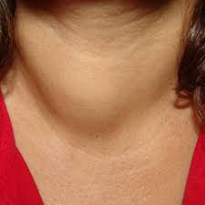
Thyroid Disorders
Dr. Mohammad Al- Akeely
Associate professor & consultant
General and laparoscopic surgeon

Slide 2
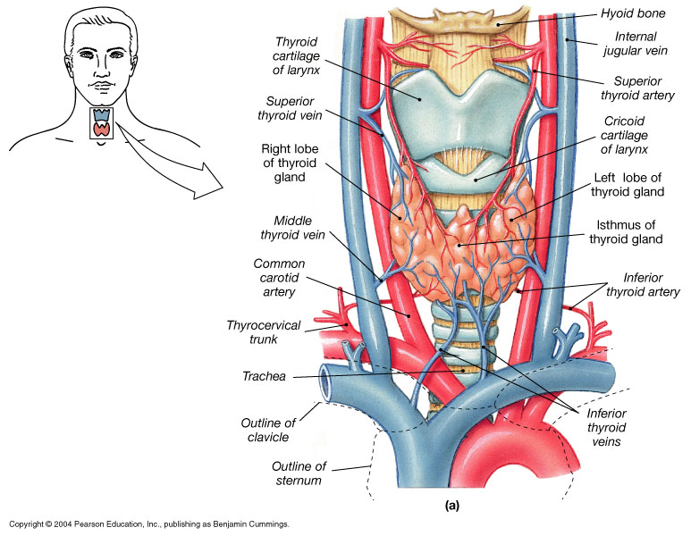

Slide 3
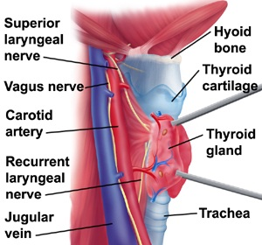

Slide 4
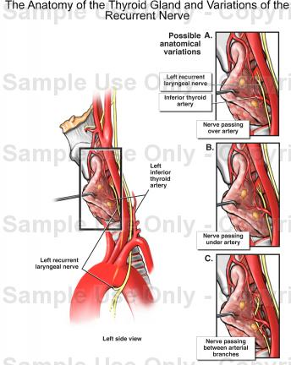

Slide 5
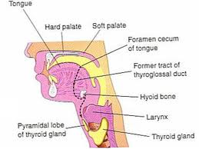
EMBRYOLOGY

Slide 6
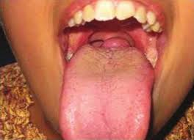
Lingual thyroid

Slide 7
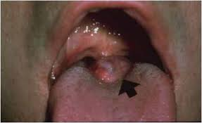

Slide 8

Thyro glossal cyst

Slide 9
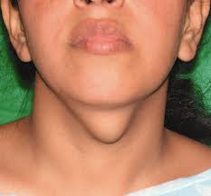
Clinical features? Operation?

Slide 10
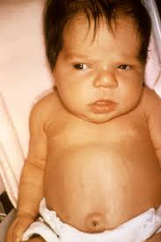
Cretinism

Slide 11
Introduction
  Nontoxic goitre
  Thyroid nodules & thyroid cancer
    Benign thyroid nodules
    Thyroid cancer
      Papillary carcinoma
      Follicular carcinoma
      Medullary carcinoma
      Anaplastic carcinoma
      Lymphoma
      Cancer metastatic to the thyroid
Thyroid disorders:
  Hypothyroidism
  Hyperthyroidism and thyrotoxicosis
    Graves’ disease
    Thyroiditis
    Toxic adenoma
    Toxic multinodular goitre
    Thyrotoxicosis factitia
    Struma ovarii
    Hydatidiform mole
    TSH-secreting pituitary adenoma

Slide 12
Hypothyroidism
Etiology:
  Primary:
    Hashimoto’s thyroiditis with or without goitre
    Radioactive iodine therapy for Graves’ disease
    Thyroidectomy for Graves’ disease or nodular goitre
    Subacute thyroiditis
    Rare causes
      Iodide deficiency
      Goitrogens such as lithium; antithyroid drug therapy
      Inborn errors of thyroid hormone synthesis
  Secondary: Hypopituitarism
  Tertiary: Hypothalamic dysfunction (rare)

Slide 13
Hashimoto’s Thyroiditis
Hashimoto’s thyroiditis is a commom cause of hypothyroidism and goitre especially in children and young adults.
It is an autoimmune disease that involves heavy infiltration of lymphocytes that totally destroys normal thyroidal architecture
It is familial and may be associated with other autoimmune diseases such as pernicious anemia, adrenocortical insufficiency, idiopathic hypoparathyroidism, and vitiligo.
.

Slide 14
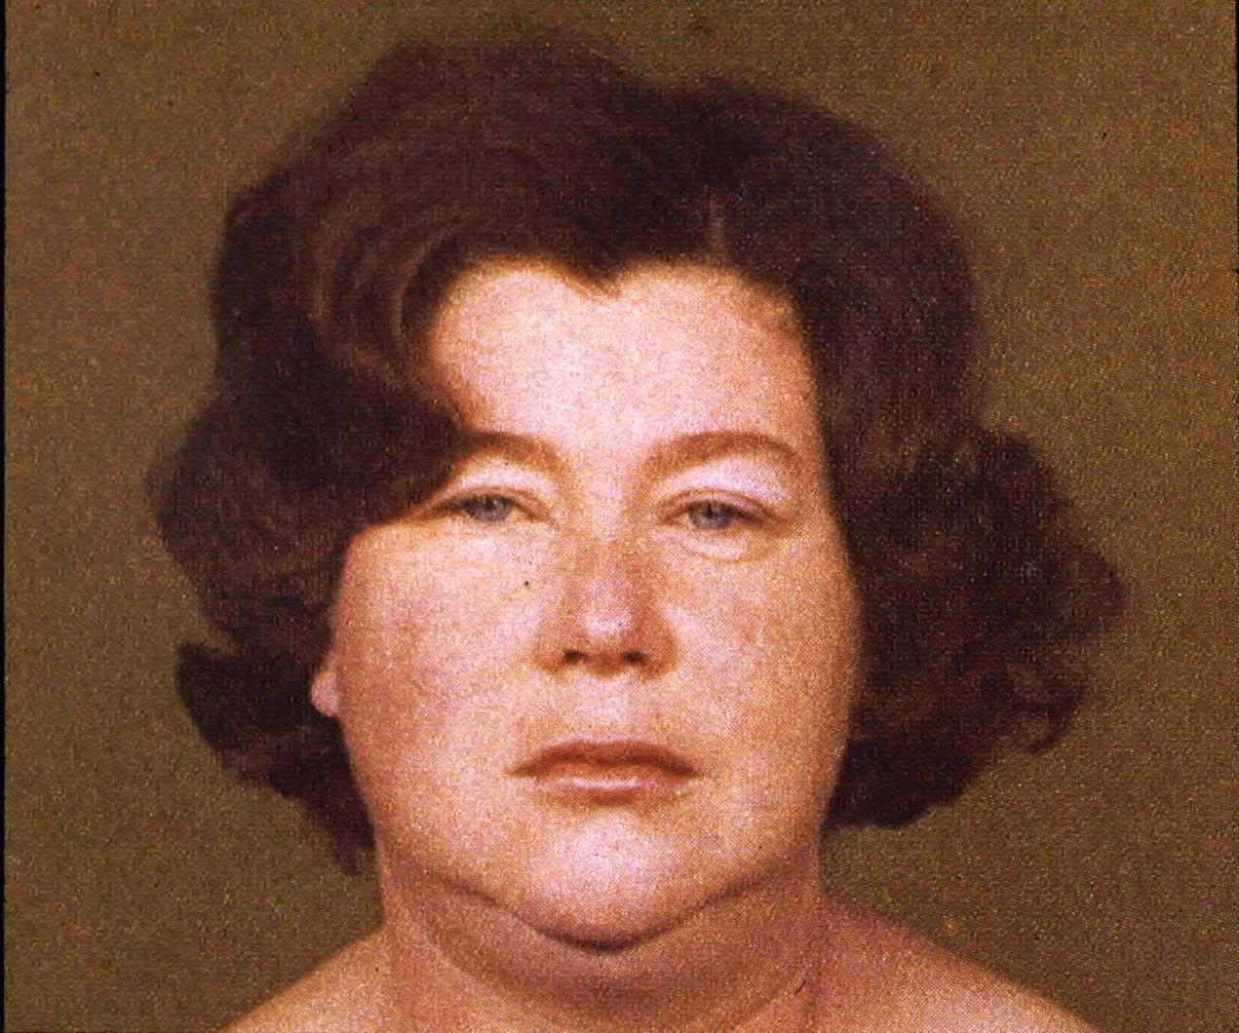

Slide 15
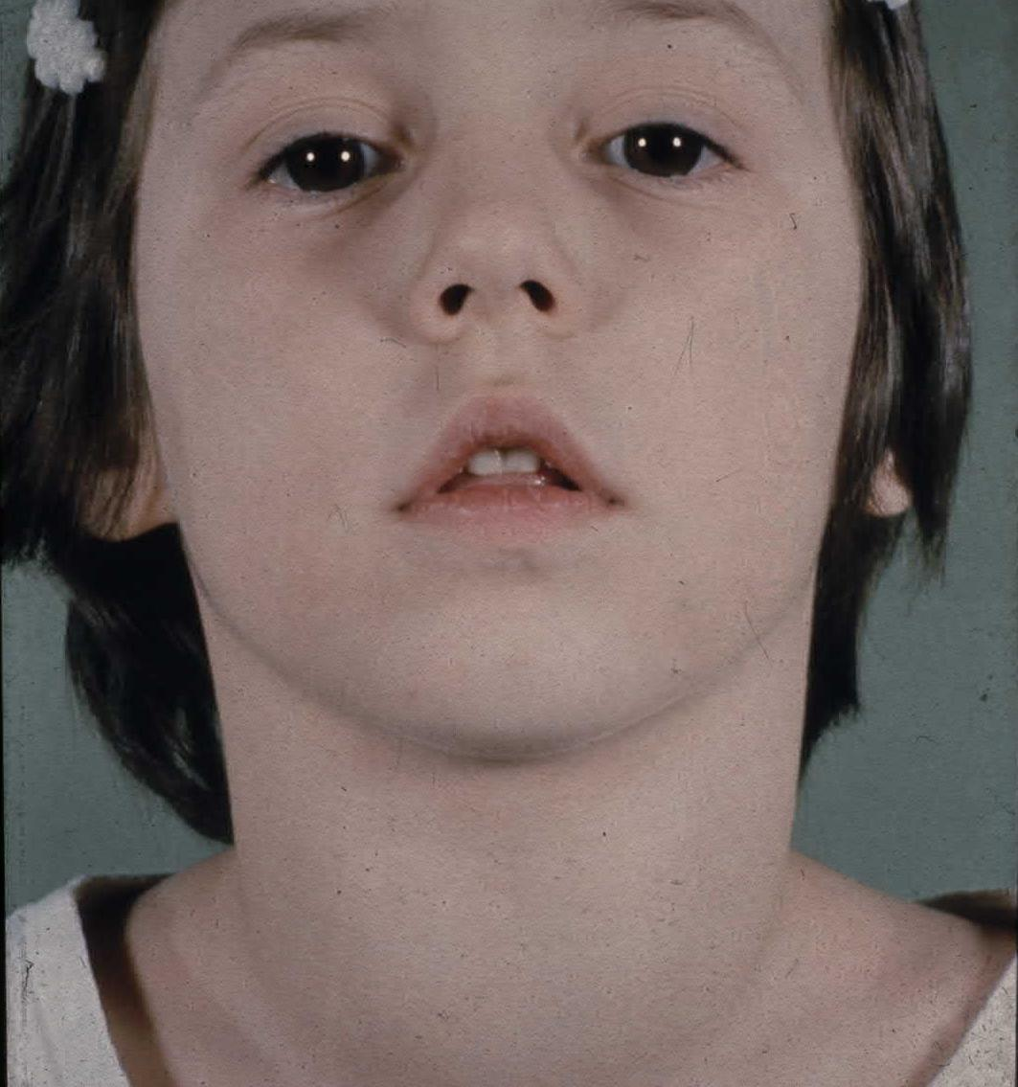

Slide 16
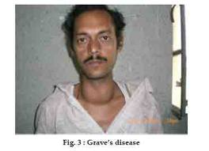
Graves’ Disease
Most common form of thyrotoxicosis
May occur at any age but mostly from 20-40
5 times more common in females than in males
Syndrome consists of one or more of the following:
  Thyrotoxicosis
  Goitre
  Opthalmopathy (exopthalmos) and
  Dermopathy (pretibial myxedema)
It is an autoimmune disease of unknown cause
15% of pts with Graves’ have a close relative with the same disorder

Slide 17
Graves’ Disease
Clinical features:
  I Eye features: Classes 0-6, mnemonic “NO SPECS”
    Class 0: No signs or symptoms
    Class 1: Only signs (lid retraction, stare, lid lag), no symptoms
    Class 2: Soft tissue involvement (periorbital edema, congestion
    or redness of the conjunctiva, and chemosis)
    Class 3: Proptosis (measured with Hertel exopthalmometer)
    Class 4: Extraocular muscle involvement
    Class 5: Corneal involvement
    Class 6: Sight loss (optic nerve involvement)
Notes:
18mm oriental, 20mm white, 22mm black, 3-4mm mild, 5-7 moderate, >7mm severe
Inferior rectus then medial rectus

Slide 18
Graves’ Disease
Clinical features:
  II Goitre:
    Diffuse enlargement of thyroid
    Bruit may be present
  III Thyroid dermopathy (pretibial myxedema):
    Thickening of the skin especially over the lower tibia
    The dermopathy may involve the entire leg and may extend onto the feet
    Skin cannot be picked up between the fingers
    Rare, occurs in 2-3% of patients
    Usually associated with opthalmopathy and very hTSH-R Ab

Slide 19
Graves’ Disease
Clinical features:
  IV Heat intolerance
  V Cardiovascular:
    Palpitation, Atrial fibrillation
    CHF, dyspnea, angina
  VI Gastrointestinal:
    Weight loss, happetite
    Diarrhea
  VII Reproductive:
    amenorrhea, oligo- menorrhea, infertility
    Gynecomastia
  VIII Bone:
    Osteoporosis
    Thyroid acropachy
  IX Neuromuscular:
    Nervousness, tremor
    Emotional lability
    Proximal myopathy
    Myasthenia gravis
    Hyper-reflexia, clonus
    Periodic hypokalemic paralysis
  X Skin:
    Pruritus
    Onycholysis
    Vitiligo, hair thinning
    Palmar erythema
    Spider nevi

Slide 20
Graves’ Disease
Diagnosis:
  Low TSH, High FT4 and/or FT3
  If eye signs are present, the diagnosis of Graves’ disease can be made without further tests
  If eye signs are absent and the patient is hyperthyroid with or without a goitre, a radioiodine uptake test should be done.
  Radioiodine uptake and scan:
    Scan shows diffuse uptake
    Uptake is increased
  TSH-R Ab (stim) is specific for Graves’ disease. May be a useful diagnostic test in the “apathetic” hyperthyroid patient or in the pt who presents with unilateral exopthalmos without obvious signs or laboratory manifestations of Graves’ disease

Slide 21
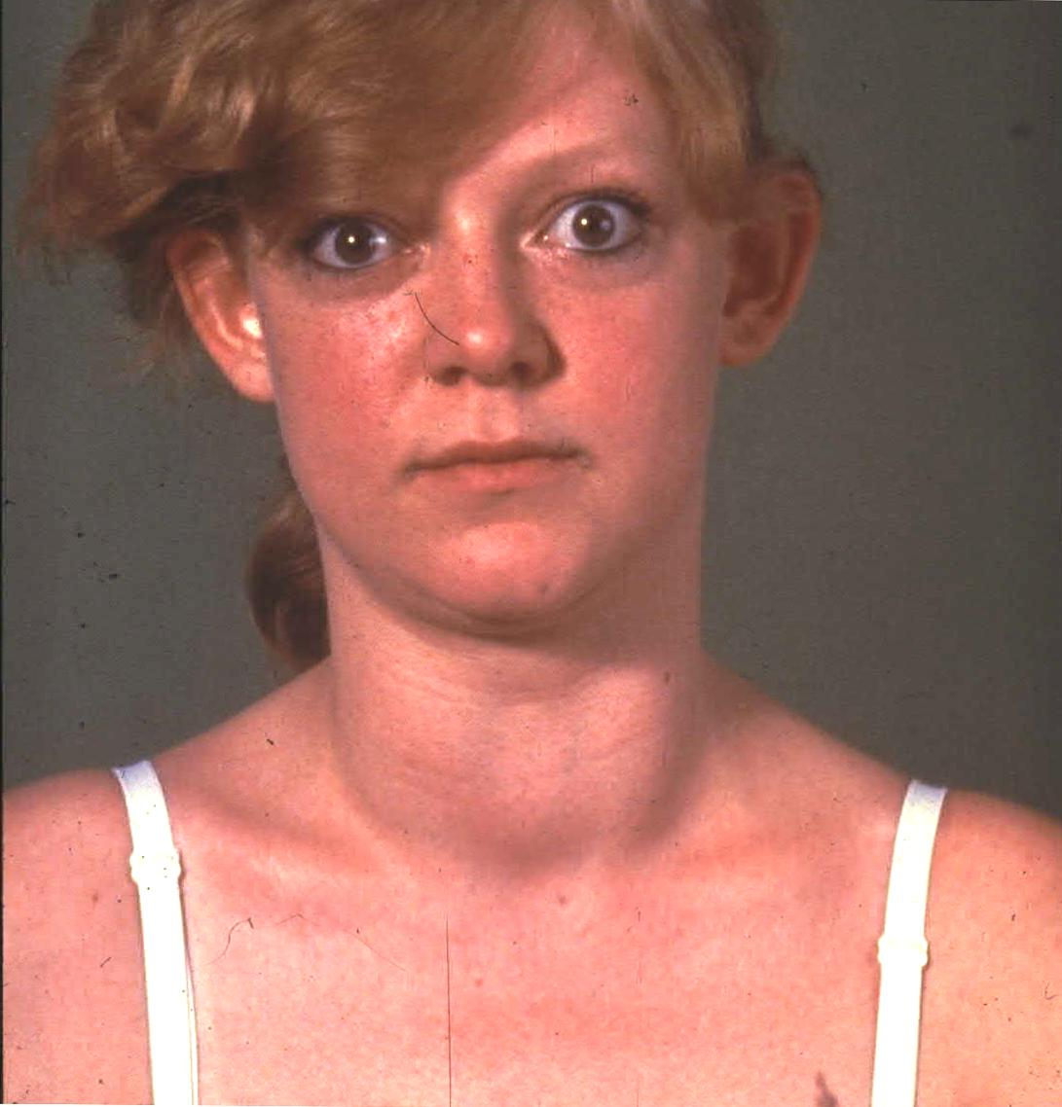

Slide 22
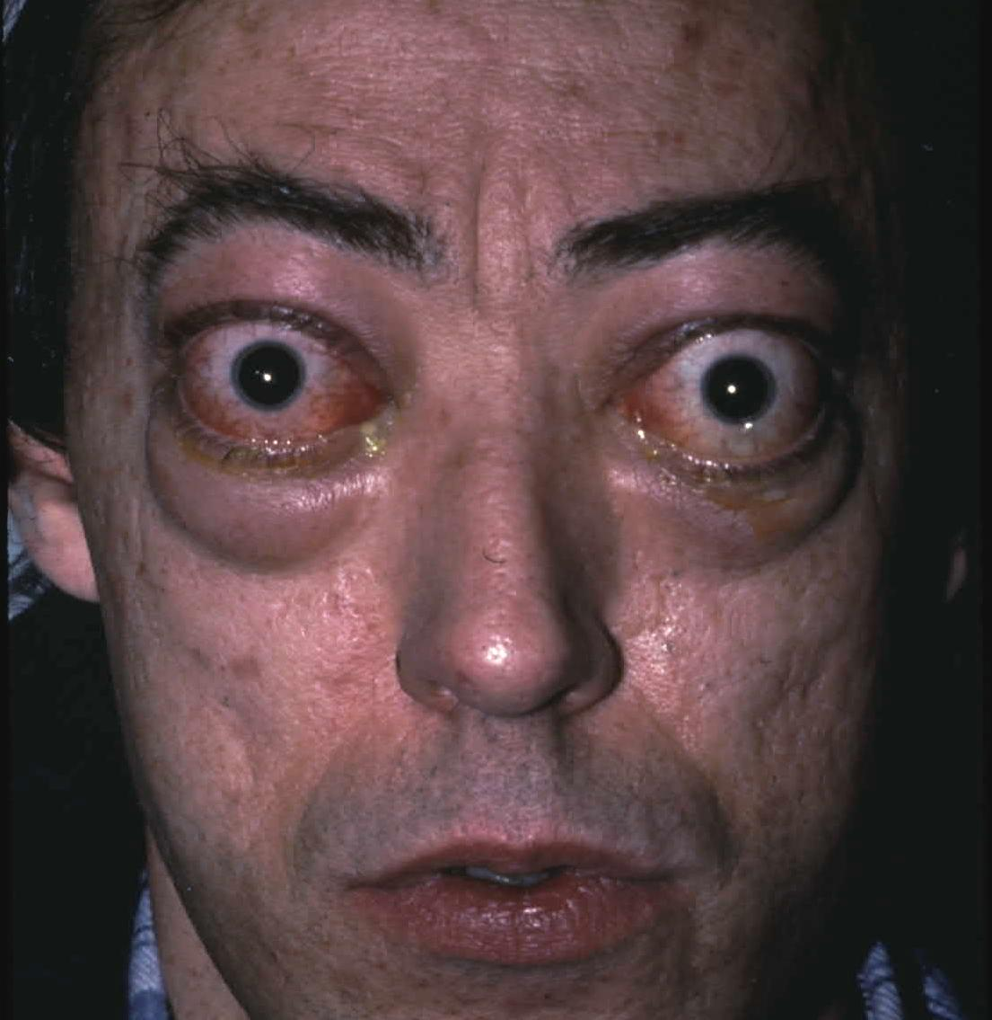

Slide 23
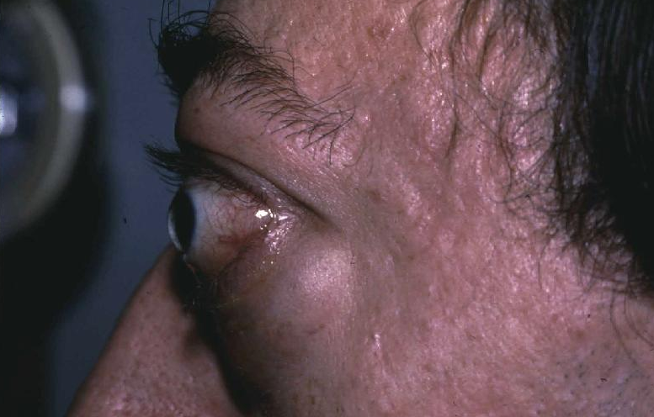

Slide 24
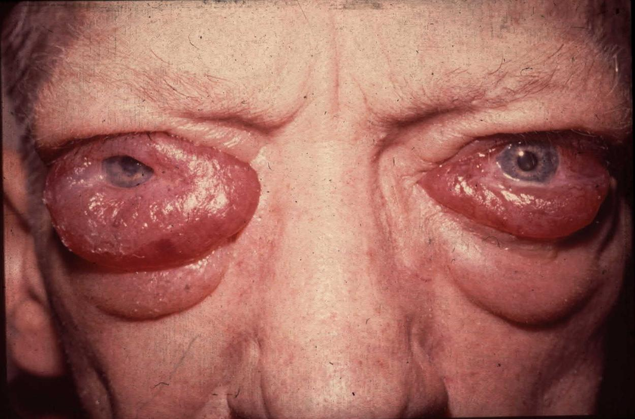

Slide 25
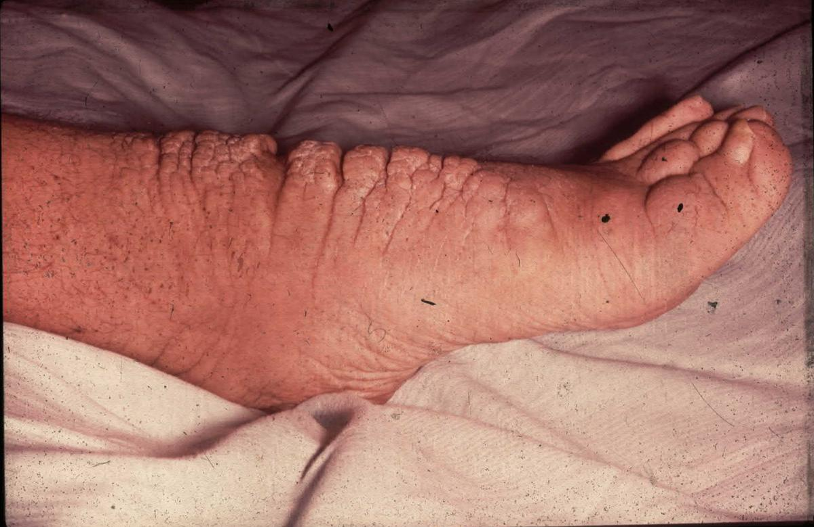

Slide 26
Treatment of Grave’s Disease
There are 3 treatment options:
  Medical therapy
  Surgical therapy
  Radioactive iodine therapy

Slide 27
Treatment of Grave’s Disease
A. Medical therapy:
  Antithyroid drug therapy:
    Most useful in patients with small glands and mild disease
    Treatment is usually continued for 12-18 months
    Relapse occurs in 50% of cases
    There are 2 drugs:
      Neomercazole (methimazole or carbimazole): start 30-40mg/D for 1-2m then reduce to 5-20mg/D.
      Propylthiouracil (PTU): start 100-150mg every 6hrs for 1-2m then reduce to 50-200 once or twice a day
      Monitor therapy with fT4 and TSH
      S.E.: 5%→rash, 0.5%→agranulocytosis (fever, sore throat), rare: cholestatic jaundice, hepatocellular toxicity, angioneurotic edema, acute arthralgia

Slide 28
Management of Grave’s disease
A. Medical therapy:
  Propranolol 10-40mg q6hrs to control tachycardia, hypertension and atrial fibrillation during acute phase of thyrotoxicosis. It is withdrawn gradually as thyroxine levels return to normal

Slide 29
Management of Grave’s disease
B. Surgical therapy:
  Subtotal thyroidectomy is the treatment of choice for patients with very large glands
  The patient is prepared with antithyroid drugs until euthyroid (about 6 weeks). In addition 2 weeks before the operation patient is given Lugols iodine (KI)5 drops BID to diminish vascularity of thyroid gland
  Complications (1%):
    Hypoparathyroidism
    Recurrent laryngeal nerve injury
    Hypothyroidisim

Slide 30
Management of Grave’s Disease
C. Radioactive iodine therapy:
  Preferred treatment in most patients
  Can be administered immediately except in:
    Elderly patients
    Patients with IHD or other medical problems
    Severe thyrotoxicosis
    Large glands >100g
    In above cases it is desirable to achieve euthyroid state first
  Hypothyroidism occurs in over 80% of cases.
  Female should not get pregnant for 6-12m after RAI.

Slide 31
Toxic Adenoma
(Plummer’s Disease)
This is a functioning thyroid adenoma
Typical pt is an older person (usually > 40) who has noted recent growth of a long-standing thyroid nodule
Thyrotoxic symptoms are present but no infiltrative opthalmopathy. PE reveals a nodule on one side
Lab: low TSH, high T3, slightly high T4
Thyroid scan reveals “hot” nodule with suppressed uptake in contralateral lobe
Toxic adenomas are almost always follicular adenomas and almost never malignant
Treatment: same as for Grave’s disease

Slide 32
Toxic Multinodular Goitre
Usually occurs in older pts with long-standing MNG
PE reveals a MNG that may be small or quite large and may even extend substernally
RAI scan reveals multiple functioning nodules in the gland or patchy distribution of RAI
Treatment: Same as for Grave’s disease. Surgery is preferred.

Slide 33
Thyroid storm (Thyrotoxic crisis)
Usually occurs in a severely hyperthyroid patient caused by a precipitating event such as:
  Infection
  Surgical stress
  Stopping antithyroid medication in Graves’ disease
Clinical clues
  fever→ hyperthermia
  marked anxiety or agitation→ coma
  Anorexia
  tachycardia→ tachyarrhythmias
  pulmonary edema/cardiac failure
  hypotension→ shock
  confusion

Slide 34
Thyroid storm (Thyrotoxic crisis)
Initiate prompt therapy after free T4, free T3, and TSH drawn without waiting for laboratory confirmation.
Therapy
1. General measures:
    Fluids, electrolytes
    A cooling blanket to treat the pyrexia
    Propranolol

Slide 35
Nontoxic Goitre
Enlargement of the thyroid gland from TSH stimulation which in turn results from inadequate thyroid hormone synthesis
Etiology:
  Iodine deficiency
  Goitrogen in the diet
  Hashimoto’s thyroiditis
  Subacute thyroiditis
  Inadequate hormone synthesis due to inherited enzyme defects
  Neoplasm, benign or malignant

Slide 36
Nontoxic Goitre
Symptoms and Signs:
  Thyroid enlargement, diffuse or multinodular
  Huge goitres may produce a positive Pemberton sign (facial flushing and dilation of cervical veins on lifting the arms over the head) especially when they extend inferiorly retrosternally
  Pressure symptoms in the neck with upward or downward movement of the head
  Difficulty swallowing, rarely vocal cord paralysis
  Most pts are euthyroid but some are mildly hypothyroid

Slide 37
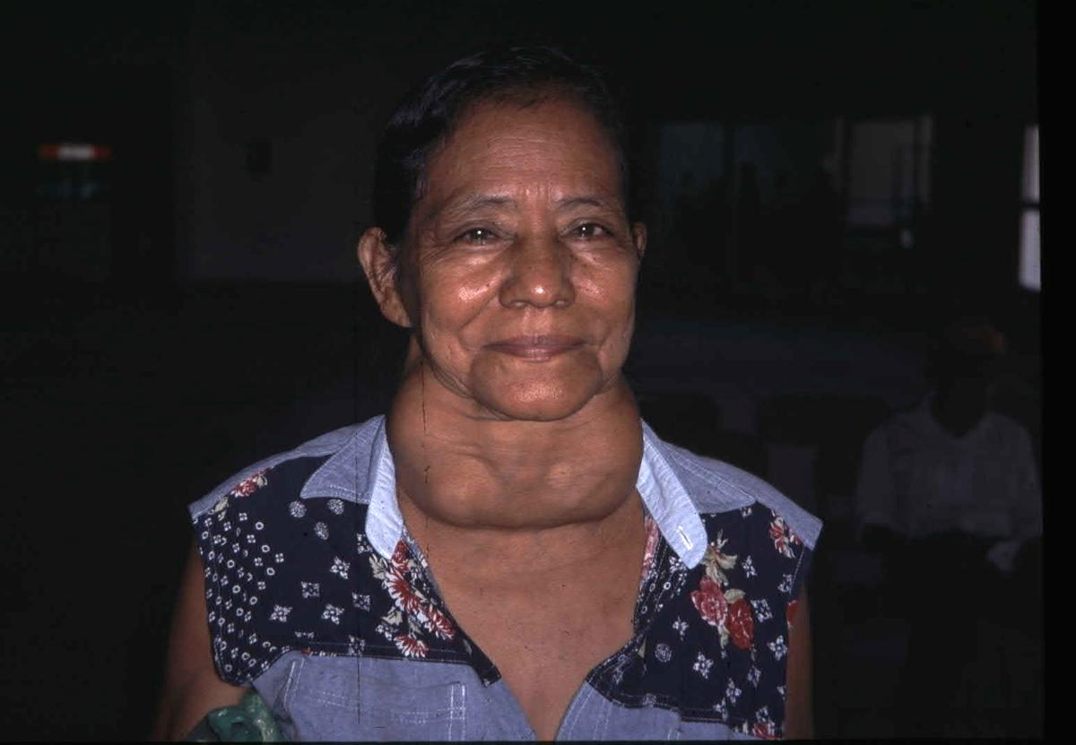

Slide 38
Management of Nontoxic Goitre
L-thyroxine suppressive therapy:
  Doses of 0.1 to 0.2mg daily is required
  Aim is to suppress TSH to 0.1-0.4 microU/L (N 0.5-5)
Suppression therapy works in 50% of cases if continued for 1 year
If suppression does not work or if there are obstructive symptoms from the start then surgery is necessary

Slide 39
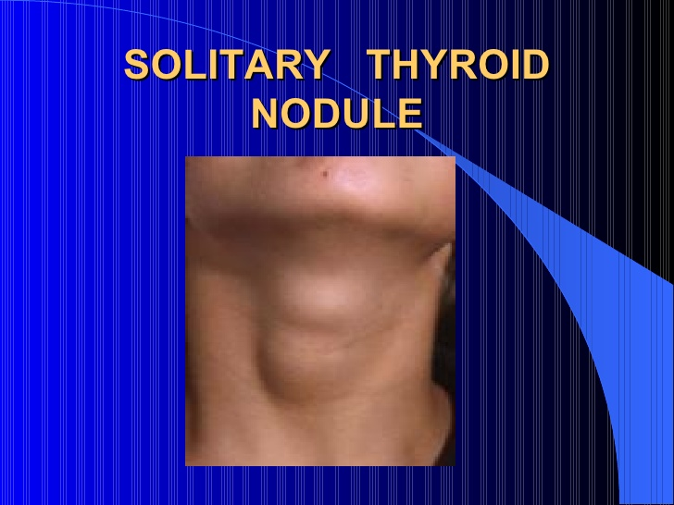

Slide 40
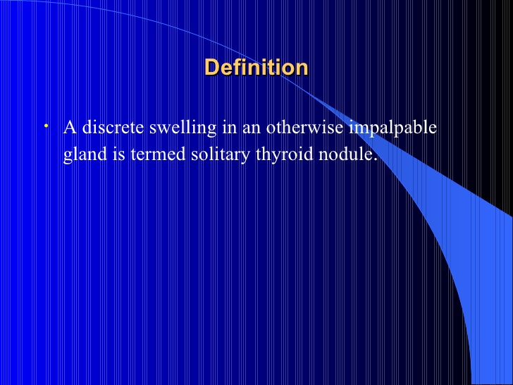

Slide 41
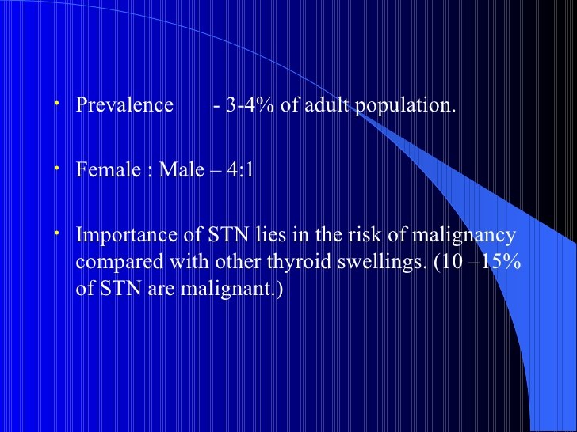

Slide 42
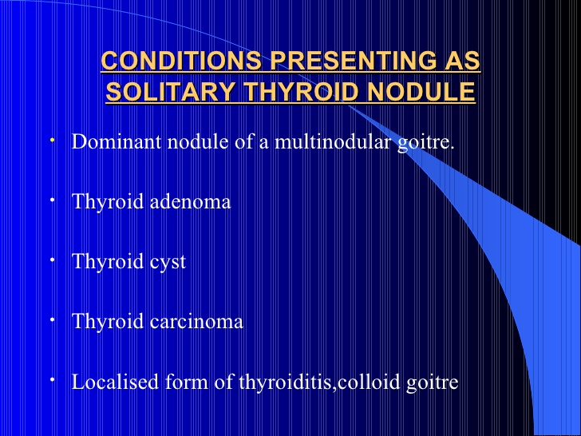

Slide 43
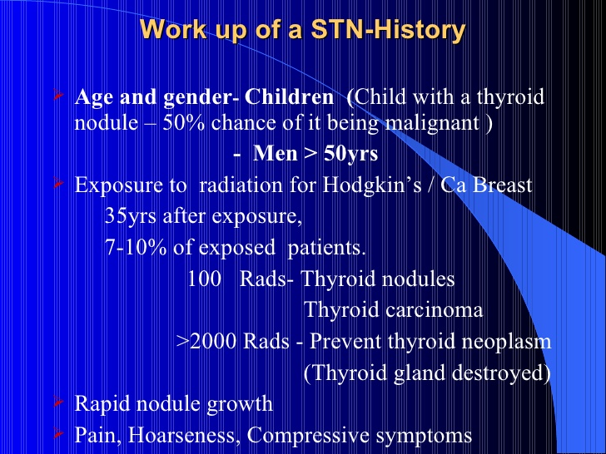

Slide 44
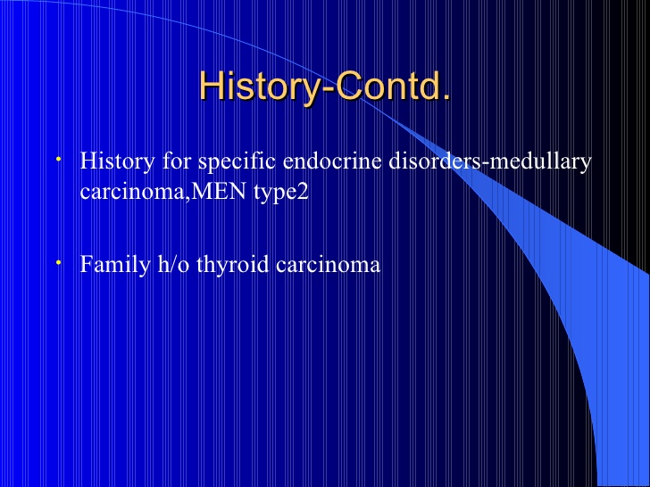

Slide 45
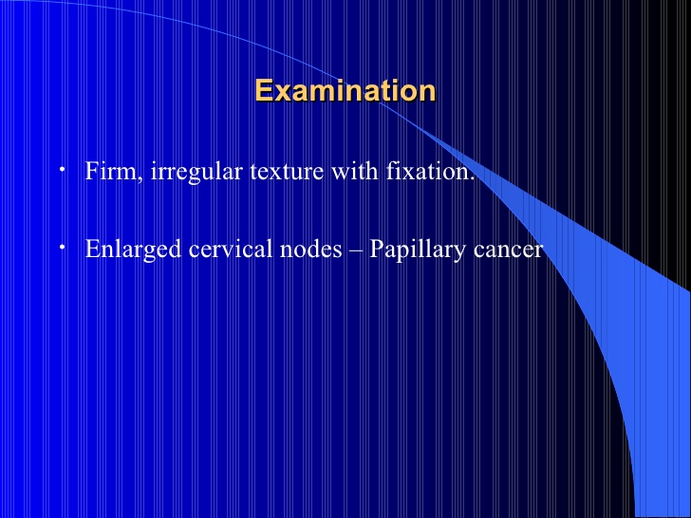

Slide 46
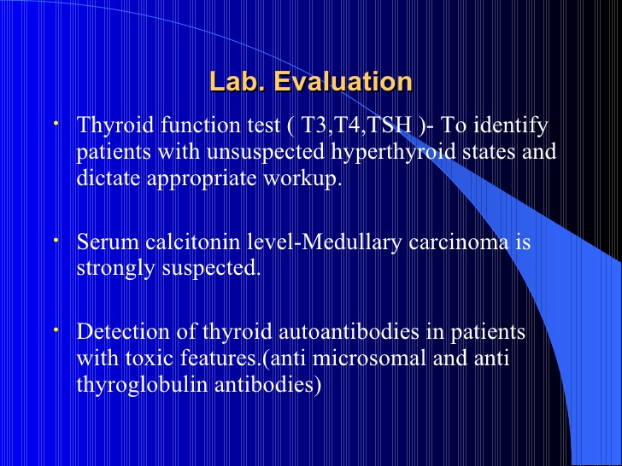

Slide 47
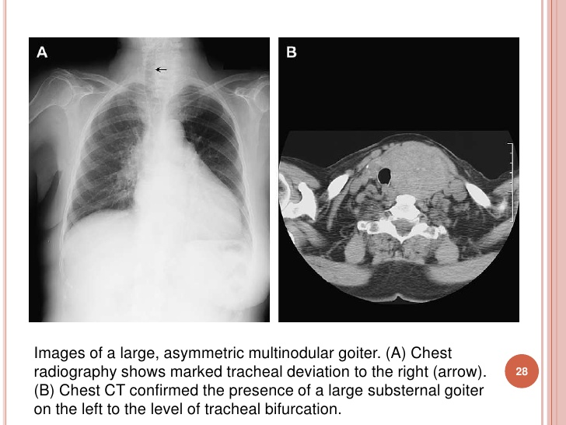

Slide 48
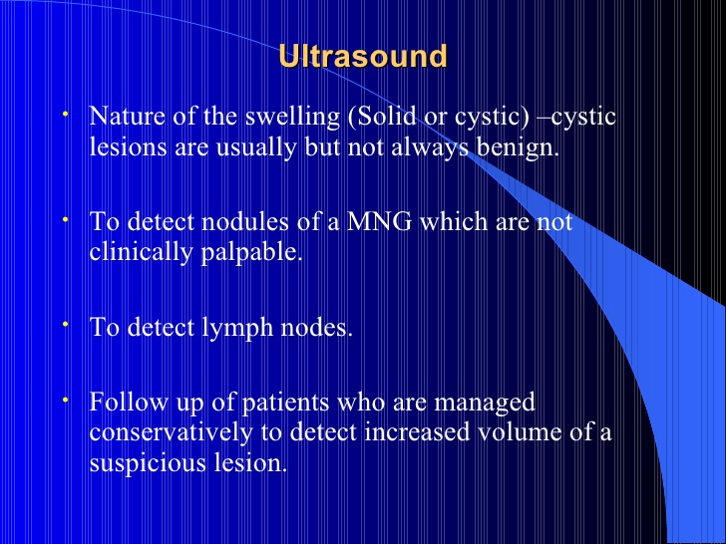

Slide 49
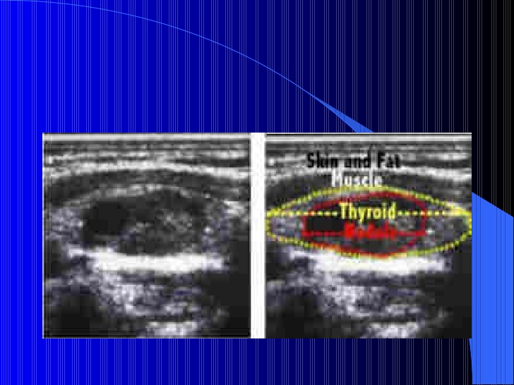

Slide 50
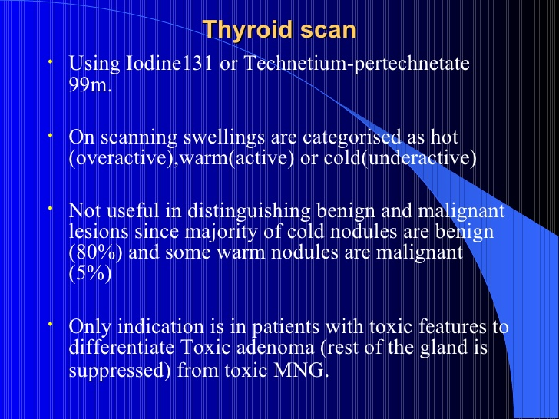

Slide 51
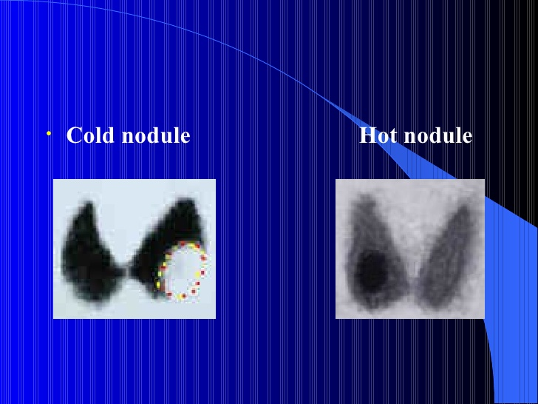

Slide 52
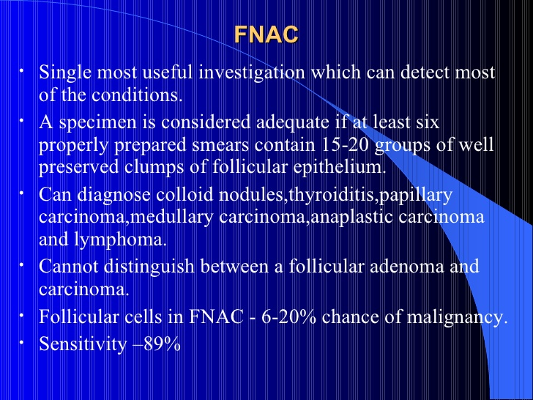

Slide 53
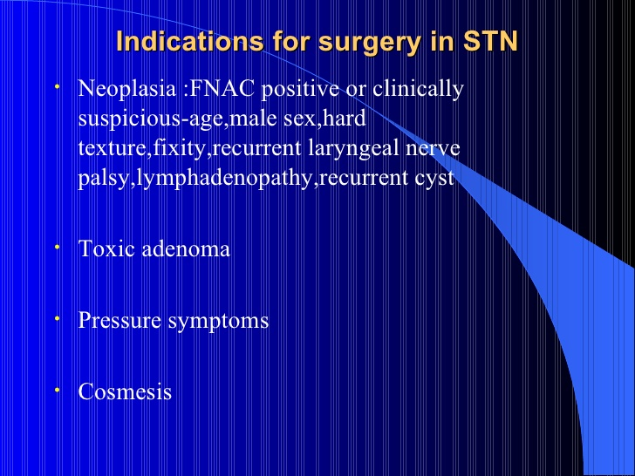

Slide 54
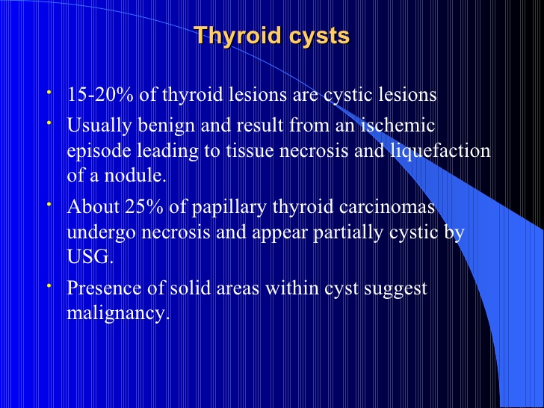

Slide 55
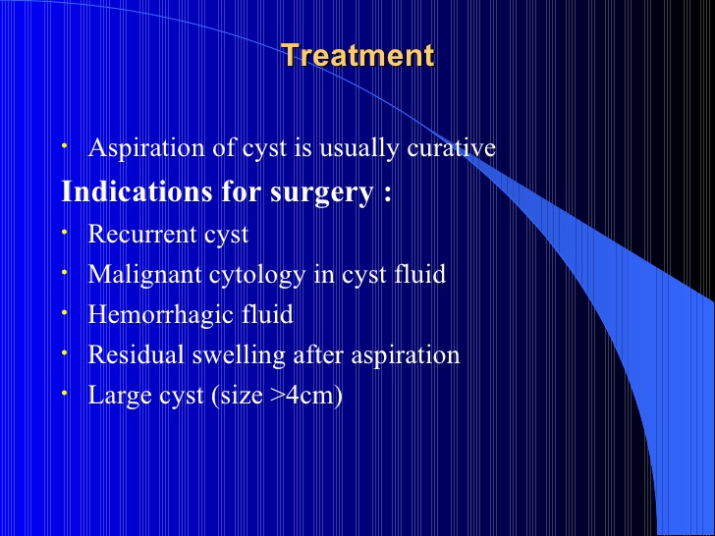

Slide 56
Thyroid Cancer
Approximate frequency of malignant thyroid tumours
Papillary carcinoma (including mixed papillary and follicular | 75%
Follicular carcinoma | 16%
Medullary Carcinoma | 5%
Undifferentiated carcinomas | 3%
Miscellaneous (e.g. lymphoma, fibrosarcoma, squamous cell ca, teratoma, & metastatic ca) | 1%

Slide 57
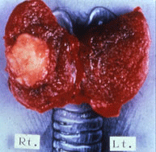

Slide 58
Papillary Carcinoma
Usually presents as a nodule that is firm, solitary, “cold” on isotope scan, and usually solid on thyroid US
In MNG, the cancer is usually a “dominant nodule” that is larger, firmer and different from the rest of the gland
10% of papillary ca present with enlarged cervical nodes
Grows very slowly and remains confined to the thyroid gland and local lymph nodes for many years.
In later stages they can spread to the lung
Death usually from local disease or lung metastases
May convert to undifferentiated carcinoma
Many of these tumours secrete thyroglobulin which can be used as a marker for recurrence or metastasis of the cancer

Slide 59
Follicular Carcinoma
Differs from follicular adenoma by the presence of capsular or vascular invasion
More aggressive than papillary ca and can spread either by local invasion of lymph nodes or by blood vessel invasion with distant metastases to bone or lung
Death is due to local extension or to distant bloodstream metastasis with extensive involvement of bone, lungs & viscera
Thyroglobulin secretion by follicular carcinoma can be used to follow the course of the disease

Slide 60
Management of Papillary and Follicular Carcinoma
Patients are classified into low risk and high risk groups
The low risk group includes patients under age 45 with primary lesions under 1cm and no evidence of intra- or extraglandular spread. (Lobectomy + isthemectomy) is adequate therapy for these patients.
All other patients are considered high risk and require (total thyroidectomy). Modified neck dissection is indicated if there is lymphatic spread.
Surgery is usually followed by RAI ablation therapy
Patient is placed on L-thyroxine suppressive therapy
Regular F/U with thyroglobulin level, thyroid US, whole body scan etc.

Slide 61
Medullary Carcinoma
A disease of the C cells (parafollicular cells)
More aggressive than papillary or follicular carcinoma but not as aggressive as undifferentiated thyroid cancer
It extends locally, and may invade lymphatics and blood vessels
Calcitonin and CEA are clinically useful markers for DX and F/U
80% of medullary ca are sporadic and the rest are familial.
Rx : TOTAL THYROIDECTOMY.

Slide 62
Undifferentiated (Anaplastic) Carcinoma
This tumour usually occurs in older patients with a long history of goitre in whom the gland suddenly—over weeks or months—begins to enlarge and produce pressure symptoms, dysphagia, or vocal cord paralysis.
Death from massive local extension usually occurs within 6-36 months
These tumours are very resistant to therapy

Slide 63
Thank you

Slide 64
Example of exam MCQ
The following are imprtant initial specific investigations in an euthyroid patient with a clinically solitary thyroid nodule EXEPT:
a. Thyroid function test.
b. Thyroid lsotope scan.
c. Fine needle aspiration of nodule.
d. ultra sound scan of thyroid.

Slide 65
Example of exam MCQ
The following are imprtant initial specific investigations in an euthyroid patient with a clinically solitary thyroid nodule EXEPT:
a. Tyroid function test.
b. Thyroid lsotope scan.
c. Fine needle aspiration of nodule.
d. ultra sound scan of thyroid.

