Slide 1
SYSTEMIC VASCULITIS
Dr. Zahoor

Slide 2
SYSTEMIC VASCULITIS
What is Vasculitis?
It is inflammatory disorder of blood vessels which causes endothelial damage.
Vasculitis is histological term describing inflammation of the vessel wall.
In Vasculitis, there is damage to skin, kidney, lung, heart, brain and gastrointestinal tract.

Slide 3
SYSTEMIC VASCULITIS
Vasculitis may be mild and transient affecting the skin or life threatening disease with multiple organ failure.
Vasculitis may occur secondary to SLE, RA, hepatitis B or C due to deposition of immune complexes in small vessels.
Primary Vasculitis occurs in absence of known cause. It is uncommon, incidence is 18 to 40 cases per million per year.
Peak onset occurs between the ages of 50 – 70.

Slide 4
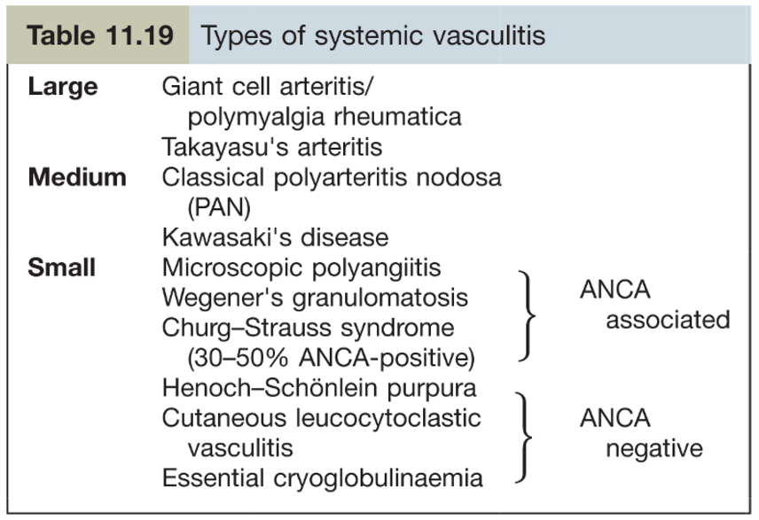
SYSTEMIC VASCULITIS
Vasculitis is usually classified on the basis of the size of vessel involved.

Slide 5
SYSTEMIC VASCULITIS
The clinical features of Vasculitis result from combination of local tissue ischemia and the systemic effects of wide spread inflammation.
Systemic Vasculitis should be considered in any patient with fever, weight loss, fatigue, evidence of multi system involvement, rashes, raised inflammatory markers and abnormal urine analysis.

Slide 6
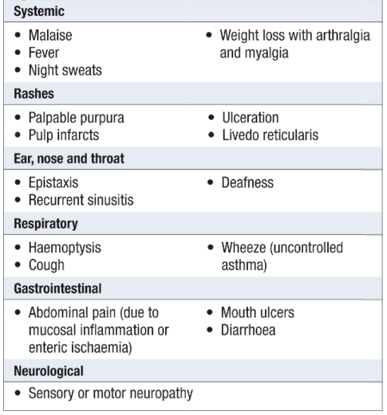
SYSTEMIC VASCULITIS
Clinical Features of Vasculitis

Slide 7
Large Vessel Vasculitis

Slide 8
SYSTEMIC VASCULITIS
We will discuss Large Vessel Vasculitis:
Polymyalgia rheumatica (PMR) and giant cell temporal arteritis are systemic illness of the elderly.
Polymyalgia Rheumatica (PMR)
Usually seen in people over 50 years.
Muscle pain is usually located in neck, shoulder, upper arms and hips but may be all over body
There is thickened temporal artery.
Sudden loss of vision (blindness) occurs.
Jaw claudication.

Slide 9

SYSTEMIC VASCULITIS
Polymyalgia Rheumatica

Slide 10
SYSTEMIC VASCULITIS
Giant Cell Arteritis (GCA)
GCA is inflammatory Granulomatous arteritis of large cerebral arteries which occur in association with Polymyalgia Rheumatica.
Usually occurs after 50 years of age.
Clinical features
Headache
Tenderness of scalp – combing the hair may be painful
Claudication of jaw when eating
Tenderness and swelling of temporal or occipital arteries
Sudden painless loss of vision in one eye (temporary or permanent) due to involvement of ophthalmic artery

Slide 11
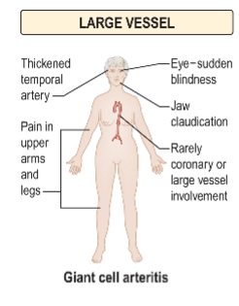
SYSTEMIC VASCULITIS
Clinical Features :

Slide 12
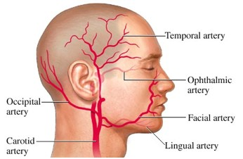
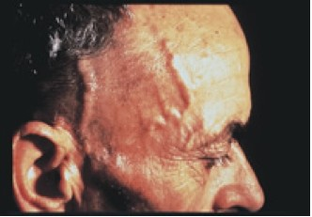
SYSTEMIC VASCULITIS
Giant Cell Arteritis (GCA)

Slide 13
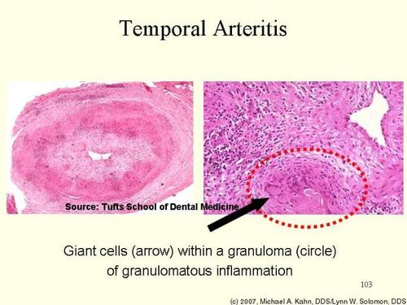
SYSTEMIC VASCULITIS

Slide 14
SYSTEMIC VASCULITIS
Investigations:
ESR is raised
CRP is high
Anemia – normocytic Normochromic
Temporal artery biopsy from the affected side is definite diagnostic test
Histological features of GCA are cellular infiltrate of CD4 T-lymphocyte, macrophages and giant cells in the vessel walls

Slide 15
SYSTEMIC VASCULITIS
Treatment for Polymyalgia Rheumatica or Giant
Cell Arteritis
1. Corticosteroids
They produce dramatic reduction of symptoms in 24-48 hours. If no improvement occurs, diagnosis should be questioned and alternate cause sought

Slide 16
SYSTEMIC VASCULITIS
2.Takayasu’s Arteritis (Large Vessel)
Takayasu disease affects the aorta, its major branches, carotid, brachial, axillary, ulnar , radial arteries occasionally pulmonary arteries
It is known as pulse less disease or Aortic arch syndrome.
It is rare except in Japan
Aetiology is unknown and occurs in female
It is characterized by Granulomatous inflammation of vessel wall leading to vessel blockage
Clinical Examination
Absent peripheral pulses are common
Hypertension
Bruits
Aortic incompetence

Slide 17
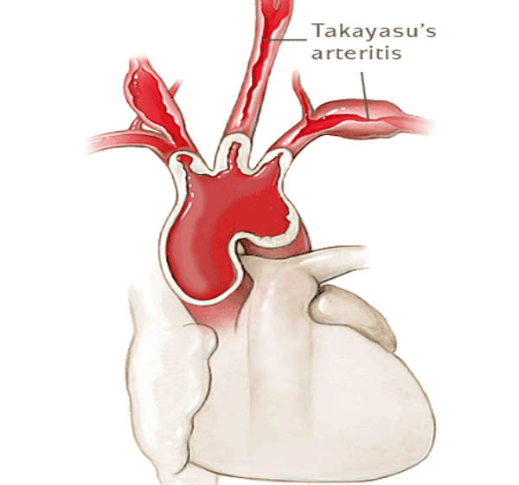
SYSTEMIC VASCULITIS
Takayasu’s Arteritis

Slide 18
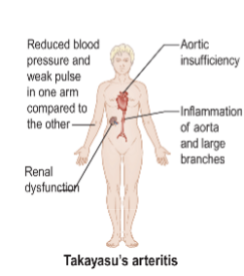
SYSTEMIC VASCULITIS

Slide 19
SYSTEMIC VASCULITIS
Investigations:
Diagnosis is based on arteriographic narrowing of aorta , its primary branches or large arteries in upper and lower limbs
Treatment:
Corticosteroids help in constitutional symptoms

Slide 20
Medium Size Vessel Vasculitis

Slide 21
SYSTEMIC VASCULITIS
Medium Size Vessel Vasculitis
1.Polyarteritis nodosa (PAN)
Usually occurs in middle aged men
It is accompanied by severe systemic manifestations and has occasional association with hepatitis B

Slide 22
SYSTEMIC VASCULITIS
Clinical Features PAN
Fever, maliase, weight loss, myalgia
These initial symptoms are followed by acute features that are due to organ infarction
- Neurological – mononeuritis multiplex due to arteritis of vasanervosum
- Abdominal – pain due to arterial involvement of abdominal viscera, mimicking acute cholecystitis, pancreatitis

Slide 23
SYSTEMIC VASCULITIS
PAN (cont)
Renal – Haematuria and protein urea, hypertension, acute and chronic kidney disease occurs
Cardiac – Coronary arteritis causes MI and heart failure. Pericarditis also occurs
Skin – Subcutaneous hemorrhage , livedo – reticularis and gangrene occurs
Lung – Involvement is rare

Slide 24
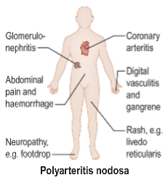
SYSTEMIC VASCULITIS

Slide 25
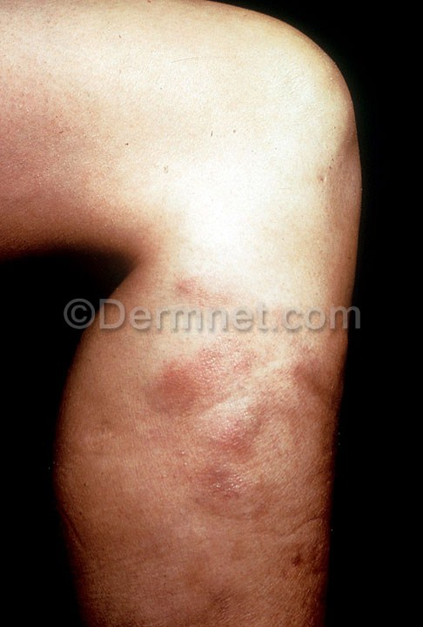
SYSTEMIC VASCULITIS
Polyarteritis nodosa
Skin - Livedoreticularis

Slide 26
SYSTEMIC VASCULITIS
PAN (cont)
Investigations
Blood count – Anemia, Leukocytosis and raised ESR
Biopsy from affected organ shows features of Vasculitis (fibrinoid nacrosis of vessel wall with microaneurysm, thrombosis and infarction)
Angiography shows microaneurysms
ANCA is rarely positive
Treatment – Corticoid steroids, immunosuppressive drugs e.g. Azathioprine

Slide 27
SYSTEMIC VASCULITIS
2.Kawasaki’s Disease (Medium vessel)
It affects mainly children under 5 years of age, but can be seen in adults
It is very frequent in Japan
Clinical features
- Fever
- Bilateral conjunctival congestion
- Dryness and redness of lips and oral cavity
- Acute cervical lymphadenopathy
- Polymorphic rash involving any part of the body
- Redness and edema of palms and soles
- CVS changes include coronary arteritis and pericarditis

Slide 28
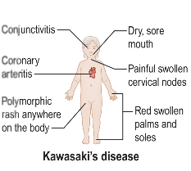
SYSTEMIC VASCULITIS

Slide 29
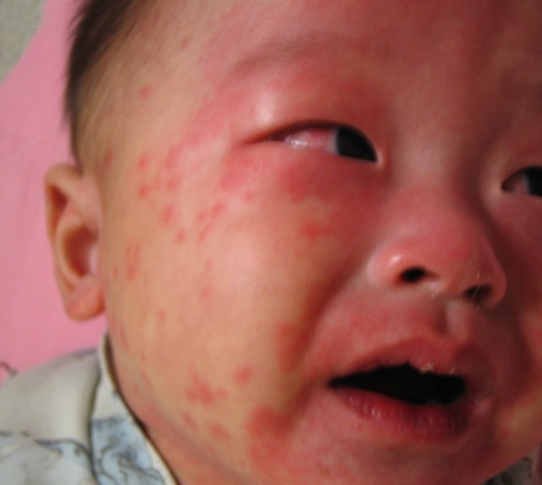
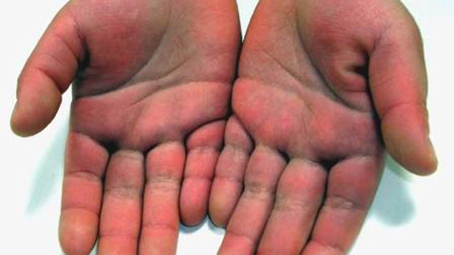
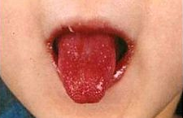
SYSTEMIC VASCULITIS
Kawasaki’s Disease

Slide 30
SYSTEMIC VASCULITIS
Kawasaki’s Disease (cont)
Investigations
Leukocytosis
Thrombocytosis
Raised CRP
Anti endothelial cell anti bodies are often present
Treatment – single high dose IV immunoglobulin. After the acute phase, aspirin 200 – 300mg daily
Corticosteroids are not helpful

Slide 31
Small Size Vessel Vasculitis

Slide 32


SYSTEMIC VASCULITIS
Small Size Vessel Vasculitis
They can be divided into
1. ANCA positive
2. ANCA negative

Slide 33
SYSTEMIC VASCULITIS
What is ANCA (Anti-Neutrophil Cytoplasmic
Antibodies)?
They are predominantly IgG auto anti-bodies against the primary granules of neutrophil and macrophage Lysosomes

Slide 34
SYSTEMIC VASCULITIS
1.Wegener’s Granulomatosis -Small Vessel ANCA+
Wegener is characterized by lesions involving the upper respiratory tract, lungs, and kidney
It usually starts with rhinorrhoea, nasal mucosal ulceration followed by cough, hemoptysis and pleuritic pain
Single or multiple pneumonic infiltrate with cavitation are seen on X-ray. They appear to migrate at one area and new lesions appearing at other place

Slide 35
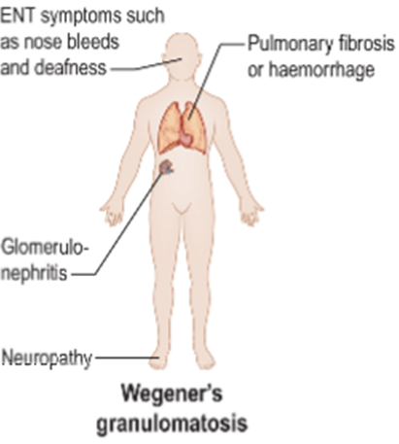
SYSTEMIC VASCULITIS

Slide 36
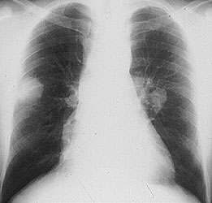
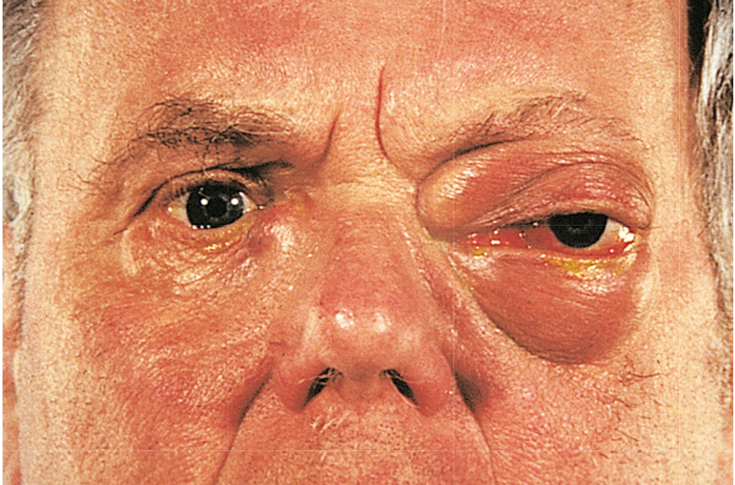
SYSTEMIC VASCULITIS
Eye involvement in Wegener
chest x–ray showing bilateral lung nodules in a 27 year old Indian man with Wegener’s granulomatosis.

Slide 37
SYSTEMIC VASCULITIS
Wegener’s Granulomatosis (Small Vessel) (cont)
Investigation
Renal biopsy shows necrotizing microvascular glomerulo nephritis
Treatment
Immunosuppresive-Cyclophosphamide

Slide 38
SYSTEMIC VASCULITIS
2.Churg Strauss Syndrome (Small Vessel,ANCA+)
It occurs in males in 4th decade
Presents with rhinitis and asthma, Eosinophilia and Systemic Vasculitis
It involves lungs, peripheral nerves and skin
Renal involvement in uncommon
Transient pneumonia like shadows may occur
Skin lesion include tender subcutaneous nodules and Purpuric lesions
Treatment – Corticosteroids

Slide 39
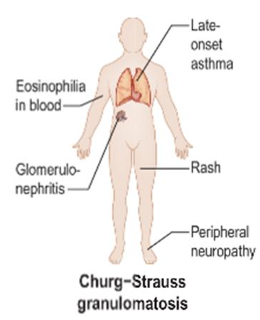
SYSTEMIC VASCULITIS

Slide 40
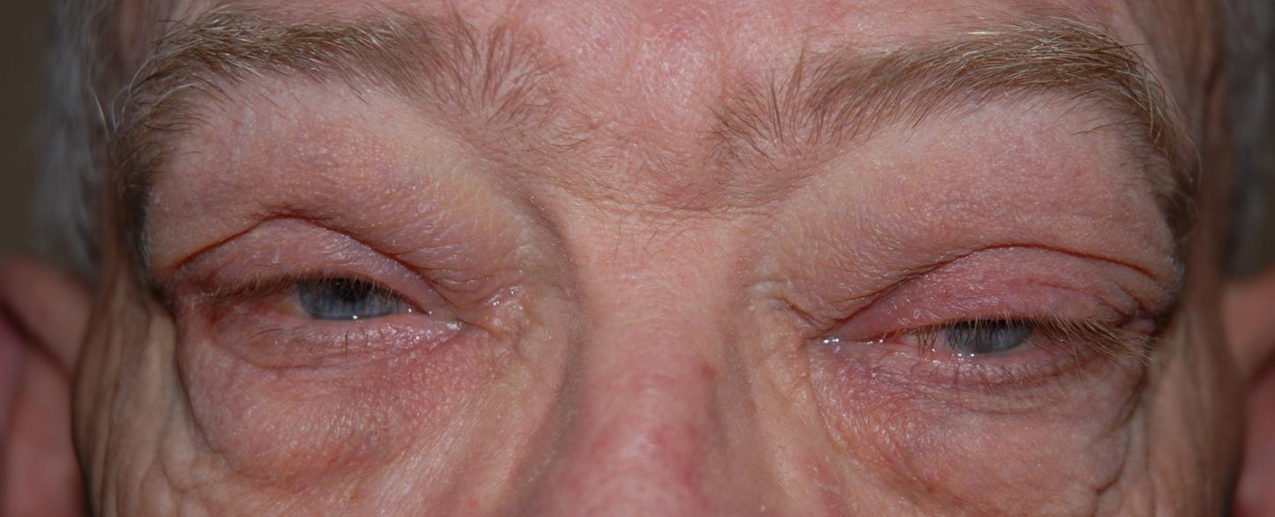
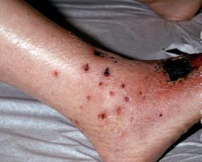
SYSTEMIC VASCULITIS
periorbital erythema, mild periorbital edema, and left-sided ptosis
Churg Strauss Syndrome

Slide 41
SYSTEMIC VASCULITIS
3.Microscopic Polyangitis -Small Vessel ANCA+
This involves
Kidneys
Lungs which result in recurrent hemoptysis

Slide 42
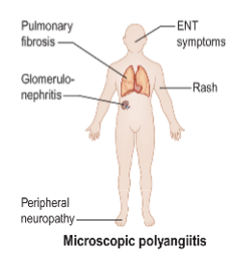
SYSTEMIC VASCULITIS

Slide 43
SYSTEMIC VASCULITIS
ANCA Negative , small vessel Vasculitis
1. Henoch-Schonlein Purpura
It occurs mainly in children, it is type III Hypersensitivity immune complex reaction
There is acute respiratory tract infection
Purpura is mainly seen on legs and buttocks
Abdominal pain, arthritis, hematuria and glomerulonephritis also occur
Recovery is usually spontaneous but some patients develop renal failure

Slide 44
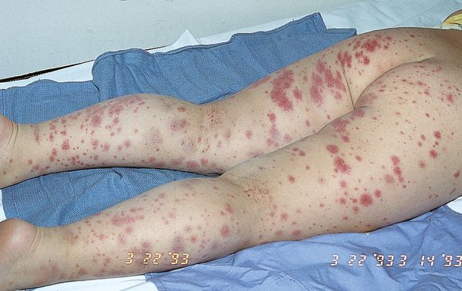
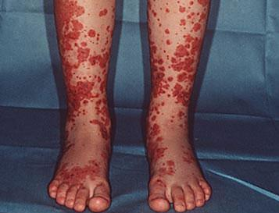
SYSTEMIC VASCULITIS
Henoch-Schonlein Purpura

Slide 45
SYSTEMIC VASCULITIS
ANCA Negative Vasculitis
1. Henoch-Schonlein Purpura (cont)
Investigation
Immunoglobulin IgA deposition occur in glomerular mesangium in kidney
Treatment
– Steroids are helpful
– Immunosuppressive therapy

Slide 46
SYSTEMIC VASCULITIS
2.Cryoglobulinaemia (ANCA negative , small vessel)
Cryoglobulins (CG) are immunoglobulin and complement component, they precipitate reversibly in the cold
Presentation is at age of 40-50 years, women are affected more
Clinical features
Purpura, arthralgia, leg ulcers, Raynaud's phenomena, Systemic Vasculitis, Polyneuropathy, Hepatic involvement, Renal involvement causing Nephrotic Syndrome and acute nephritics syndrome
Treatment
– Corticosteroids
– Immunosuppressive

Slide 47
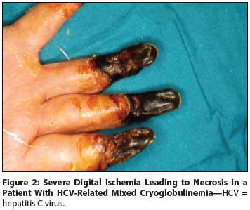
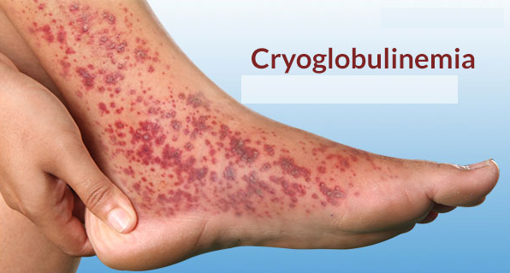
SYSTEMIC VASCULITIS

Slide 48
Important Points
Remember the classification of Vasculitis i.e. large, medium and small vessel Vasculitis

Slide 49
Important Points (cont)
Important features in each disease like
- Giant cell arteritis – sudden loss of vision
- Takayasu’s arteritis – absence of pulse
- Polyarteritis nodosa – severe systemic
manifestation, livedo reticularis, and association with hepatitis B
- Kawasaki’s disease – occurs in children,
coronary artery involvement

Slide 50
Important Points (cont)
- Wegener’s granulomatosis – pulmonary hemorrhage, glomerulonephritis, ENT symptoms
- Churg – Strauss granulomatosis – bronchial asthma, Eosinophilia
- Henoch-Schonlein purpura – occur usually in children, palpable purpura, mainly seen on legs and buttocks
- Cryoglobulinaemia – Raynaud's phenomenon, purpura, precipitated by cold
Treatment for Vasculitis – Corticosteroids and immunosuppressive drugs

Slide 51
Thank you

