Slide 1
SYSTEMIC LUPUS ERYTHEMATOSIS
BY
Dr. Hayam Hebah
Associate professor of internal medicine
AL-Maarefa College

Slide 2
Objectives:
Background
Etiology
Clinical picture
Investigations
DD
Treatment

Slide 3
Background
SLE is an autoimmune disorder characterized by multisystem inflammation with the generation of autoantibodies. (autoantibody response to nuclear and cytoplasmic antigens).
The specific cause of SLE is unknown, multiple factors are associated with the development of the disease .
(SLE) follows a relapsing and remitting course .
SLE can affect any organ system
90% in females(11:1)
More in blacks and hispanics
Highest in women aged 14 to 64 years. SLE does not have an age predilection in males
SLE is more common in those with Klinefelter syndrome
Mortality due to premature cardiovascular disease.

Slide 4
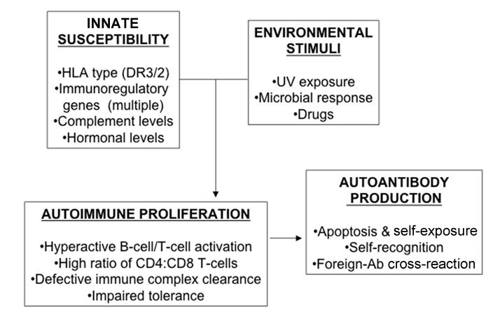
aetiology

Slide 5
Clinical picture
1-Constitutional symptoms: Fatigue(commonest symptom), myalgia, fever, arthralgia, and weight changes
---Fever may reflect active SLE, infection, and reactions to medications (i.e, drug fever).
--- Most infections are bacterial in origin, but atypical and opportunistic infections, can occur when patients are on immunomodulating or immunosuppressive therapy.
-----functional asplenia predispose to encapsulated bacteria.

Slide 6
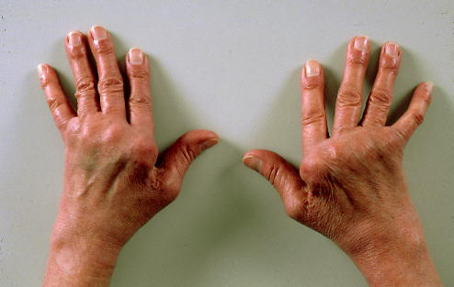
2-musculoskeletal:
Arthralgia with early morning stiffness, myalgia
frank arthritis of the PIP and MCP joints of the hands, as well as the wrists, is the most common musculoskeletal finding in SLE and knees (usually symmetrical, polyarticular, non erosive).
SLE arthritis or arthralgia may be asymmetrical, with pain that is disproportionate to swelling.
Jaccoud arthropathy is
the nonerosive hand deformities
due to chronic arthritis and tendonitis
that develop in 10% of patients with
SLE.

Slide 7
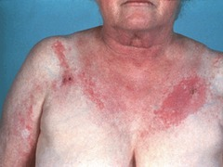
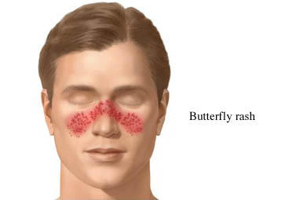
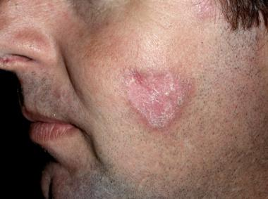
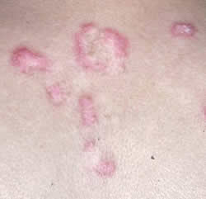
3- Dermatologic
Cutaneous manifestations of SLE
include 3 lupus diagnostic criteria: malar rash, photosensitivity, and discoid lupus

Slide 8
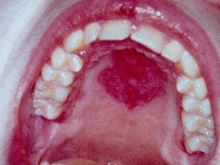
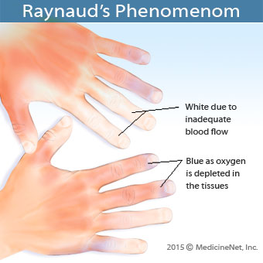
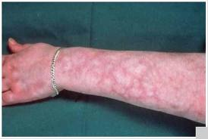
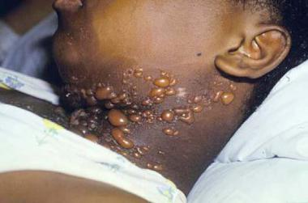
Alopecia
Oral or vaginal ulcers which are painless.
Palatal ulcers are most specific for SLE.
Other cutaneous manifestations
(not specific )includes:
Raynaud phenomenon
Urticaria
Livedo reticularis
Bullous lesions
Vasculitic purpura
Telangiectasias

Slide 9
4- Neuropsychiatric
Fatigue, headache and poor concentration are common.
Only seizure and psychosis were typically included in the diagnostic criteria.
Seizures related to SLE may be generalized or partial and may precipitate status epilepticus. Psychosis may manifest as paranoia or hallucinations
Other neurological manifestations may occur also

Slide 10
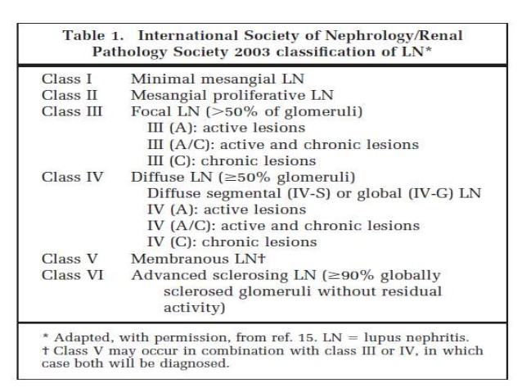
5-Renal:

Slide 11
6- Pulmonary:
Pulmonary features of SLE may manifest acutely or indolently
Multiple pulmonary complications: pleurisy, pleural effusion( exudative, with an elevated lactate dehydrogenase level), pneumonitis, pulmonary hypertension, and interstitial lung disease.
The chronic steroids prescribed to patients also place them at increased risk for atypical infections
Pleuritis is one of the formal diagnostic criteria for SLE.
Pleural effusion is the commonest lung lesion in SLE.

Slide 12
7- Gastrointestinal:
Nausea and dyspepsia
Peptic ulcer disease is a common complication, especially in SLE patients treated with nonsteroidal anti-inflammatory agents (NSAIDs) and glucocorticoids.
Occasional abdominal pain in active SLE may be directly related to active lupus, including peritonitis, pancreatitis, mesenteric vasculitis, and bowel infarction. Jaundice due to autoimmune hepatobiliary disease may also occur.

Slide 13
8-Cardiac
Pericarditis is the most common cardiac feature of SLE, manifesting as positional chest pain that is often relieved when the patient leans forward.
Myocarditis may occur in SLE with heart failure symptoms.
Pulmonary hypertension may present with indolent chest pain or dyspnea.
Coronary vasculitis manifesting as angina or infarction is rarely reported. Libman-Sacks endocarditis is noninfectious but may manifest as symptoms similar to those of infective endocarditis in patients with SLE or antiphospholipid syndrome.
More commonly, accelerated ischemic coronary artery disease (CAD) is associated with SLE and may present indolently as atypical anginal equivalents.

Slide 14
9-Hematologic
A history of multiple cytopenias such as leukopenia, lymphopenia, anemia, or thrombocytopenia. Leukopenia and, more specifically, lymphopenia are common in SLE; coupled with immunosuppression, may predispose persons with SLE to frequent infections.
Thrombocytopenia may be mild or part of a full thrombotic thrombocytopenic purpura (TTP)–like syndrome or antiphospholipid antibody syndrome. A history of recurrent early miscarriages or a single late pregnancy loss may be clues to lupus or isolated antiphospholipid antibody syndrome.

Slide 15
Physical Examination
Vital signs: Temperature-BP-pulse –respiratory rate.
Skin manifestations.
Edema
Muscles and joints.
Renal
Neuropsychiatric
Cardiopulmonary
Gastrointestinal
Ophthalmologic: Slit-lamp examinations are recommended every 6 months for SLE patients who are on hydroxychloroquine. Retinal vasculitis can lead to blindness .

Slide 16
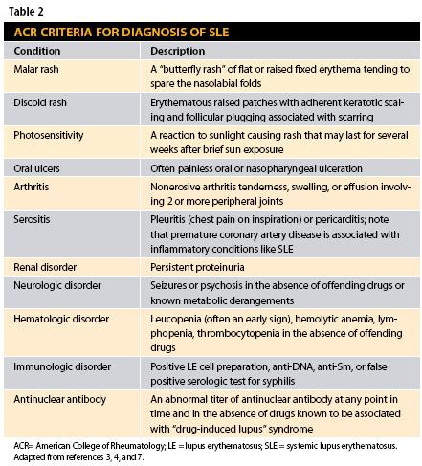

Slide 17
Differential Diagnoses
Drug-Induced LupusErythematosus:
procainamide, hydralazine, and isoniazid , minocycline and propylthiouracil, Anti-TNF drugs are reported to cause severe drug-induced lupus,
Drug-induced lupus differs from SLE by the following features:
Sex ratios are nearly equal
Antibodies to histones are usually found in 80-90%
Nephritis and central nervous system features are not commonly present
There are no antibodies to native DNA or hypocomplementemia
Discontinuation of the drug leads to resolution of clinical manifestations and reversion of abnormal laboratory values to normal

Slide 18
DD
Skin lesions
Arthritis, arthralgia
Myopathies ,myalgia
fUO
Pancytopenia
Seizures, psychosis , stroke
Nephrotic syndrome
Vasculitis
Interstitial lung diseases
Fetal losses

Slide 19
laboratory studies
Complete blood count (CBC) with differential: for leukopenia, lymphopenia, anemia, and thrombocytopenia
Serum creatinine
Urinalysis with microscopy
BOTH may be useful to screen for kidney disease.: proteinuria, hematuria, casts
Erythrocyte sedimentation rate (ESR) elevation may show a discrepancy relative to a normal CRP level in SLE flares; or C-reactive protein (CRP).
Complement levels: C3 and C4 levels are often decreased.
Liver function tests: ↑in response to therapies or in autoimmune hepatitis.
Creatine kinase assay: elevated in myositis or overlap syndromes
Spot protein/spot creatinine ratio

Slide 20
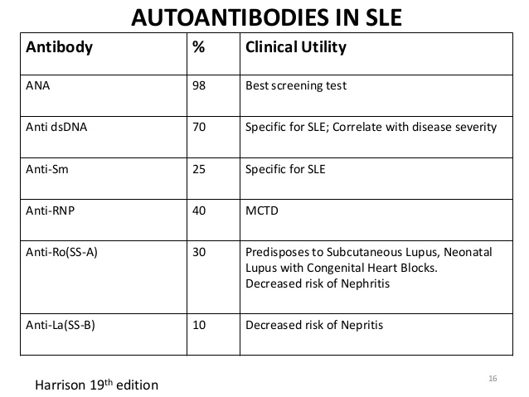

Slide 21
Life threatening complications in SLE:
diffuse alveolar hemorrhage with hemoptysis.
Severe neurologic involvement
Systemic vasculitis
Profound thrombocytopenia with a thrombotic thrombocytopenia (TTP)–like syndrome
Rapidly progressive glomerulonephritis

Slide 22
Radiologic Studies
Chest X-ray and chest CT scanning to monitor interstitial lung disease and to assess for pneumonitis, pulmonary emboli, and alveolar hemorrhage.
Echocardiography is used to assess for pericardial effusion, pulmonary hypertension
Brain (MRI) &/or (MRA) is used to evaluate for central nervous system (CNS) lupus
Joint Effusion and CSF Studies
Biopsies and Histologic Feature: -renal biopsy
- skin biopsy.

Slide 23
The following comorbidities as increasing the risk of morbidity and mortality in patients with SLE :
Infections
Hypertension
Lipid disorders (dyslipidemia), atherosclerosis, and coronary heart disease
Diabetes mellitus
Bone-related conditions: Osteoporosis; avascular bone necrosis
Malignancies such as non-Hodgkin lymphoma, lung cancer, and hepatobiliary cancer

Slide 24
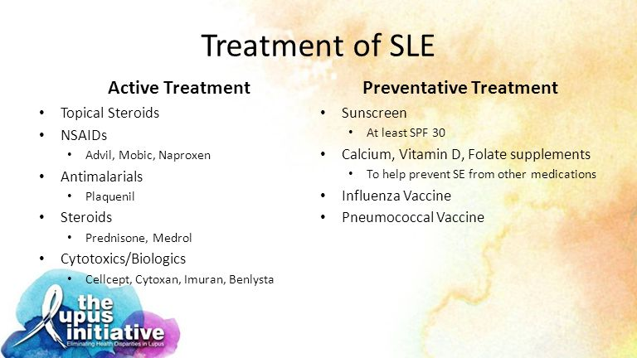

Slide 25
Treatment & Management of SLE depends on disease severity and disease manifestations.
cutaneous manifestations
musculoskeletal manifestations
Serositis
represent milder disease
controlled with NSAIDS or low-potency immunosuppression medications beyond hydroxychloroquine and/or short courses of corticosteroids.
for patients with involvement of vital organs as CNS involvement
diffuse proliferative renal disease.
Pulmonary hemorrhage
Severe forms
ttt is by more prolonged steroid use and immunosuppression

Slide 26
In patients with SLE without major organ manifestations, glucocorticoids and antimalarial agents may be beneficial
NSAIDs may be used for short periods in patients at low risk for complications from these drugs.
Consider immunosuppressive agents (eg, azathioprine, mycophenolate mofetil, methotrexate) in refractory cases or when steroid doses cannot be reduced to levels for long-term use
stress and physical illness may precipitate SLE flares

Slide 27
Ttt of acute emergencies in SLE
High-dose intravenous steroids( Methylprednisolone) and cytotoxic therapy such as cyclophosphamide.
Strokes, acute myocardial infarctions, and pulmonary emboli occurring as complications of SLE are managed in the same way as they are in patients without SLE.
In patients who present with fever, it may be necessary to limit immunosuppression to steroids and to empirically treat for an infection until culture results have been received.
In diffuse alveolar hemorrhage may require plasma exchange, or profound steroid-refractory thrombocytopenia may require therapy with intravenous immunoglobulin (IVIG).
Catastrophic antiphospholipid antibody syndrome also requires aggressive acute management.

Slide 28
Lupus nephritis treatment:
class I or II LN do not need management with immunosuppression. For proteinuria use ACEI or ARB to target BP130/80.
class III or IV disease, or combination of class V and class III or IV disease, generally undergo aggressive therapy with glucocorticoid drugs and immunosuppressants :
Induction therapy by mycophenolate mofetil, cyclophosphamide) to achieve remission , used for 3 months to 1 year
maintenance therapy : started once remission is achieved with azathioprine or mycophenolate mofetil
In patients with SLE and nephritis who progress to end-stage renal disease, dialysis and transplantation may be required;
Class vi will progress to ESRD.

Slide 29
Adjunctive therapy in lupus nephritis
Unless contraindicated, hydroxychloroquine should be used as adjunctive therapy in lupus nephritis because of the potential for reduction in rates of disease flare.
Administer ACEI or ARBs to all patients with lupus nephritis, except pregnant women, who have proteinuria of 0.5 g or more per 24 hours
Statin therapy is recommended when (LDL-C)
levels >100 mg/dL because both renal dysfunction alone and SLE alone are independent risk factors for accelerated atherosclerosis.

Slide 30
Hydroxychloroquine (Plaquenil)
Mediates subtle immunomodulation without causing overt immunosuppression in SLE.
Useful in preventing and treating lupus skin rashes, constitutional symptoms, arthralgias, and arthritis .
also help to prevent lupus flares and have been associated with reduced morbidity and mortality
SIDE EFFECTS:
Corneal changes or deposits (visual disturbances, blurred vision, photophobia; reversible on discontinuance)
Retinal damage with long-term .

Slide 31
NSAIDs
(NSAIDS) provide symptomatic relief for arthralgias, fever, headache, and mild serositis. NSAIDs may cause elevated creatinine or liver function test results in patients with active SLE.
Additionally, concomitant administration with prednisone may increase the risk of gastrointestinal ulceration

Slide 32
DMARDS, Immunomodulators
Disease-modifying antirheumatic drugs (DMARDS) are immunomodulatory agents that act as immunosuppressives and cytotoxic and anti-inflammatory medications.
Cyclophosphamide
Cyclophosphamide is used for immunosuppression in cases of serious SLE organ involvement, especially severe CNS involvement, vasculitis, and lupus nephritis
Side effects: SIADH, infertility, hemorrhagic cystitis, malignancy,rash.

Slide 33
Methotrexate
Methotrexate is used for managing arthritis, serositis, cutaneous, and constitutional symptoms.
Azathioprine (Imuran)
Azathioprine is an immunosuppressant and a less toxic alternative to cyclophosphamide. It is used as a steroid-sparing agent in nonrenal disease
Mycophenolate (CellCept, Myfortic
is useful for maintenance in lupus nephritis and other serious lupus cases.

Slide 34
Biologic drugs:
Belimumab
is indicated for active, autoantibody-positive SLE in patients in whom standard therapy, including corticosteroids, antimalarials, immunosuppressives, and nonsteroidal anti-inflammatory drugs, is failing
Rituximab
as rescue therapy for patients with active SLE who were unresponsive to standard immunosuppressant therapy
Corticosteroids

Slide 35
References:
Davidson‘s principles and practice of medicine.

