Slide 1
SHOCK
M K ALAM MS;FRCS

Slide 2
ILO’s
At the end of this presentation students will be able to:
Describe the different types of shock.
Understand the pathophysiology of different types of shock.
Explain the effect of shock on different organs.
Discuss the management of each type of shock.

Slide 3
Introduction
Definition: A state of inadequate delivery of oxygen and nutrients to maintain normal tissue and cellular function.
Untreated results in anaerobic metabolism, tissue acidosis & cellular dysfunction leading to multi organ dysfunction and death.

Slide 4
Types of Shock
Hypovolemic.
Septic.
Cardiogenic.
Anaphylactic.
Neurogenic.

Slide 5
Hypovolemic Shock (HS)
Most common type in surgical practice.
Reduction in intravascular volume.
  Blood loss: Trauma, GI bleeding, ruptured aneurysm
  Plasma loss: Burn
  Water & electrolytes loss: Diarrhoea, vomiting
Easily correctable.

Slide 6
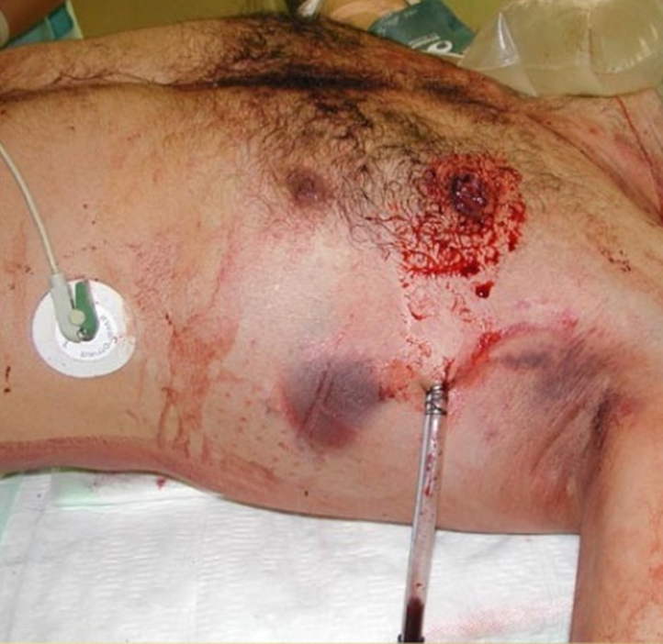
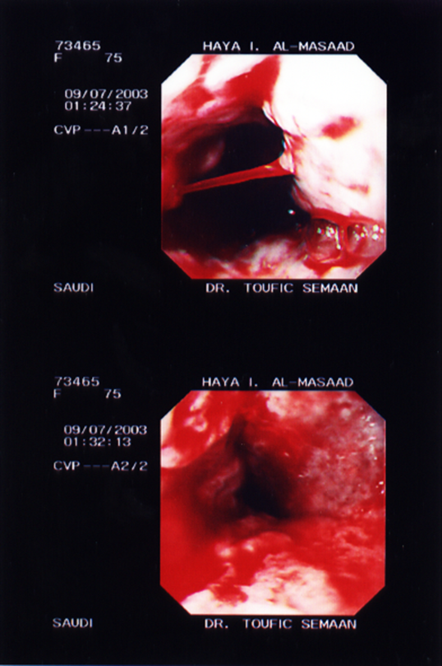
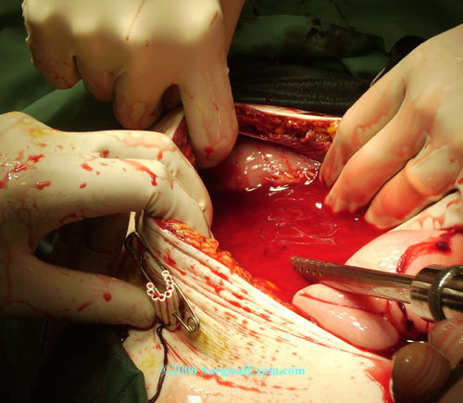

Slide 7
Hypovolemic Shock- pathophysiology
Catecholamines release- adrenal medulla, sympathetic nerve endings.
AT II- renin-angiotensin system.
Tachycardia, vasoconstriction.
Increased myocardial contractility attempting to maintain CO.
Later ↓ CO.
Maintains blood flow to vital organs- brain, heart & muscle.
Diverts blood from non-vital organs- skin (pale, cold, prolonged capillary refill), gut

Slide 8
Classes of hemorrhagic shock
 | Class I | Class II | Class III | Class IV
Blood loss (ml) | Up to 750 | 750- 1500 | 1500- 2000 | > 2000
Pulse | <100 | >100 | >120 | >140
BP | Normal | Normal/low normal | Decreased | Decreased

Slide 9
Established hemorrhagic Shock
Tachycardia
Vasoconstriction
Decreased cardiac output
Narrow pulse pressure (increased diastolic pressure)
Decreased blood flow

Slide 10
Septic Shock (SS)
Sepsis induced hypotension (systolic < 90 mmHg).
Disturbance in O₂ delivery and O₂ consumption.
Gram positive (52%), Gram negative (38%) infections.
Common sites of infection: Lung (50-70%), abdomen (20-25%), urinary tract (5-7%), skin.

Slide 11
Septic Shock- pathophysiology
Infection- triggers cytokines (TNF-α, IL 1-β) mediated pro-inflammatory response.
Peripheral vasodilatation (NO), redistribution of blood flow.
Increased cardiac output (CO)- High output state.
Warm well perfused periphery, low diastolic BP, wide pulse pressure.

Slide 12
Septic Shock- pathophysiology
If septic state persists:
↑vascular permeability (endothelial dysfunction), loss of intravascular volume.
Ventricular dysfunction affects CO.
Peripheral perfusion falls- now indistinguishable from hypovolemia.
Microthrombi formation within microcirculation.
Microcirculatory dysfunction impairs O₂ delivery to cells.
Mitochondrial dysfunction impairs O₂ utilization within cell.

Slide 13
Cardiogenic Shock (CS)
Causes: Myocardial infarction, arrhythmias, valve dysfunction, massive pulmonary embolism, cardiac tamponade and tension pneumothorax.
A pump failure: Heart unable maintain adequate cardiac output to meet metabolic requirements.
Low output state.
Normal circulating volume.

Slide 14
Anaphylactic Shock (AS)
Severe systemic reaction to an allergen.
Drugs (antibiotics, dextran, radiological contrasts), food (peanuts, shellfish, dairy) insect stings and latex.
Release of vasoactive mediators from basophil & mast cells (histamine, kinins, prostaglandins) .
Reaction mostly mediated by IgE, IgG, or complement.
Shock: Vasodilatation, intravascular volume redistribution, capillary leak and reduced CO.

Slide 15
Neurogenic Shock (NS)
Injury to spinal cord (cervical, thoracic), high spinal anaesthesia.
Disruption of sympathetic efferent.
Loss of vasomotor tone- profound vasodilatation, fall in peripheral vascular resistance.
loss of cardiac stimulation (T1-4).
Loss of sweat gland innervation- anhydrosis.
Hypotension, bradycardia, dry & warm periphery

Slide 16
Microcirculation in shock
Microcirculation: Arterioles, capillaries & venules
Early HS & CS: Arteriolar vasoconstriction→ fall in capillary hydrostatic pressure → shift of interstitial space fluid to intravascular space to maintain intravascular volume.
SS: Disruption of microcirculation & activation of coagulation, DIC
Shock uncorrected: Accumulation of lactic acid, CO₂, endothelium factors → pre-capillary vasodilatation.
Pooling of blood in capillary bed, ↑capillary permeability leading to loss of fluid into interstitial space.
Increased viscosity, platelet aggregation, microthrombi formation.

Slide 17
Cellular function in shock
Anaerobic metabolism - accumulation of lactic acid
O₂ extraction ↑initially, continued ↓O₂ supply results fall in its use.
Anaerobic glycolysis generating only 2 moles of ATP vs 38 in normal state.
Intracellular accumulation of Na⁺ leads to cell swelling.
Disruption of protein synthesis, lysosomal & mitochondrial damage due to fall in pH (due to lactic acidosis)
Less ATP supply leads to cell dysfunction, ultimately cell death.

Slide 18
Effects of shock on organs function
CVS: ↓ coronary blood flow → myocardial ischemia→ ↓CO.
Widespread endothelial activation→ microcirculatory dysfunction.
RS: Tachypnoea
Pulmonary edema (cardiogenic shock)
Acute lung injury→ hypoxia.

Slide 19
Effects of shock on organs function
CNS: Restless, confusion, coma
GIT: Splanchnic hypoperfusion→ breakdown of gut mucosal barrier→ bact./bact. wall content entry into circulation → SIRS
Renal: Hypoperfusion→ oliguria→ anuria
Acute renal failure: ↑ urea, creatinine, K⁺& metabolic acidosis.

Slide 20
Management- general principles
Identification & treatment of underlying cause.
Like most emergencies- ABC approach.
Admission to HDU or ICU
Adequate O₂ delivery: Maintaining airway, high flow O₂ delivery (10-15L/ min)
Pulse oximetry, frequent ABG
Intubation & ventilatory support.

Slide 21
Hypovolemic shock
  Blood loss*: Trauma, GI bleeding, ruptured aneurysm
  Plasma loss: Burn
  Water & electrolytes loss: Diarrhoea, vomiting
* Commonest cause in surgical practice.

Slide 22
Indicators of hypovolemic shock
Tachycardia*
Agitation
Tachypnea
Sweating
Cool extremities
Collapsed neck veins
Weak peripheral pulse
Decreased pulse pressure
Hypotension
Oliguria
Low CVP

Slide 23
Management of HS
Hemorrhage: Arrest external bleeding
Fluid resuscitation- Two wide bore (14-16 gauge) peripheral venous access.
Crystalloid infusion- titrated to clinical response.
PRBCs: Life threatening/ continued bleeding.
Diagnosis & treatment: Bleeding source ,?other causes, specific treatment.
Invasive monitoring: CVP, PAWP, acid-base status
Vasopressor & inotropes- little role
Urine output monitoring- Foley catheter

Slide 24
Management
Parameters of improvement:
Reduction in tachycardia.
Increasing blood pressure.
Improving peripheral perfusion.
Improving urine output.
CVP rise

Slide 25
Management- septic shock
Crystalloid infusion ( target CVP ≥8 mmHg).
Urine output: ≥0.5 ml/kg/hr.
Vasopressors (noradrenaline):Persistent hypotension, after volume restoration
Serum lactate: Monitor tissue perfusion.
Identification of underlying infection: History, examination & investigations
Treatment of infection: IV antibiotics (empirical, post-culture), Radiological / Surgical intervention.

Slide 26
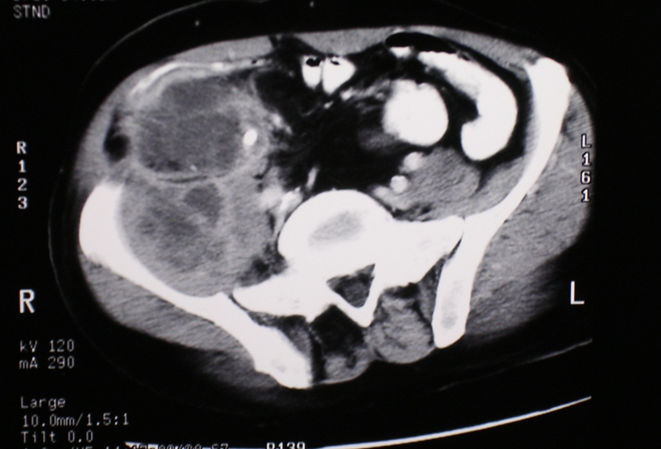
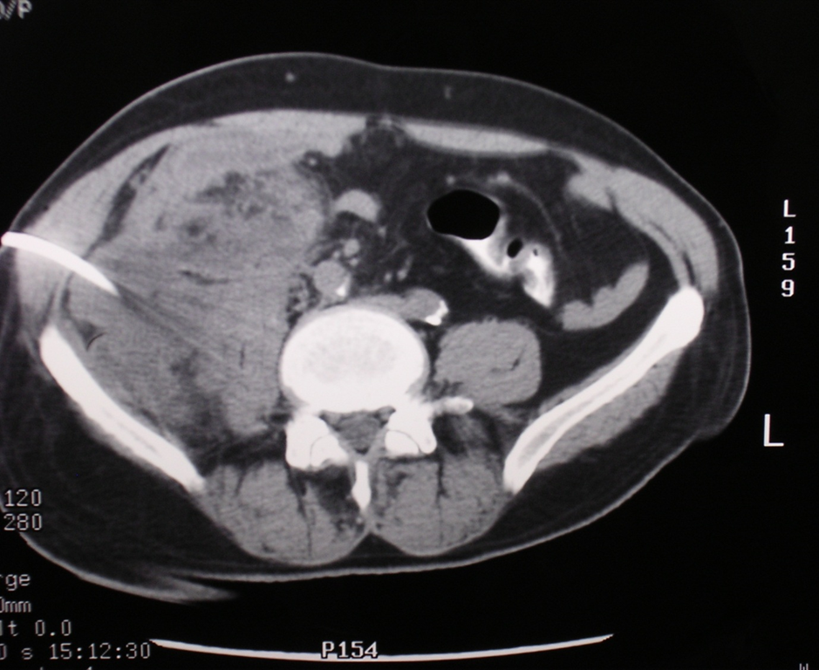
PCD- intra-abdominal abscess

Slide 27
Management of cardiogenic Shock
Myocardial infarction- commonest cause.
Tension pneumothorax, traumatic cardiac tamponade- trauma.
Hypotension, cool and mottled skin, depressed mental status, tachycardia, and diminished pulses, dysrhythmia.
Distended neck veins , Raised CVP.
ECG, echocardiography, CXR,ABG, CK-MB, troponin.
Maintenance of adequate oxygenation.
Judicious fluid administration to avoid fluid overload.
Cardiology consultation.
Thoracocenteasis, pericardiocentesis in trauma.

Slide 28
Management of neurogenic shock
Acute spinal cord injury: Bradycardia, hypotension, cardiac dysrhythmias, reduced cardiac output, and decreased peripheral vascular resistance.
Airway secured, adequate ventilation.
Fluid resuscitation to restore intravascular volume.
Administration of vasopressor.

Slide 29
Management of anaphylactic shock
Stop administration of causative agent.
Maintain airway, give 100% O₂.
Adrenaline 0.5-1 mg (0.5-1 ml 1:1000) IM.
IV crystalloid.
2nd line: Antihistamine- chlorphenamine 1—20 mg slow IV or Hydrocortisone 200 mg IV

Slide 30
Thank you!

