Slide 1
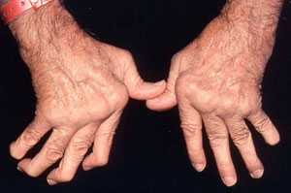
RHEUMATOID ARTHRITIS
Dr. M. SOFI MD; FRCP (London); FRCPEdin; FRCSEdin

Slide 2
RHEUMATOID ARTHRITIS
“A chronic progressive disease causing inflammation in the joints and resulting in painful deformity and immobility, especially in the fingers, wrists, feet, and ankles”.
Pattern of joints affected — RA usually affects the same joints on both sides of the body.
“In the early stages, rheumatoid arthritis typically affects small joints, especially the joints at the base of the fingers, the joints in the middle of the fingers, and the joints at the base of the toes. It may also begin in a single, large joint, such as the knee or shoulder, or it may come and go and move from one joint to another”.
Joint symptoms — Usually begin gradually and include pain, stiffness, redness, warmth to the touch, and joint swelling.

Slide 3
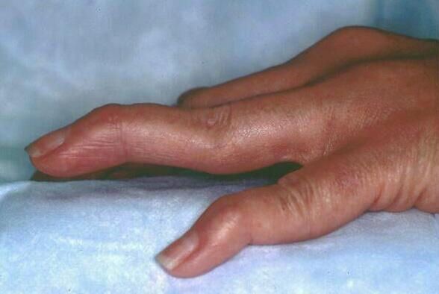
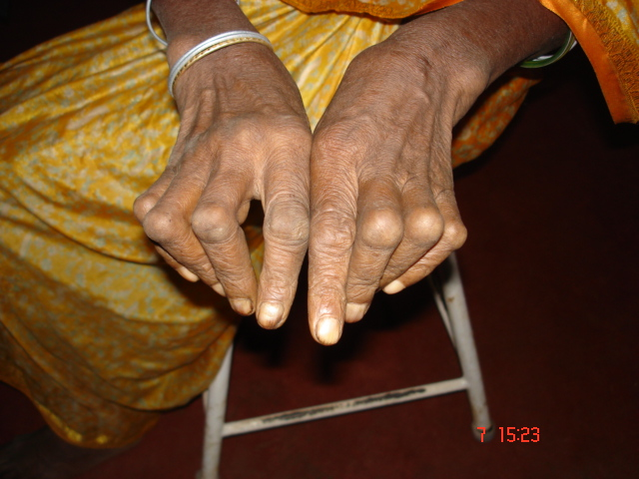
Hands – The joints of the hands are often the very first joints affected by RA.
Certain hand deformities can occur with longstanding RA. The fingers may develop swan neck and boutonniere deformities, and they may drift together in the direction of the small finger bowstring sign.
Wrist – Most commonly affected joint. In the early stages of RA, it may become difficult to bend the wrist backward.
Elbow – Swelling of this joint may compress nerves.
Swan neck deformity
Boutonniere deformity

Slide 4
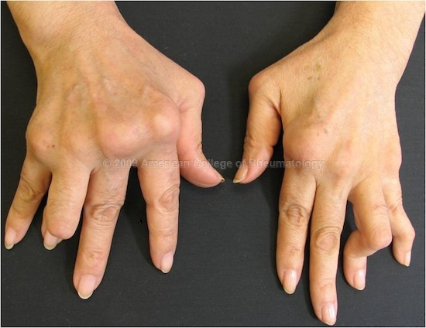
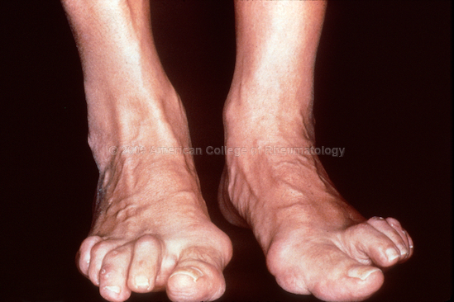
Shoulder – May be inflamed in the causing pain and limited motion.
Foot – Often affected in the early. May be swollen and red.
Ankle –RA of this joint may cause nerve damage, leading to numbness and tingling.
Knee – RA may cause swelling of the knee, difficulty bending the knee, excessive looseness of the ligaments. May cause the Baker's cyst.
Cervical spine – May cause a painful and stiff neck and a decreased ability to bend the neck and turn the head
Sublaxation metacarpophalyngeal joints
Hallux valgus and hammertoes

Slide 5
Extra-articular manifestations of Rheumatoid arthritis
Systemic | Musculoskeletal
Fever | Muscle wasting
Weight loss | Tenosynovitis/Bursitis
Fatigue | Osteoporosis
Hematological | Ocular
Anaemia | Episcleritis/Scleritis
Thrombocytosis | Scleromalacia
Eosinophilia | Keratoconjunctivitis sica
Vasculitis | Carditis (30% in+ RA)
Digital arteritis | Pericarditis/Myocarditis/
Ulcers | Conduction defects
Pyoderma gangrenosum | Coronary vasculitis/ Granulomatous aortitis

Slide 6
DIAGNOSIS — There is no single test used to diagnose RA. Diagnosis is based upon many factors, including the characteristic signs and symptoms, the results of laboratory tests, and the results of x-rays.
Morning stiffness that lasts at least one hour and that has been present for at least six weeks
Swelling of three or more joints for at least six weeks
Swelling of the wrist, hand, or finger joints for at least six weeks
Swelling of the same joints on both sides of the body
Changes in hand x-rays that are characteristic of rheumatoid arthritis
Rheumatoid nodules of the skin
Blood test positive for rheumatoid factor and/or anti-citrullinated peptide/protein antibodies (ACPA)

Slide 7
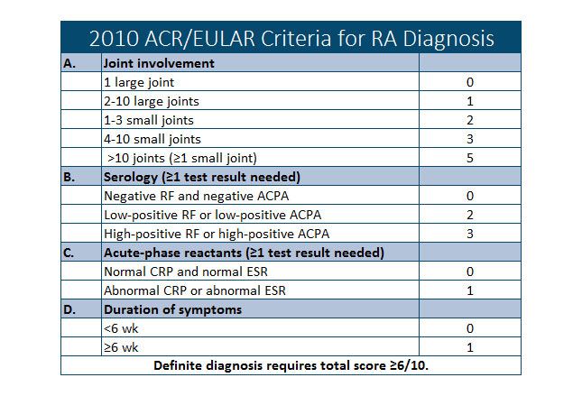

Slide 8
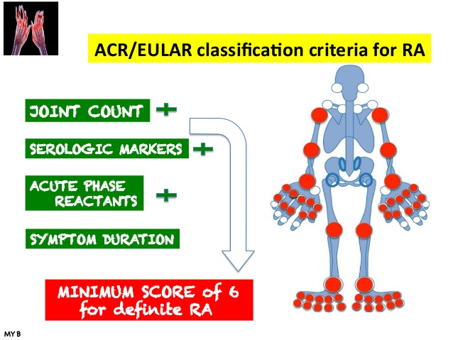

Slide 9
Laboratory Studies
Useful laboratory studies in suspected RA fall into 3 categories—
  Markers of inflammation,
  Hematologic parameters
  Immunologic parameter
include following:
Erythrocyte sedimentation rate (ESR)
C-reactive protein (CRP) level
Complete blood count (CBC)
Rheumatoid factor (RF) assay
Antinuclear antibody (ANA) assay
Anti−cyclic citrullinated peptide (anti-CCP)
Anti−mutated citrullinated vimentin (anti-MCV) assays

Slide 10
Laboratory Studies
Markers of inflammation
The ESR and the CRP level are associated with disease activity. The CRP value over time correlates with radiographic progression.
Hematologic parameters
CBC -- anemia of chronic disease correlates with disease activity; it improves with successful therapy.
Hypochromic anemia suggests blood loss, commonly from GIT associated NSAIDs.
Thrombocytosis is common and is also associated with disease activity. Thrombocytopenia may be a rare adverse event of therapy and may occur in patients with Felty syndrome.
Leukocytosis may occur but is usually mild.
Leukopenia -- consequence of therapy or a component of Felty syndrome, which may then respond to DMARD therapy.

Slide 11
Laboratory Studies
Immunologic parameters
Rheumatoid factor — An antibody is present in the blood of 70 to 80 percent of people with RA.
RF is not specific for RA but is also present in other connective tissue diseases, infections, and autoimmune disorders, as well as in 1-5% of healthy people.
The presence of RF predicts radiographic progression of bone erosions, independent of disease activity.
RF values fluctuate with disease activity, though titers of RF generally remain high even in patients with drug-induced remissions.
Anti-citrullinated peptide/protein antibody (ACPA) test — are more specific than RF for diagnosing RA. Anti-ACPA antibody tests may be positive very early in the course of disease. The test is positive in most patients with rheumatoid arthritis.

Slide 12
Laboratory Studies
Immunologic parameters
ANAs are present in about 40% of patients with RA.
Assays for anti-citrullinated protein antibody (ACPA) are now used clinically for diagnosing RA.
ACPA-positive and ACPA-negative RA may be 2 distinct disease subsets, with different underlying pathogeneses and risks for developing RA.
ACPA-positive patients may have a more erosive RA disease course than ACPA-negative patients.
ACPA antibodies suggest a sensitivity and specificity equal to or better than those of RF.
Presence of both anti-ACPA antibodies and RF is highly specific for RA.
Presence of anti-ACPA antibodies, like that of RF, indicates a worse prognosis.

Slide 13
Joint Aspiration indications
For a definitive diagnosis of RA to rule out coexistent infection or crystal arthritis in an acutely swollen joint.
In a new-onset monoarticular arthritis or an unusual flare up in a patient with RA may need joint aspiration and synovial fluid analysis.
Analysis of synovial fluid includes Gram staining, cell count, culture, and assessment of overall appearance.
In RA, analysis typically reveals WBC count >2000/µL, generally in the range of 5000-50,000/µL.
Usually, neutrophil predominance (60-80%) is observed (in contrast to mononuclear cell predominance in the synovium).
Because of transport defect, glucose levels of synovial fluids (as well as pleural and pericardial fluids) in patients with RA are low compared with serum glucose levels.

Slide 14
Radiographic Feature
Peri-articular osteopenia
Uniform symmetric joint space reduction
Marginal subchondral erosions
Joint sublaxations
Joint destruction
Collapse
Ultrasound detects early soft tissue swelling
MRI has greatest sensitivity to detect synovitis and
marrow changes

Slide 15
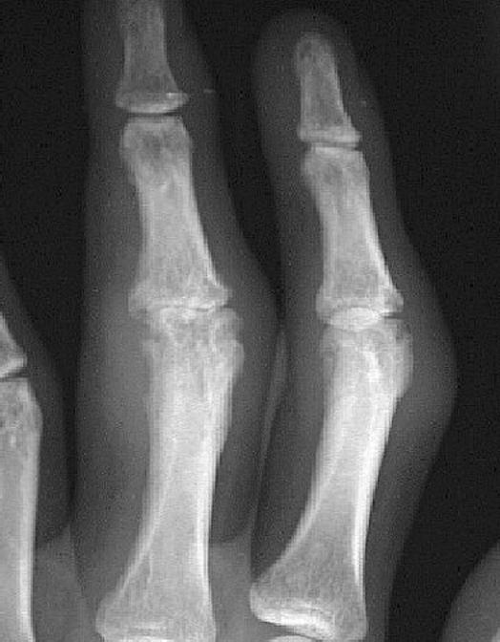
Soft-tissue swelling and early erosions in the proximal interphalangeal joints in a patient with rheumatoid arthritis of the hands.

Slide 16
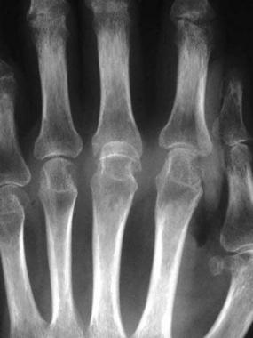
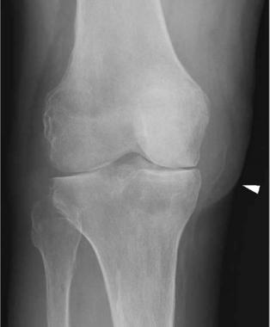
Anteroposterior radiograph of the knee shows uniform joint-space loss in the medial and lateral knee compartments without osteophytosis. A Baker cyst is seen medially (arrowhead).
Metacarpophalangeal joint and marginal erosions at the heads of the second to fourth metacarpals in a patient with rheumatoid arthritis of the hands.

Slide 17
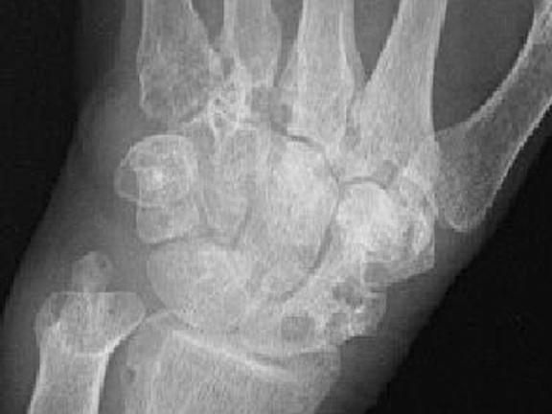
Well-defined bony erosions in the carpal bones and metacarpal bases in a patient with rheumatoid arthritis of the hands.
Soft-tissue swelling and early erosions in the proximal interphalangeal joints in a patient with rheumatoid arthritis of the hands.

Slide 18
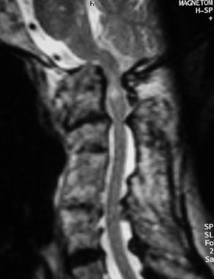
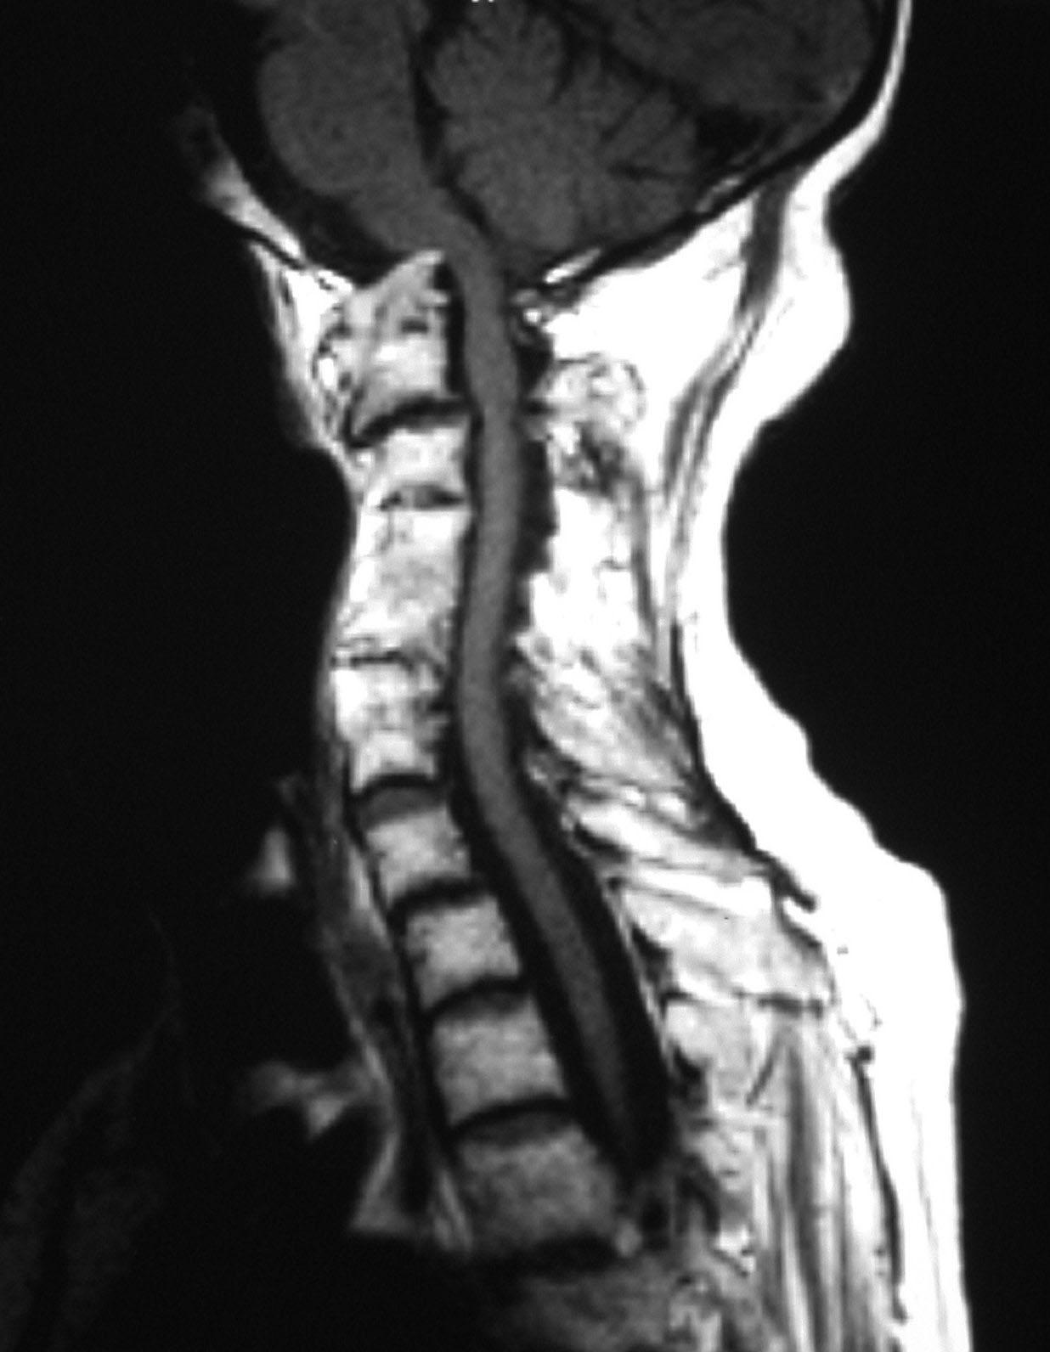
Sagittal T2- MRI of cervical spine Compromised foramen magnum and there is increased signal intensity within upper cord; this is consistent with compressive myelomalacia.
T1-weighted sagittal MRI image of the cervical spine shows basilar invagination with cranial migration of an eroded odontoid peg.

Slide 19
Pathophysiology: Rheumatoid arthritis
Pathogenesis of RA is not completely understood.
An external trigger that triggers an autoimmune reaction, leading to synovial hypertrophy and chronic joint inflammation along with the potential for extra-articular manifestations.
Synovial cell hyperplasia and endothelial cell activation are early events that progresses to uncontrolled inflammation and consequent cartilage and bone destruction.
Genetic factors and immune system abnormalities contribute to disease propagation.
CD4 T cells, mononuclear phagocytes, fibroblasts, osteoclasts, and neutrophils play major cellular roles in the pathophysiology of RA, whereas B cells produce autoantibodies.
Abnormal production of numerous cytokines, chemokines, and other inflammatory mediators (eg, [TNF-a], interleukin [IL]-1, IL-6, IL-8, transforming growth factor beta [TGF-ß], fibroblast growth factor [FGF], and platelet-derived growth factor [PDGF]) has been demonstrated in patients with RA.

Slide 20
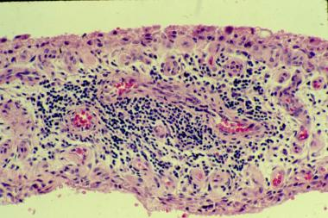
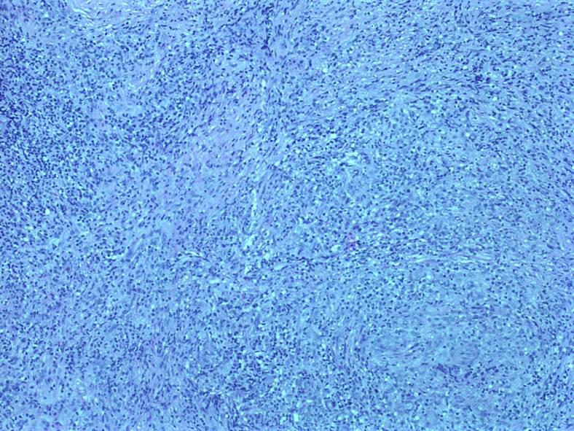
Histologic Findings
The hallmark of rheumatoid arthritis is a perivascular mononuclear cell infiltrate in the synovium (pictured here). The early stages are noted to have plasma cells as well
The inflammation involved in rheumatoid arthritis can be intense. It is composed of mononuclear cells and can resemble a pseudosarcoma.

Slide 21
Extra-articular manifestations of Rheumatoid arthritis
Musculoskeletal system other than joints and of nonarticular organs (eg, skin, eye, lungs, heart, and others) occurs in about 40 percent RA over the course of the disease
Bone loss in RA is common. It may be generalized, resulting from immobility, the inflammatory process, and treatment effects with glucocorticoids
Muscle weakness is a common. It may have several, often additive, causes, including synovial inflammation, myositis, vasculitis, and drug-induced myopathy (eg, from steroids,hydroxychloroquine, or statins).
Cutaneous manifestations of RA is the rheumatoid nodule.
Ocular and/or oral dryness are the hallmarks of Sjögren’s syndrome, which may occur in association with RA.
Eye involvement in RA also may include episcleritis, scleritis, peripheral ulcerative keratitis, and, less frequently, uveitis
Pulmonary involvement in RA may include pleurisy and parenchymal lung diseases (eg, interstitial fibrosis, pulmonary nodules, bronchiolitis obliterans, and organizing pneumonia

Slide 22
Extra-articular manifestations of Rheumatoid arthritis
Cardiac involvement, such as pericarditis and myocarditis, are uncommon in RA. There is an increased risk of coronary artery disease, heart failure, and atrial fibrillation (AF).
Vasculitis of small to medium blood vessels can occur, and higher than expected rates of coronary artery, peripheral vascular, and cerebrovascular disease are also seen
kidney involvement is rare and include a focal glomerulonephritis, possible membranous nephropathy, and rheumatoid vasculitis. Drug toxicity is much more common.
Anemia is commonly present in active RA. Neutropenia, in Felty’s syndrome and in the large granular lymphocyte (LGL) syndrome, may require therapeutic interventions
Central nervous system Abnormalities associated with RA include, peripheral or central nervous system. Carpal tunnel syndrome is the most common, and a compressive myelopathy or radiculopathy can also occur. Patients with instability of the cervical spine, most commonly at the articulation of C1 and C2, are at increased risk for myelopathy and require particular attention.

Slide 23
Rheumatoid arthritis: Differential Diagnoses
Fibromyalgia
Lyme Disease
Myelodysplastic Syndrome
Osteoarthritis
Paraneoplastic Syndromes
Polychondritis
Polymyalgia Rheumatica
Psoriatic Arthritis
Sarcoidosis
Sjogren Syndrome
Systemic Lupus Erythematosus (SLE)

Slide 24
Treatment:
Directed toward the control of synovitis and the prevention of joint injury.
The choice of therapies depends upon the
  Severity of disease activity
  When therapy is initiated
  Response of the patient to prior therapeutic interventions.
Early recognition of diagnosis
Care by an expert in the treatment of RA
Early use of disease-modifying antirheumatic drugs (DMARDs) for all patients diagnosed with RA
Importance of tight control with target of remission or low disease activity
Use of nonsteroidal anti-inflammatory (NSAIDs) and glucocorticoids, only as adjuncts to therapy

Slide 25
Goals of management RA
Focus on relieving pain
Preventing damage/disability
Patient education about thee disease
Physical therapy for stretching and range of motion exercise
Occupational therapy for splints and adaptive devices
Treatment should be started early and should be individualized
Early aggressive treatment

Slide 26
Treatment for RA
Pretreatment evaluation —
General testing for all patients include a baseline CBC, serum creatinine, aminotransferases, erythrocyte sedimentation rate (ESR), and C-reactive protein (CRP) in all patients
Ophthalmologic screening for hydroxychloroquine use
Testing for latent tuberculosis with skin testing or an interferon-gamma release assay prior to all biologic DMARDs
Treatment options RA
NSAIDS
Steroids
DMARDs
Immunosuppressive therapy
Biological therapies
Surgery

Slide 27
NONPHARMACOLOGIC AND PREVENTIVE THERAPIES
Briefly, these include:
Patient education
Psychosocial interventions
Rest, exercise, and physical and occupational therapy
Nutritional and dietary counseling
Interventions to reduce risks of cardiovascular disease, including smoking cessation, and of osteoporosis
Immunizations to decrease risk of infectious complications of immunosuppressive therapies

Slide 28
Choice of therapy: Choices between treatment options are based upon multiple factors, including:
Level of disease activity (mild versus moderate to severe)
Stage of therapy initial versus subsequent therapy in patients resistant to a given intervention
Patient preferences route and frequency of drug administration, monitoring requirements
A combination of the following types of therapies may be used:
Rapidly acting anti-inflammatory medications, including NSAIDs and systemic and intra-articular glucocorticoids

Slide 29
Choice of therapy
DMARDs:
  Nonbiologic DMARDs
  Biologic DMARDs,
  Orally-administered small molecule kinase inhibitor
The nonbiologic DMARDs
  Hydroxychloroquine
  Sulfasalazine
  Methotrexate
  Leflunomide
Biologic DMARDs, produced by recombinant DNA technology
These medications are used include etanercept, infliximabcertolizumab which are all a class of drugs called TNF inhibitors.
Other agents including anakinra, rituximab are often combined with methotrexate or other DMARADs to improve efficacy, generally target cytokines or their receptors

Slide 30
Early use of DMARDs
In mildly active RA, initiate anti-inflammatory therapy with a NSAID for rapid symptomatic relief
Begin DMARD treatment with Hydroxychloroquine (HCQ) or Sulfasalazine (SSZ).
In moderately to severely active RA, initiate anti-inflammatory therapy with either a NSAID or glucocorticoid
Begin DMARD therapy with methotrexate .
In patients resistant to initial DMARD therapy (e.g., MTX), treat with a combination of DMARDs (eg, MTX plus either a TNF inhibitor or SSZ and HCQ)
Switch the patient to a different DMARD of potentially comparable efficacy (eg, leflunomide or a TNF inhibitor), while also treating the active inflammation with ant-iinflammatory drug therapy.

Slide 31
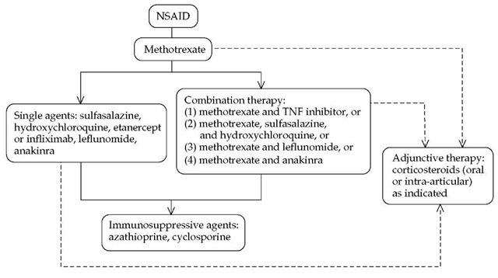

Slide 32
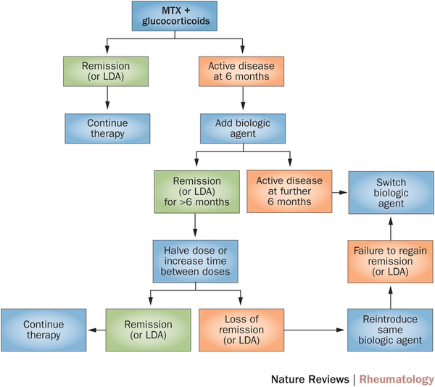

Slide 33
ASSESSMENT AND MONITORING —
Patients should be seen on a regular basis for
clinical evaluation and monitoring of clinical and
laboratory assessment of disease activity and for
screening for drug toxicities.
Patient and clinician assessment of symptoms and
functional status
Evaluation of joint involvement and extra-articular
manifestations
Laboratory markers
Imaging

Slide 34
Juvenile Idiopathic Arthritis
Juvenile rheumatoid arthritis (JRA) is the most common chronic rheumatologic disease in children and is one of the most common chronic diseases of childhood.
The etiology is unknown, and the genetic component is complex, making clear distinctions between the various subtypes difficult.
A new nomenclature, juvenile idiopathic arthritis (JIA), is being increasingly used to provide better definition of subgroups.

Slide 35
Signs and symptoms
History findings in children with JIA may include:
Arthritis present for at least 6 weeks before diagnosis (mandatory for diagnosis of JIA)
Either insidious or abrupt disease onset, often with morning stiffness or gelling phenomenon and arthralgia during the day
Complaints of joint pain or abnormal joint use
History of school absences or limited ability to participate in physical education classes
Spiking fevers occurring once or twice each day at about the same time of day
Evanescent rash on the trunk and extremities
Psoriasis or more subtle dermatologic manifestations

Slide 36
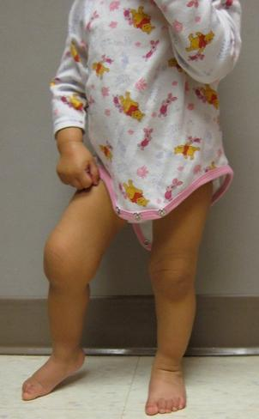
Physical findings
Physical finding :
Arthritis: Defined either as intra-articular swelling on examination or as limitation of joint motion in association with pain, warmth, erythema of the joint; physical findings in JIA reflect the extent of joint involvement
Synovitis: Characterized by synovial proliferation and increased joint volume; the joint is held in a position of maximum comfort, and range of motion often is limited only at the extremes

Slide 37
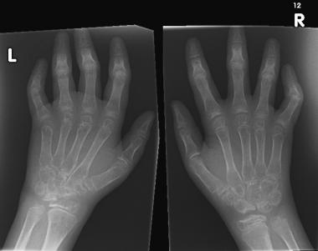
Physical findings
Types of JIA include the following:
Systemic-onset juvenile idiopathic arthritis
Oligoarticular juvenile idiopathic arthritis
Polyarticular juvenile idiopathic arthritis
Psoriatic arthritis
Enthesitis-related arthritis
Undifferentiated arthritis
Widespread osteopenia, carpal crowding (due to cartilage loss), and several erosions affecting the carpal bones and metacarpal heads in particular in a child with advanced juvenile rheumatoid arthritis .

Slide 38
Management
Management may include:
Pharmacologic therapy with NSAIDs, disease-modifying antirheumatic drugs (DMARDs), biologic agents, or intra-articular and oral corticosteroids
Psychosocial interventions
Measures to enhance school performance (e.g., academic counseling)
Improved nutrition
Physical therapy
Occupational therapy
American College of Rheumatology (ACR) criteria for complete remission are as follows:
No inflammatory joint pain
No morning stiffness
No fatigue
No synovitis
No progression of damage, as determined in sequential radiographic examinations
No elevation of the ESR and CRP level

Slide 39
Felty's syndrome
Felty's syndrome is characterized by the combination of rheumatoid arthritis, splenomegaly and neutropenia. The condition is more common in those aged 50-70 years, and is more prevalent in females than males and more in Caucasians than blacks.
Neutropenia – Neutropenia is present in all patients, with absolute neutrophil counts below 2000/microL.
Rheumatoid arthritis – The arthritis is typically severe, erosive, and seropositive for rheumatoid factor (RF) and/or anti-citrullinated peptide antibodies (ACPA) and is more frequently associated with extraarticular manifestations
Splenomegaly – Splenomegaly is present in most patients, although infrequently splenomegaly is undetectable in RA despite marked neutropenia

Slide 40
Physical Examination
Physical findings include:
Splenomegaly
Hepatomegaly (mild)
Lymphadenopathy
Weight loss
Rheumatoid nodules
Sjögren syndrome
Articular findings of long-standing RA – Joint deformities typical of RA, as well as synovitis (joint swelling and tenderness), which may be mild at presentation
Small-vessel inflammation (vasculitis) – Lower-extremity ulcers, palpable purpura and brownish pigmentary changes of the lower extremities, and periungual infarcts
Signs of systemic vasculitis – Mononeuritis multiplex and extremity ischemia
Other findings – Pleuritis, peripheral neuropathy, episcleritis, and signs of portal hypertension

Slide 41
Diagnostic Considerations
In addition to the conditions listed in the differential diagnosis, other problems to be considered include the following:
Chronic infection
Drug reactions
Other rheumatologic diseases
Infiltrative diseases
HIV infection
Neutropenia with large granular lymphocytosis (LGL), also known as pseudo-Felty syndrome
Differential Diagnoses
Cirrhosis
Myeloproliferative Disease
Non-Hodgkin Lymphoma
Sarcoidosis
Sjogren Syndrome
Systemic Lupus Erythematosus (SLE)
Tuberculosis

Slide 42
Laboratory and Imaging Studies
WBC count and differential, which are crucial when determining the degree of granulocytopenia.
Anemia and thrombocytopenia may result from hypersplenism.
Mild elevations of ALP and transaminase levels may occur.
Some 98% of patients with FS have high titers of RF.
Antinuclear antibodies (ANAs), found in 67% of cases
Antineutrophil cytoplasmic antibodies (perinuclear pattern; p-ANCA), found in 77% of cases.
ESR and serum immunoglobulin levels are invariably elevated
Diagnostic imaging
Radionuclide studies, ultrasonography, or computed tomography (CT) may define the presence and extent of splenomegaly.
The same modalities can also be used to assess patient response to therapy.

Slide 43
Treatment
Immunosuppressant
Immunosuppressive agents inhibit key factors in the immune system responsible for immune reactions.
Methotrexate : It is very effective in treating rheumatoid arthritis (RA). Antirheumatic effects may take several weeks to become apparent.
Methotrexate ameliorates symptoms of inflammation (e.g., pain, swelling, and stiffness).
Cyclophosphamide is an antineoplastic alkylating agent and immunosuppressive agent.
It reduces the numbers of B and T cells and increases the risk of infection.
Hematopoietic Growth Factors
CSFs stimulate production, maturation, and activation of neutrophils and increase migration and cytotoxicity of neutrophils.
Most experience has been with the use of granulocyte CSF (G-CSF).
Granulocyte-macrophage CSF (GM-CSF) stimulates division and maturation of earlier myeloid and macrophage precursor cells.
It reportedly increases granulocytes in 48-91% of patients.
Monoclonal Antibody: Rituximab
Current data suggest that rituximab should be considered a second-line therapy in patients with refractory FS.

Slide 44
THANK
YOU
FOR
YOUR
ATTENTION

