Slide 1
Principles of surgical oncology
M K ALAM
PROFESSOR OF SURGRY

Slide 2
ILOs
At the end of this presentation students will be able to:
Understand the biology of malignant diseases.
Outline general features of malignancy.
Describe clinical features of malignant disease.
Describe tumor staging
Explain the multi-modal approach to management of malignant diseases.
Outline the principles and methods of screening malignant diseases.

Slide 3
Introduction
Neoplasm: A mass of transformed cells that does not respond in a normal way to growth regulatory system.
- No useful function.
- Atypical & uncontrolled growth.
- Genomic abnormality: Increased cell replication or Inhibit cell death.
Normal cell: Balanced replication & cell death.

Slide 4
Carcinogenesis
Multifactorial, complex mechanisms & influenced by:
Inherited genetic makeup. (FAP)
Environment. (BCC, melanoma)
Radiation exposure.(skin tumors, leukaemia)
Exposure to carcinogens (bladder carcinoma, mesothelioma).
Viral infection (HCC, cervical carcinoma, Kaposi’s sarcoma, b cell lymphoma, nasopharyngeal carcinoma)
Diet (Aflatoxins- ca-esophagus, smoked foods- gastric carcinoma)
Hormonal imbalances (HRT).
Life style.

Slide 5
Mechanism of gene mutation
Insults leads to DNA mutation → cancer.
Mutation lead to- disruption of cell replication cycle. ↓
Either
Activation or overexpression of oncogenes.
Inactivation of tumor suppressor gene.

Slide 6
Examples of gene mutation
Gene Point of action in cell cycle
P16, CDK4,Rb - Cell cycle check point
MSH2, MLH1 - DNA replication & repair
P53, fas- Apoptosis
E cadherin- Cellular adhesion
erb-A- Cellular differentiation
Ki-ras, erb B- Regulatory kinase
TGF-β- Growth factors

Slide 7
Natural protective mechanisms
Repair error in DNA replication
Immune surveillance
Simple wastage of cells (loss of cell from surface)
Apoptosis

Slide 8
Neoplasms- Benign & Malignant
Malignant cells are invasive & metastasize
Malignant genotype develops as result of progressive acquisition of cancer mutation (chromosomal loss or translocation).
Progressive accumulation of mutation give rise to cancer stem cell (pluripotent- give rise to different type of cells- epithelial, vascular, structural cells)
Concept of progression from benign to malignant- rationale behind screening & early detection plan

Slide 9
Metastasis
Mechanism of metastasis is complex & unclear.
Further mutation in cancer cell occur for metastasis.
Local pressure effects from expanding tumors
Loss of adhesion
Increased motility of cancer cells
Secretion of multiple factors
Embolization of cancer cells
Survival of metastatic deposits – local angiogenesis

Slide 10
Routes of metastasis
Direct invasion
Haematogenous spread
Lymphatic spread
Transcelomic spread

Slide 11
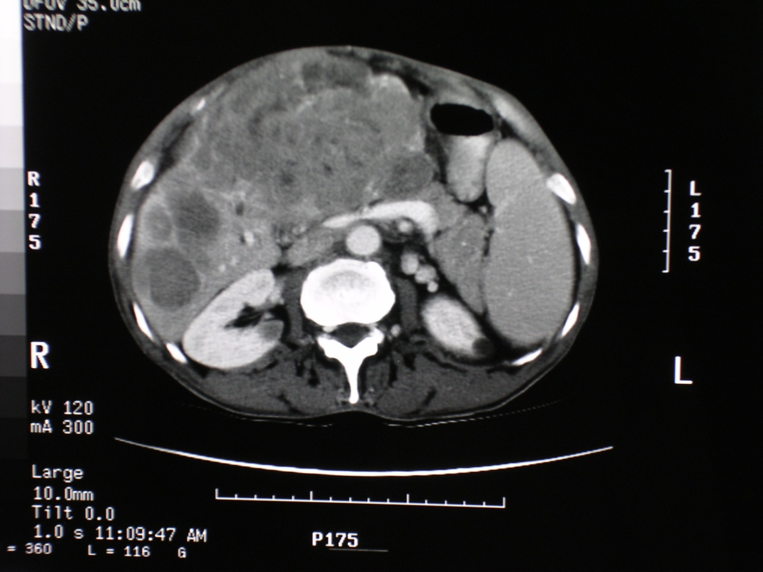

Slide 12
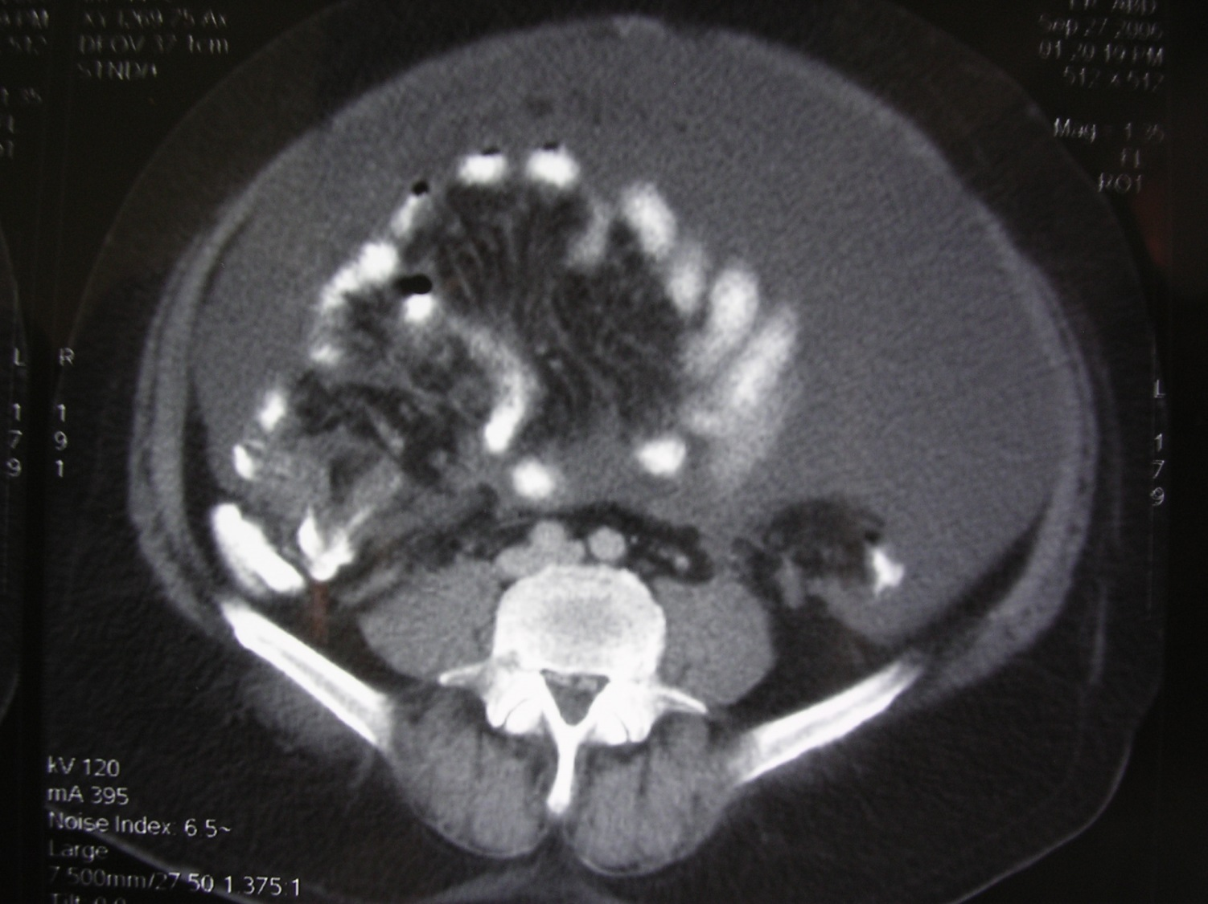

Slide 13
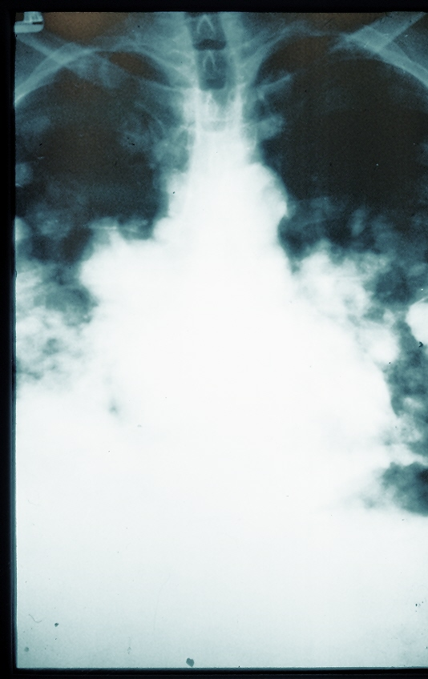

Slide 14
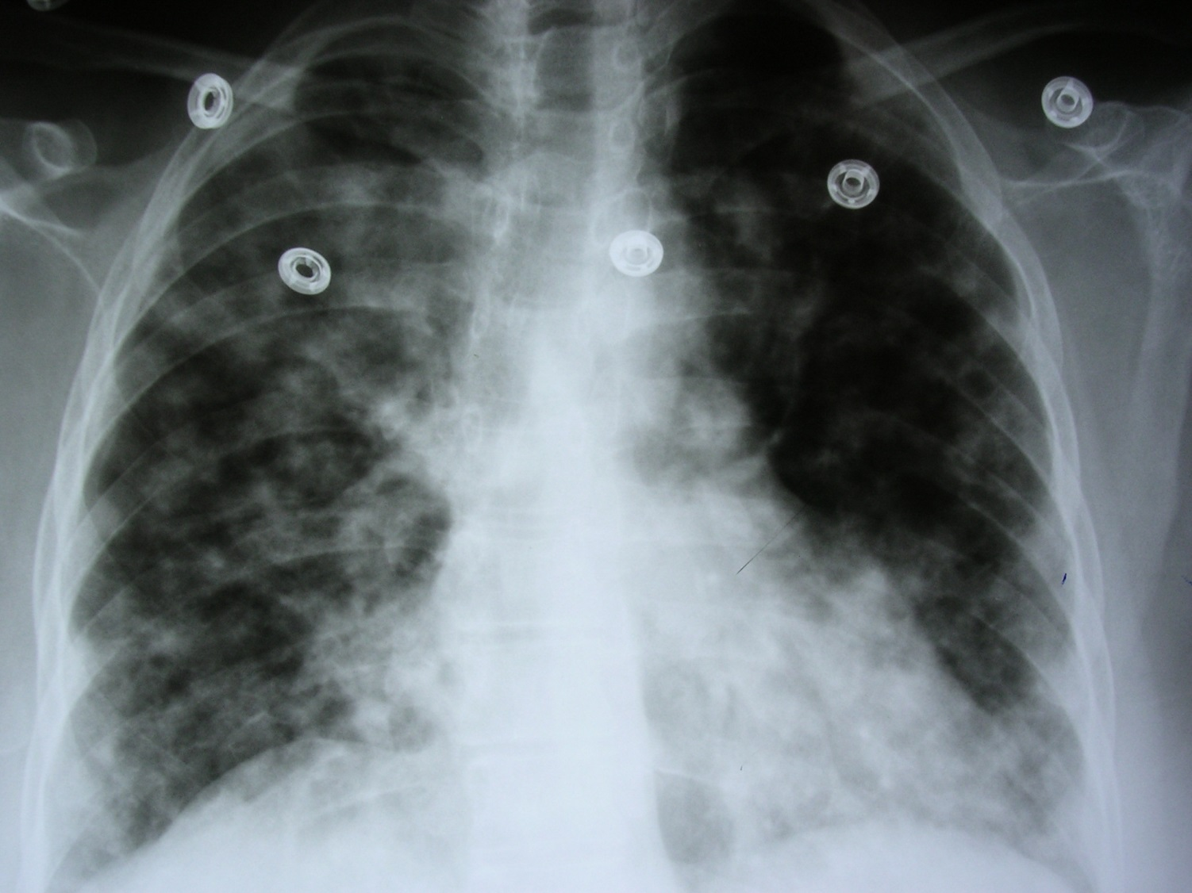

Slide 15
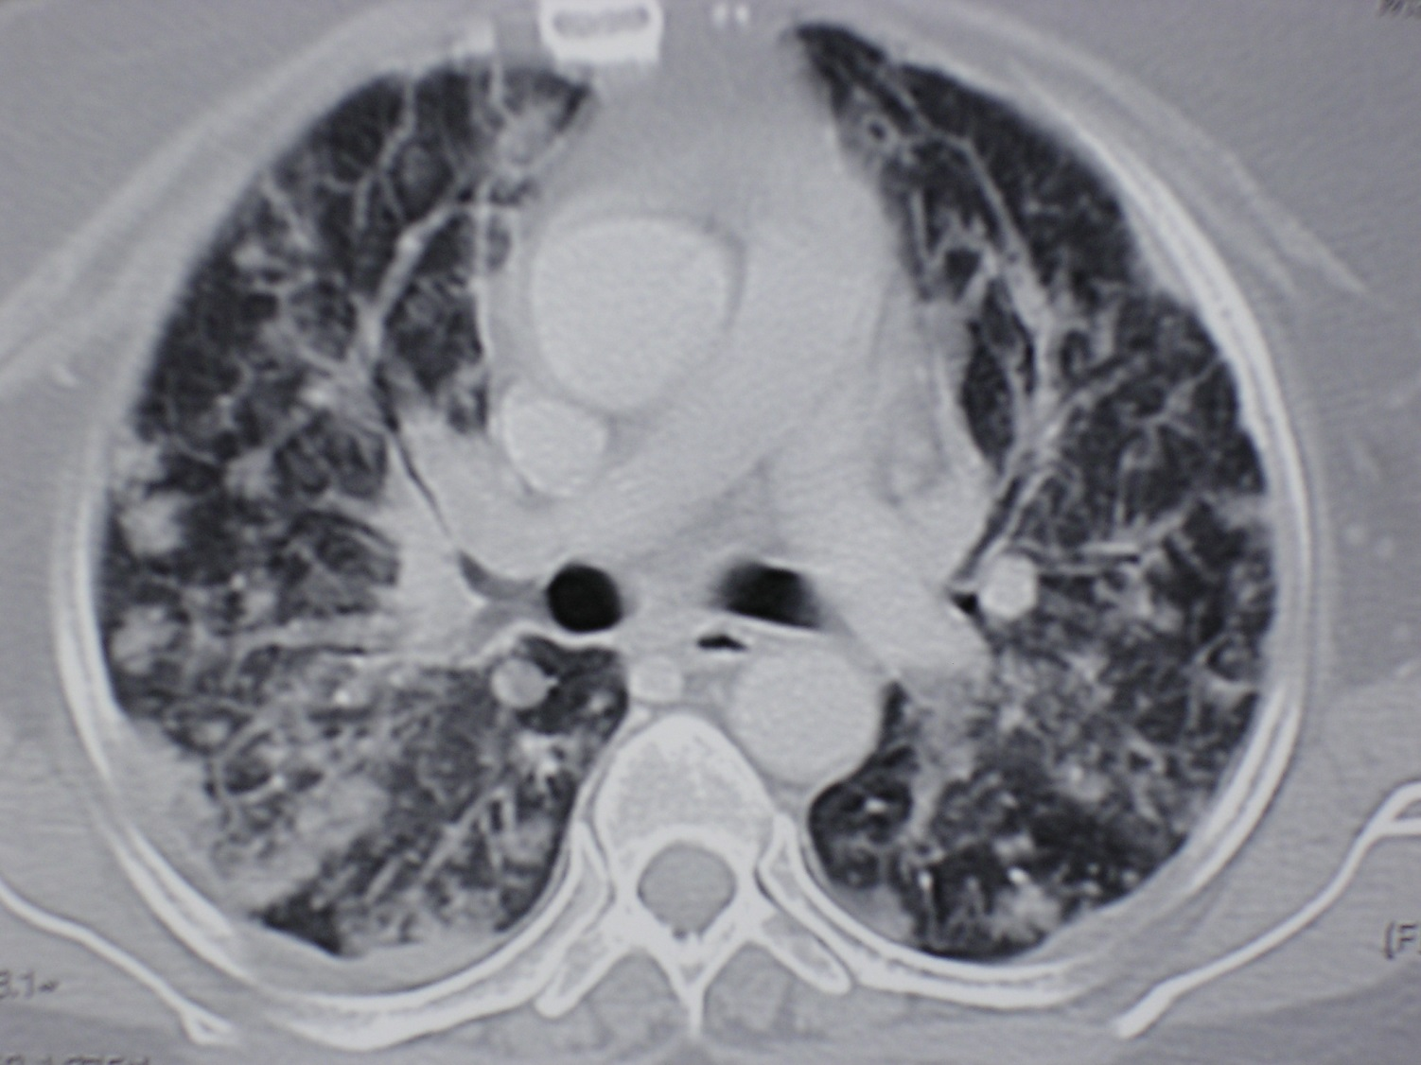

Slide 16
Natural history
3/4th of tumor life span- pre-clinical or occult.
Progression of malignant tumors: Carcinoma in situ (pre-invasive) → early invasive → advanced invasive → metastatic tumor.
Cure: Every malignant cell eradicated, no recurrence during patient’s life time & no residual tumor at death.

Slide 17
Goals of Management of malignant diseases
Prevention: Smoking, sunlight, chemoprevention
Screening: Early detection for cure.
- Risk groups: Cervical cytology, mammography, CRC (FOB, sigmoidoscopy/colonoscopy), PSA
- Inherited cancers: BRCA 1, BRCA 2
Cure
Palliation

Slide 18
Presentation of malignant diseases
Swellings: Painless, irregular, firm or hard.
Anemia: Chronic blood loss from GI tumors.
Obstruction of hollow tubes: Dysphagia, bowel obstruction, jaundice, hydronephrosis.
Metastasis: Lymphadenopathy, hepatomegaly, ascites, pleural effusion, pathological fracture.
Asymptomatic: Tumor discovered during routine checkup.

Slide 19
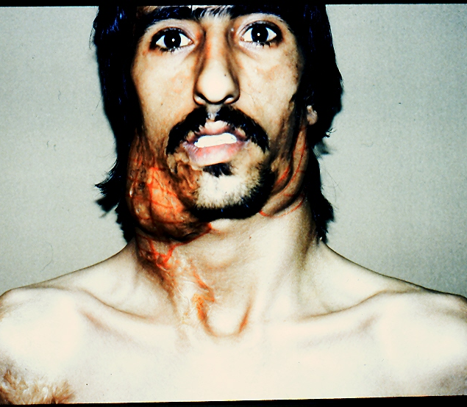
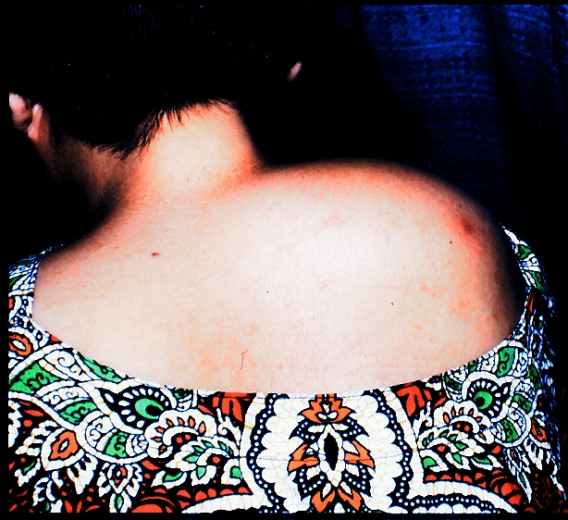

Slide 20
Diagnosis of malignant diseases
History:
Wt. loss,
Bleeding GI/urinary),
Lump,
Obstruction-dysphagia, bowel obstruction
Persistent non-specific symptoms.
Examination:
Primary lesion,
local spread,
metastasis.
Investigations:

Slide 21
Investigations
Blood tests: Hematology, biochemistry, tumor markers- (α-fetoprotein, CEA, CA 125, PSA, CA19-9).
Radiology: Plain x-rays, contrast studies, US, CT, MRI, PET scan.
Endoscopy: Upper GI, lower GI, ERCP.
Cytology/histology: FNA, core biopsy, excision/ incision biopsy, endoscopic brushings, radiology guided FNA.
Operative: EUA & biopsy, Lymph node excision biopsy, diagnostic laparoscopy & biopsy

Slide 22
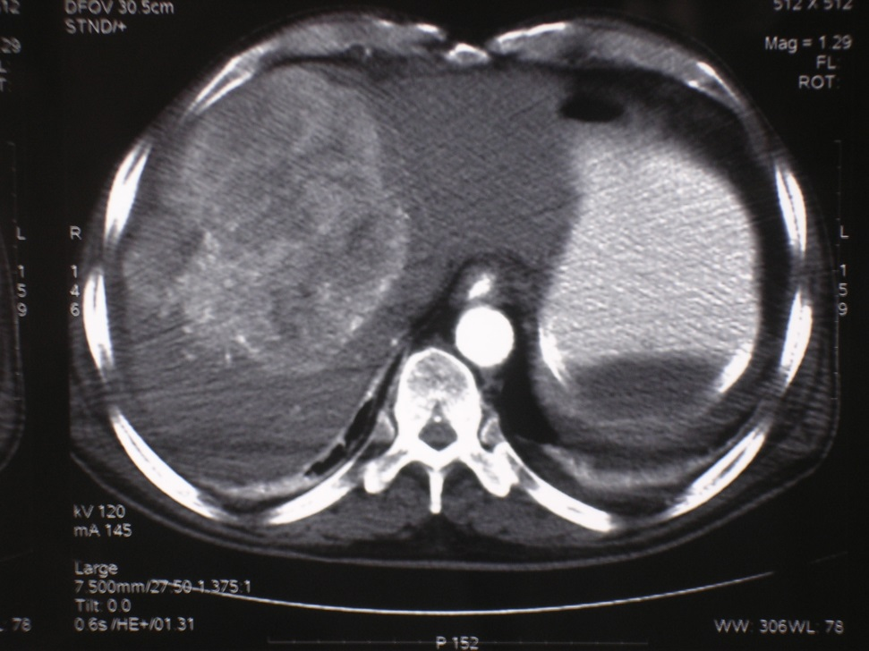
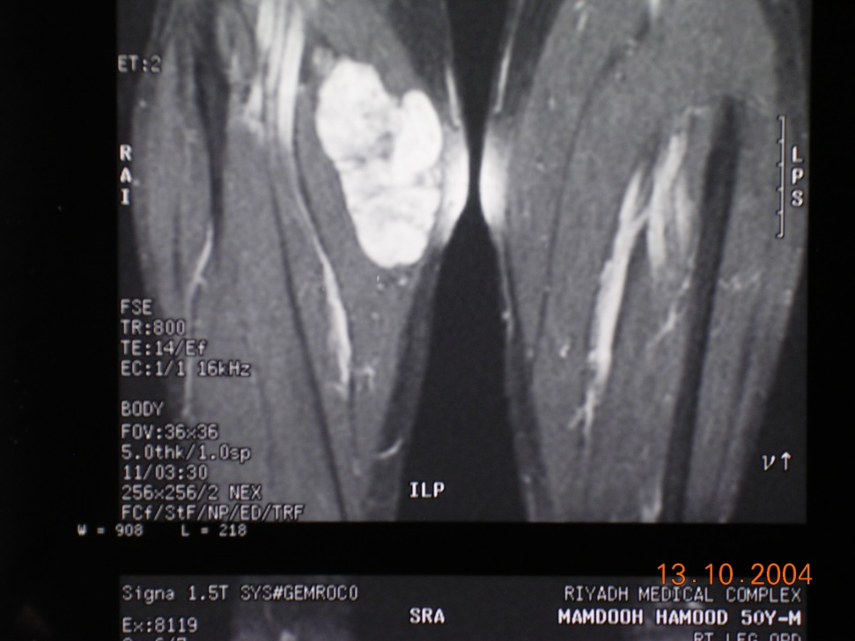

Slide 23
Tumor staging- TNM
Tumor:
T0- primary unknown, Tis- tumor in-situ
T1- < 2cm tumor, T2- > 2cm tumor,
T3- > 5cm or reaching serosa (GI tumors)
T4- infiltrating into surrounding tissues.
Nodes:
N0- not involved
N1- local nodes involved
N2- distant nodes involved (fixed nodes- breast, N3- distant nodes involved)
Metastasis:
M0- no metastasis.
M1- metastasis present.
Mx- status unknown

Slide 24
Tumor staging
Purpose of staging:
  Define extent of disease.
  Development of treatment plan.
  Assess likely prognosis.
Investigations for staging:
CT, MRI, PET scan, endoscopic ultrasound, bone scans, laparoscopy

Slide 25
Tumor Grading-histological
Grade 1: Well differentiated (recognizable structures of parent tissue)
Grade 2: Moderately differentiated (some degree of organization)
Grade 3: Poorly differentiated (architecture totally disorganized, cells not recognizable from parent tissue)

Slide 26
Management of malignant diseases
Multidisciplinary team approach:
Surgeon.
Oncologist( radiotherapy, chemotherapy).
Radiologist.
Pathologist.
Specialist nurse.

Slide 27
Principles of surgical treatment
Benign: Complete excision with sufficient surrounding tissue.
Malignant: Discussion with multidisciplinary team before or after surgery.
-Radical surgery: Complete removal of tumor bearing tissue together with margin of unaffected tissue
-En bloc resection: removal of tumour with loco-regional lymph nodes.
-Sentinel lymph node biopsy: example- breast ca.

Slide 28
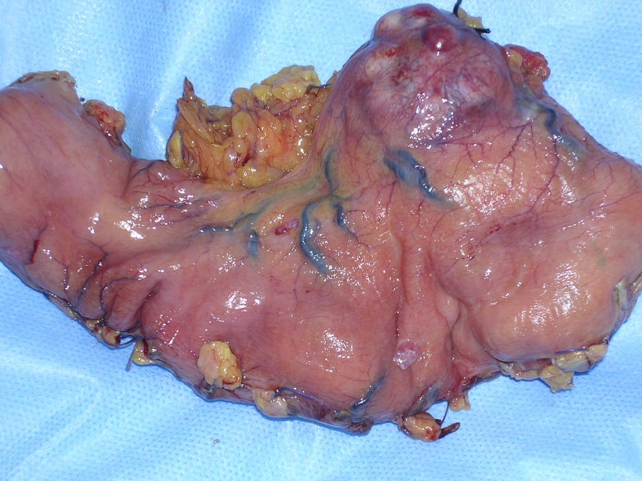
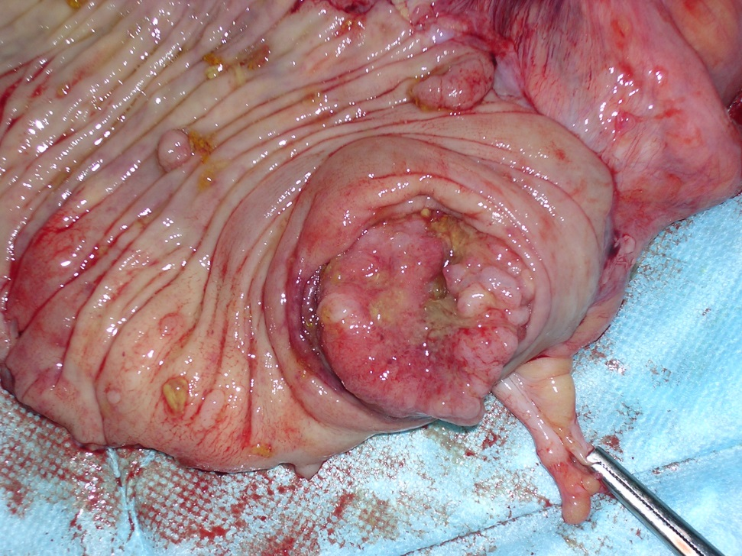

Slide 29
ADJUVANT THERAPY
Accurate staging after histopathological examination of resected tumor.
Multidisciplinary team discussion.
Aim: Local and systemic disease control.

Slide 30
Chemotherapy
Help control local and systemic disease.
Success varies in different types of cancer.
Chemotherapy is toxic.
Affects quality of life.
Benefits, morbidity and affect on quality of life must be balanced.

Slide 31
Radiotherapy
Post-operative: Local control (incompletely removed tumor, close margin resection)
Neoadjuvant: Given before surgery to downstage, or shrink a bulky and fixed tumors ( rectum)
Part of radical treatment: to improve cosmetic result in radiosensitive tumors ( breast- lumpectomy vs mastectomy)

Slide 32
Other forms of adjuvant therapy
Hormone therapy: Anti-oestrogen-Tamoxifen, orchidectomy (prostate cancer)
Immunotherapy: Monoclonal antibodies – herceptin in breast carcinoma.
Gene therapy to restore function of tumor suppressor gene.

Slide 33
Management of advanced malignant diseases
Surgery for metastasis: colorectal liver metastasis. Improved 5- year survival- 40%.
Palliative surgery: relief of distressing symptoms by surgery, chemotherapy, radiotherapy, pain relief, psychological and social aspect management.
Care of dying: palliative team, hospice care

Slide 34
Regular follow-up
Local recurrence( history, examination, investigations- tumor markers, radiology, endoscopy).
Metastasis.
Symptom relief.
Patients seen more frequently in early months after surgery.
Interval increased later.

Slide 35
Thank you!

