Slide 1
METABOLIC RESPONSE TO INJURY
M K ALAM MS; FRCS

Slide 2
ILOs
At the end of this presentation students will be able to:
Understand the body’s local and systemic response to injury.
Explain the metabolic changes that happen in response to injury.
Recognize the harmful effects of this response.
Describe the clinical interventions to minimize harmful effects.
Differentiate the clinical spectrum of SIRS

Slide 3
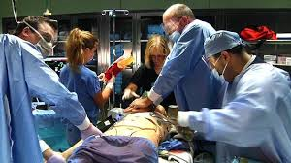
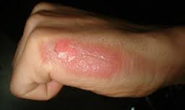
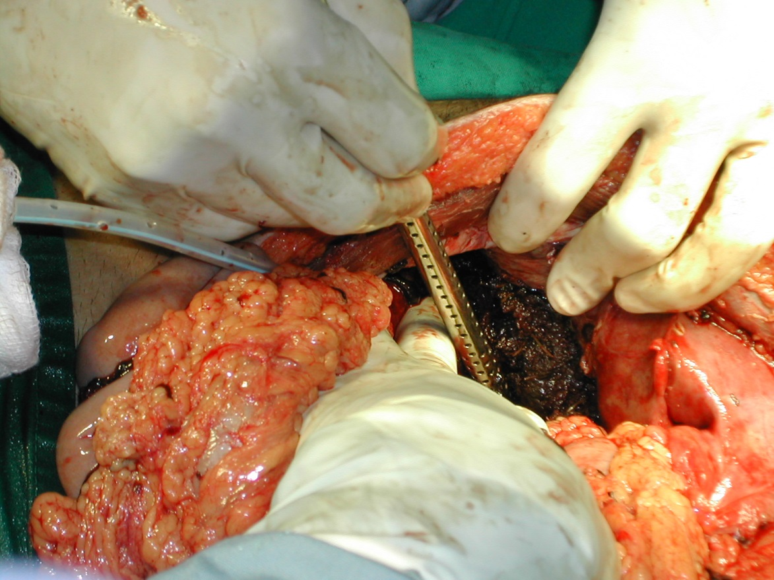

Slide 4
INTRODUCTION
Complex neuroendocrine response
Aim : Restore body to pre-injury state
Acts locally & systemically
Major insults- overwhelming inflammatory response
Without appropriate intervention- threatens survival.

Slide 5
RESPONSE
Proinflammatory: Activation of cellular processes designed to restore tissue function and eradicate invading microorganisms.
Anti-inflammatory: Preventing excessive proinflammatory activities and restoring homeostasis in the individual.

Slide 6
Response
INITIAL CATABOLIC (Lasts up to 1 week)
High metabolic rate
Breakdown of protein and fat
Negative nitrogen balance
Weight loss
ANABOLIC: (2-4 weeks)
Protein & fat store restored
Positive nitrogen balance
Weight gain

Slide 7
Acute Inflammatory Response
Tissue damage→ Activation of tissue MACROPHAGE → CYTOKINES release - IL1, IL6, IL8, TNFα
Cytokines are a category of small proteins that are important in cell signaling. They are released by cells and affect the behavior of other cells.
IL8 - attracts circulating MACROPHAGE & NEUTROPHILS
IL1,IL6, TNFα activates inflammatory cells to kill bacteria
CYTOKINES entry into circulation- fever, acute-phase protein response (IL6). C-reactive protein used as a biomarker

Slide 8
Acute Inflammatory Response- contd.
Other substances released:
PRO-INFLAMMATORY: Prostaglandins, complement, free radicals
ANTI-INFLAMMATORY: IL10, antioxidants (VIT. A,C)
Clinical condition depends on:
-Extent to which inflammation remains localized
-Balance between PRO AND ANT-INFLAMMATORY process

Slide 9
ROLE OF ENDOTHELIUM & BLOOD VESSELS
Leucocyte- adhesion to endothelium & transmigration
Vasodilatation – due to kinins, prostaglandins, nitric oxide release
Increased capillary permeability delivering inflammatory cells, O₂, nutrients- all important for healing
Colloid leak (mainly albumin) → oedema
Coagulation & reduced bleeding: due to tissue factors & activated platelets.
If inflammatory process generalized → microcirculatory thrombosis & disseminated intravascular coagulation (DIC)

Slide 10
ROLE OF AFFRENT NERVE IMPULSES
Injury & inflammation: stimulates afferent pain fibres → stimulus reaches to thalamus which stimulates:
↓
Sympathetic NS: Catecholamine release ( noradrenaline from sympathetic nerve ends & adrenaline from adrenal medulla) → tachycardia, increased cardiac output, changes in CH, protein & fat metabolism
Hormone release:
- Increased secretion of stress hormones
- Decreased secretion of anabolic hormones

Slide 11
HORMONAL CHANGES
 | PITUITARY | ADRENAL | PANCREAS | OTHERS
↑ SECRETION | GH ACTH PROLACTIN ADH | ADRENALINE CORTISOL ALDOSTERONE | GLUCAGON | RENIN ANGIOTENSIN
UNCHANGED | TSH LH FSH | - | - | -
↓ SECRETION | - | - | INSULIN | TESTOSTERONE OESTROGEN THYROID HORMONES

Slide 12
CONSEQUENCES OF METABOLIC RESPONSES TO INJURY
Hypovolaemia (moderate to severe injury) due to:
- Blood, electrolyte containing fluid/ water loss
- Protein rich fluid loss in 3rd space (24-48 hrs) greater loss in burn, ischemia, infection
Hypovolaemia leads to reduced O₂ & nutrient delivery to tissue

Slide 13
Fluid conserving measures
Sodium & water retention (Oliguria) due to:
-↑ADH (injury, atrial stretch receptors, osmoreceptors, pain, anxiety)- free water retention
-↑Aldosterone (stimulated by renin-angiotensin, ACTH, ADH)- increase reabsorption of water and Na⁺
- ADH & Aldosterone elevated for 48-72 Hours
Increased sympathetic activity- compensatory increase in CO, peripheral vasoconstriction (↑BP)

Slide 14
INCREASED METABOLISM
Energy expenditure rise (10-30%) due to:
Increased thermogenesis due to inflammatory response (IL1)
Increased BMR- ↑ metabolism of carb., protein, fat. (increased ion pump & cardiac activity)
Patients following major surgery/ severe trauma are in a state of:
Catabolism: increased breakdown of nutrients to its constituents ( glucose, amino acid & fatty acids)
Starvation : ( low intake & increased demand)

Slide 15
CARBOHYDRATE METABOLISM
↑Catecholamines & Glucagon:
Stimulates glycogenolysis in the liver.
Gluconeogenesis (lactate, amino acids, glycerol) in the liver.
Suppress Insulin secretion
Result: Hyperglycaemia- impaired cellular glucose uptake
Glucose available for - repair and inflammatory process
Severe hyperglycaemia-↑ morbidity & mortality in surgical patients

Slide 16
FAT METABOLISM
Catecholamines, Glucagon, cortisol & growth hormone:
Activate triglyceride lipase in adipose tissue.
Lipolysis- glycerol & free fatty acids (FFA).
Glycerol used in gluconeogenesis.
FFA converted to ketone in liver & to ATP in most tissues.
Brain uses ketone for energy when less glucose available.

Slide 17
PROTEIN METABOLISM
Proteolysis (skeletal muscle) mediated primarily by glucocorticoids
↑urinary nitrogen excretion to ˃30 g/d (normal 10-20 g/d).
Amino acids (AA): Used for gluconeogenesis and other activity
Not a long-term fuel reserve.
Excessive protein depletion-(25-30% lean body wt.)incompatible with life.
Catabolism: Correspond to- severity & duration of injury.
Feeding can’t reverse catabolism but reduces it.

Slide 18
PROTEIN METABOLISM (AMINO ACIDS FROM PROTEOLYSIS)
1. Glucogenic AA (alanine, glycine, cysteine)- gluconeogenesis in liver
2. Other AA (Krebs cycle) pyruvate, acetyl co. A - gluconeogenesis
3. Substrate for acute phase proteins (liver)- C reactive protein
Role of acute phase protein not known ? defence or healing

Slide 19
CHANGES IN RBC AND COAGULATION
Anaemia: Blood loss, haemodilution, impaired RBC production in bone marrow (↓ erythropoietin)
Hypercoagulable state: (Endothelial injury, platelet activation, venous stasis, increased procoagulant factors) Increased risk of thrombo-embolism

Slide 20
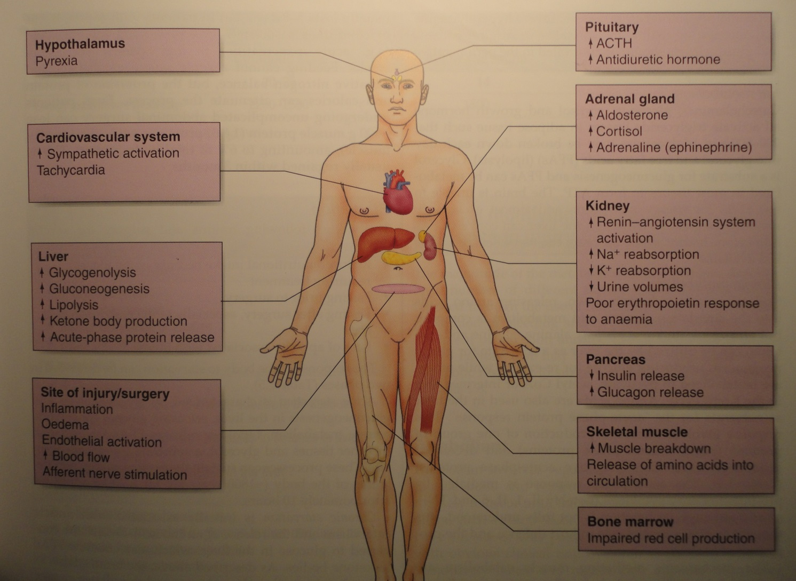

Slide 21
FCTORS MODIFYING RESPONSE TO INJURY
Patient related factors: Coexisting illness, medications, nutritional status, genetic factors.
Injury related factors: Severity, nature (burn, ischemia), temperature.
Response magnitude can be minimized by: minimal invasive surgery , minimizing blood loss, preventing/ treating infection, use of loco-regional anaesthesia.

Slide 22
CLINICAL SPECTRUM OF INFECTION & SYSTEMIC INFLAMATORY RESPONSE SYNDROME (SIRS)
Terminologies to describe various facets of inflammation:
SIRS: 2 or more of following:
  Temperature ≥38°C or ≤36°C
  Heart rate ≥90 beats/min
  Respiratory rate ≥20/mi
  WBC count ≥12,000/L or ≤4000/L
Sepsis: Identifiable source of infection + SIRS
Severe sepsis: Sepsis + organ dysfunction
Septic shock: Sepsis + cardiovascular collapse

Slide 23
ANABOLISM
Pro-inflammatory cytokine has subsided
Regaining weight, skeletal muscle mass, and fat.
Patients feel better, regain appetite
Hormones: Insulin, insulin like growth factor, growth hormone, androgens, 17-ketosteroids
Adequate nutrition & early mobilization promote enhanced recovery.

Slide 24
THANK YOU!

