Slide 1
INFLAMMATORY MYOPTHIES
Dr. M. A. SOFI
MD; FRCP; (London); FRCPEdin;FRCSEdin

Slide 2
INFLMMATORY MYOPATHIES
Are a group of disorders sharing the common feature of immune-mediated muscle injury.
Clinical & histopathological distinctions between these conditions suggest that different pathogenic processes underlie each of the inflammatory myopathies.
The most common of these disorders include:
Dermatomyositis (DM)
Inclusion body myositis (IBM)
Polymyositis (PM)
Overlap syndromes (with another systemic rheumatic disease)
Neither environmental factors nor infectious causes have known roles in these disorders.
All are thought to be due to immune system abnormalities leading to the development of inflammation in muscle and other tissues.

Slide 3
Clinical manifestations
The main symptom common to the all IM is muscle weakness.
Other symptoms that indicate involvement of body systems other than muscle can occur.
Muscle weakness —Typically patients develop painless weakness of the proximal—in a symmetric pattern affecting both sides of the body.
The smaller distal muscles of the hands, wrists, feet, and ankles are usually not affected.
Difficulty rising from a chair, climbing stairs, or performing tasks such as reaching up to a high shelf
Grip strength remains normal.
At times there may be mild muscle soreness.
The weakness usually develops over several weeks to months.
Some patients will develop difficulty swallowing or may aspirate food into the lungs, which can lead to pneumonia.

Slide 4
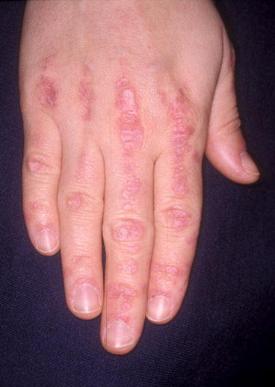
Clinical manifestations
Skin changes
DM often develop skin rash or other changes in the skin.
Rash may occur without any muscle weakness .
Gottron’s sign is a flat red rash over the back of the fingers, elbows or knees.
Gottron’s papules are red, often scaly, bumps overlying the knuckles of the fingers.
Gottron’s sign: Erythematous to violaceous macules, patches, or papules on the extensor surfaces of joints

Slide 5
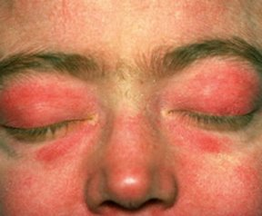
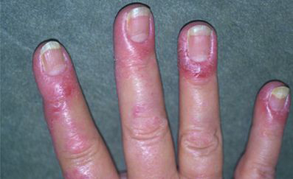
Clinical manifestations
Heliotrope rash – The heliotrope rash is located on the upper eyelids and is often accompanied by eyelid swelling.
Nail abnormalities – The nailfolds (the skin around the fingernails) may become reddened and may develop changes in the blood vessels.
Heliotrope eruption :
Periungual erythema in a patient with dermatomyositis

Slide 6
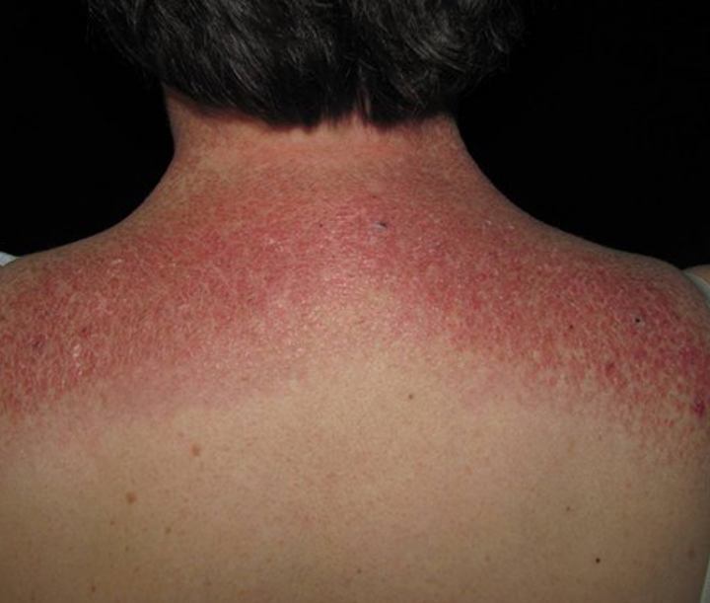
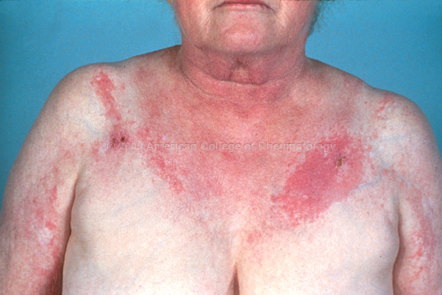
Clinical manifestations
Skin changes
Shawl sign – The shawl sign is a widespread, flat, reddened area that appears on the upper back, shoulders, and back of the neck. It can worsen with exposure to ultraviolet light.
V sign – The V sign has an appearance similar to that of the shawl sign, but appears on the front of the chest in the area of skin exposed by a V-necked sweater.
Shawl sign
V sign

Slide 7
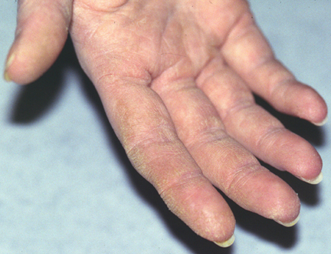
Clinical manifestations
Mechanic's hands – People with dermatomyositis or polymyositis may develop “mechanic's hands,” a roughening and cracking of the skin of the tips and sides of the fingers, resulting in irregular, dirty-appearing lines that resemble those of a manual laborer.
Scalp – Changes in the scalp resembling psoriasis often occur in people with dermatomyositis.
Mechanic's hands in a patient with dermatomyositis

Slide 8
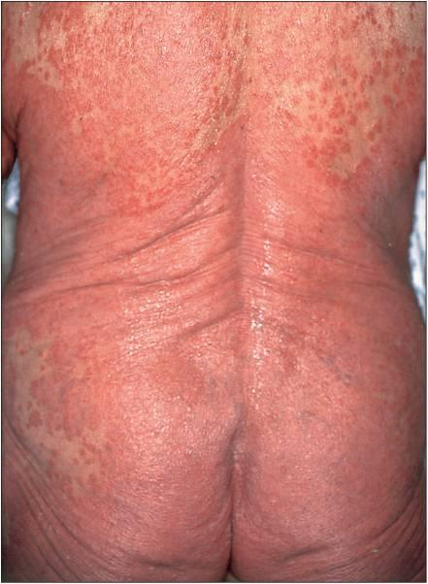
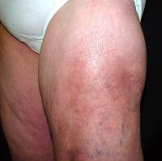
Clinical manifestations
Holster sign
Generalized Erythederma
An erythematous and violaceous rash over the lateral hip, called the "Holster sign,"

Slide 9
Clinical manifestations
Lung disease — ILD occurs most commonly in patients with anti-synthetase antibodies in their blood.
These patients may develop a cough and SOB with exertion that ranges from mild symptoms to severe, progressive respiratory distress.
Antisynthetase syndrome
This subgroup of patients all have anti-synthetase antibodies.
Anti-Jo-1 antibody is found in about 20 percent of DM patients.
This subgroup is characterized by rashes:
  Mechanic’s hands
  interstitial lung disease
  fever, arthritis, and Raynaud’s phenomenon.

Slide 10
Clinical manifestations
Other systemic rheumatic diseases — When myositis accompanies scleroderma or systemic lupus, the myositis does not always cause symptoms.
May have mild muscle weakness, others have only abnormal blood muscle enzymes.
Cancer — Inflammatory myopathies, especially adults with dermatomyositis who do not have anti-synthetase antibodies, have an increased risk of cancer.
Juvenile dermatomyositis — Children with inflammatory myopathy usually but not always have a DM rash.
They develop painful calcium deposits on the skin and fascia.

Slide 11
Laboratory findings
Elevated muscle enzyme: CK, LDH, AST, ALT are all muscle enzymes that may be elevated
Autoantibodies, including antinuclear antibodies, in up to 80 percent of patients with DM and PM
Elevated levels of serum and urine myoglobin
The erythrocyte sedimentation rate (ESR) is often normal or is only mildly elevated, even in patients with active muscle disease
Specific autoantibodies:
Myositis-specific autoantibodies are detected primarily in patients with inflammatory myositis and which may offer information regarding prognosis and potential patterns of organ involvement
Myositis-associated autoantibodies are found with other autoimmune rheumatic diseases that may be associated with myositis especially in patients with overlap syndromes

Slide 12
Laboratory findings
HISTOPATHOLOGY:
Dermatomyositis (DM) and polymyositis (PM) can be distinguished from each other and from other forms of myopathy by their histopathologic findings.
In patients with dermatomyositis, characteristic findings may also be seen on skin biopsy, although these findings are very similar on light microscopy to changes that can be seen in systemic lupus erythematosus

Slide 13
Differential diagnosis: Inflammatory myopathies
Hypothyroidism (usually severe cases).
Drug induced: Drugs that can cause myopathy include:
Statins used for dyslipidemia
Prednisone in high and prolonged doses
Colchicine used on a daily basis in patients with kidney disease.
Muscular dystrophies - specific patterns of weakness and may be familial.
Metabolic myopathies – (Rare) due to abnormalities in enzymes involved in the metabolism of carbohydrates or fats.
Electrolyte abnormalities - such as severe potassium depletion.
Infections - (most commonly viral).
Inclusion body myositis

Slide 14
Diagnosis: Inflammatory myopathies
The diagnosis involves a careful history, a thorough physical exam, and some blood tests.
Nearly all patients with myositis will have elevation of creatine kinase (CK) levels.
Many will have antinuclear antibodies (ANA) or one of the anti-synthetase antibodies in their blood.
Some patients will be “serologically silent,” meaning they have no antibody markers.
Magnetic resonance imaging (MRI) scan of the muscles can demonstrate inflammation of muscles.
Electromyogram (EMG) can demonstrate abnormal electrical activity in muscles, also indicating muscle injury.
Muscle biopsy is the most accurate test to definitive diagnosis.
May not be necessary in cases with typical presentations and characteristic rash.

Slide 15
Management: Inflammatory myopathies
Osteoporosis prevention
  Calcium supplement with vitamin D to prevent osteoporosis.
  Bisphosphonates, are often recommended in patients treated with prednisone.
Exercise
Physical therapy and rehabilitation should begin soon after the diagnosis of DM or PM to prevent contractures
Avoidance of sunlight:
People with DM should protect themselves from the sun by using sunscreen
Aspiration prevention
Patients who have trouble swallowing must take care to avoid inhaling (aspirating) foods and drinks.
Initial therapy
The goals of treatment are to improve muscle strength and to avoid the development of extra-muscular complications.
In patients with dermatomyositis (DM), resolution of cutaneous disease manifestations is an additional goal.

Slide 16
Management: Inflammatory myopathies
Glucocorticoid regimen:
Treatment with high doses for the first several months to establish disease control
Taper to the lowest effective dose for a total duration of 9 to 12 months
First 4 – 6 week at 1 mg/kg per day with ongoing assessment of the clinical response.
After 4 - 6 weeks at the initial dose, prednisone tapering should begin by 10 mg each week until a dose of 40 mg/day is reached.
80% of patients with inflammatory myopathies improve with glucocorticoids alone.
50 % of patients with PM do not respond to steroids alone
Glucocorticoid sparing agent:
Patients treated with combination therapy (Predisone + Azothioprin) had better functional outcomes and required less prednisone as maintenance therapy (1.6 mg/day versus 8.7 mg/day)

Slide 17
Management: Inflammatory myopathies
Apparent glucocorticoid failures — Three possibilities should be reviewed before intensifying immunosuppression:
Alternative diagnoses :
  Inclusion body myositis
  Muscular dystrophy
  Hypothyroidism
Glucocorticoid-induced myopathy should be considered.
Unrecognized malignancy associated with myositis may be a cause of failed response to glucocorticoids.
Most myositis-associated malignancies are diagnosed within the two-year period before and after the development of myositis.

Slide 18
Management: Inflammatory myopathies
Antimalarials:
Hydroxychloroquine (200 to 400 mg/day) is effective in up to 75 percent of patients in controlling skin disease but without any benefit to muscle disease.
Treatment complications:
Side effects of therapy included:
Cushingoid appearance (71 percent)
Psychological or psychiatric symptoms (35 percent)
Osteoporosis (29 percent)
Infections (29 percent)

Slide 19
INFLMMATORY MYOPATHIES
A form of DM, termed amyopathic DM, is a condition in which patients have characteristic skin findings of DM without weakness or abnormal muscle enzymes
Epidemiology:
Combined incidence of (DM) and (PM) has been estimated at 2 per 100,000 annually .
Female to male predominance of about two to one.
Peak incidence in adults occurs between the ages of 40 and 50.
Estimates of prevalence range from 5 to 22 per 100,000 .

Slide 20
Inclusion Body Myosisits (IBM):
Sporadic inclusion body myositis (IBM) is classified along with polymyositis, dermatomyositis, and autoimmune necrotizing myopathy as one of the idiopathic inflammatory myopathies.
However, despite some similarities, the clinicopathologic manifestations of IBM are clearly distinct from the other two disorders
EPIDEMIOLOGY
IBM is a rare sporadic disorder with a prevalence of 5 - 9 cases per million adults;
some estimates of prevalence have been as high as 70 per million population.
It is the most common acquired idiopathic inflammatory myopathy in individuals over the age of 50.
The disease affects men more often than women.
The mean age at onset of symptoms is approximately 60 years, with a range from the third to the ninth decade.

Slide 21
Inclusion body myosisits: Clinical features
Muscle weakness is the usual presenting feature.
Painless and insidious, and usually presents after the age of 50.
Duration of symptoms is 6 years before diagnosis.
Weakness is asymmetrical in contrast to polymyositis.
Fatigue and exercise intolerance are common
Respiratory muscles are usually spared.
Dysphagia is problematic in 40-50% of patients.
Examination
Weakness of flexion and extension of the wrist and fingers is disproportionate.
Extension of the knee is weak compared with flexion of the hip.
Facial muscle weakness may occur, but extra-ocular muscles are not affected and ptosis is not seen
Tendon reflexes are usually suppressed in myopathy and in this condition it is most marked at the knee.

Slide 22
Inclusion body myosisits: Investigations
Muscle enzymes are typically normal or mildly elevated in IBM
Creatine kinase (CK) levels generally being less than 10 times normal
ESR or the C-reactive protein (CRP), are usually normal
There is no association with antinuclear antibodies
Myositis-specific autoantibodies are typically absent in patients with IBM
Muscle biopsy should be performed in all patients with suspected IBM,
Histopathological confirmation is not always possible
Diagnosis may still be made based on characteristic clinical findings.

Slide 23
Laboratory findings
ELECTROMYOGRAPHY
Characteristic electromyography (EMG) are often seen in inflammatory myopathy.
Such changes are not specific for the diagnoses of dermatomyositis or polymyositis,
EMG is normal in 10% of patients.
Similar findings may occur in various infectious, toxic, or metabolic myopathies
MR IMAGING:
Magnetic resonance (MR) imaging of skeletal muscles is a noninvasive sensitive but nonspecific modality for detecting areas of muscle inflammation and edema with active myositis, fibrosis, and calcification

Slide 24
Inclusion body myosisits: Differential diagnosis
Acid maltase deficiency
Hereditary inclusion body myopathy
Motor neuron disease
Post polio syndrome
Oculopharyngeal muscular dystrophy
Late-onset distal myopathies
Overlap myositis
Sarcoidosis (chronic atrophic sarcoid myopathy)
Drug-induced myopathies
Myotonic dystrophy, type 1/2
Myofibrillar myopathies

Slide 25
Treatment
Initial therapy:
The goals of treatment are to improve muscle strength and to avoid the development of extra-muscular complications.
In patients with (DM), resolution of cutaneous disease.
Systemic glucocorticoids:
Initiation with high doses for the first several months to establish disease control
Start with 1 mg/kg per day for first 6/52
Slowly taper to the lowest effective dose for a total duration of therapy between 9 and 12 months

Slide 26
Treatment
Glucocorticoid tapering — After 4-6 weeks tapering should begin.
Prednisone should be tapered by 10 mg each week until a dose of 40 mg/day is reached.
After one week on 40 mg/day, the dose should be tapered by 5 mg each week until the 20 mg/day.
After one week on 20 mg/day, the dose should be tapered by 2.5 mg each week until the 10 mg/day
After one week on 10 mg/day dose should be tapered by 1 mg every two weeks until the patient reaches 5 mg/day.
If no improvement a glucocorticoid-sparing agent should be added

Slide 27
Morbidity and mortality and prognosis
Poor prognostic factors include the following:
Advanced age
Female sex
Interstitial lung disease
Presence of anti-Jo-1 (lung disease) and anti-SRP antibodies (severe muscle disease, cardiac involvement)
Associated malignancy
Delayed or inadequate treatment
Dysphagia, dysphonia
Cardiac and pulmonary involvement

Slide 28
Morbidity and mortality and prognosis
Morbidity and mortality:
Complications of polymyositis may include the following:
Interstitial lung disease
Aspiration pneumonia
Heart block
Arrhythmias
Congestive heart failure
Pericarditis
Dysphagia
Malabsorption
Pneumonia
Infection
Myocardial infarction

Slide 29
THANK
YOU
FOR
YOUR
ATTENTION

