Slide 1
Diseases of Spleen
M K Alam

Slide 2
ILOs
At the end of this presentation students will be able to:
Describe the surgical anatomy and immunological functions of the spleen.
List the causes of splenomegaly.
Describe hematological diseases of surgical interest.
Name indications of splenectomy.
Describe the hematological changes, complications and its prevention post-splenectomy.

Slide 3
Surgical anatomy
Lies in LUQ
Convex surface & upper pole related to diaphragm.
Concave surface- fundus of stomach, tail of pancreas, & upper pole of lt. kidney. Lower pole rests on splenic flexure of colon.
Splenic artery from celiac axis
Splenic vein joins SMV to form portal vein

Slide 4
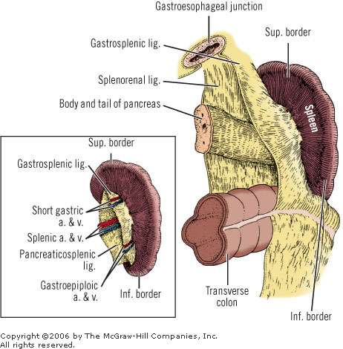
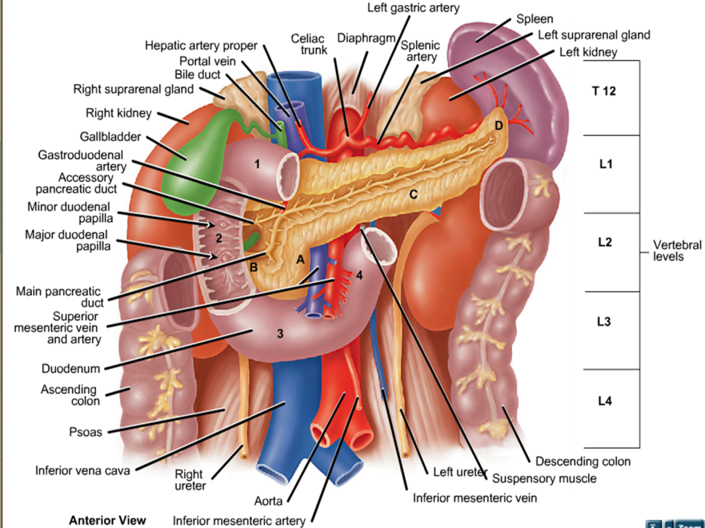
Anatomy of Spleen

Slide 5
Physiology
Composed of red & white pulp.
Red pulp made up of sinusoids which filters out old RBC and phagocytosed. Iron is transported back to bone marrow for new RBC.
Post-splenectomy- mis-shapen RBC with nuclear remnants seen in circulation (Howell-Jolly bodies)
White pulp composed of lymphoid follicles (Malpighian bodies), lymphocytes, macrophages, and plasma cells.
Antigens entering spleen are engulfed by macrophages for subsequent antibody production
Splenectomy impairs immunological response

Slide 6
Causes of splenomegaly
Infective: TB, splenic abscess, HIV, malaria, schistosomiasis, hydatid cyst
Blood disease: ITP, Hereditary spherocytosis, autoimmune haemolytic anemia, thalassaemia, sickle cell disease, polycythemia, leukaemia
Metabolic: Gaucher’s disease, amyloidosis
Circulatory: Portal hypertension, infarction
Nonparasitic Cysts: Congenital/ acquired
Neoplasms: Hodgkin’s, other lymphoma, myelofibrosis, angioma

Slide 7
Diseases where splenectomy indicated
Splenic trauma leading to hemodynamic instability.
Purpuras: Idiopathic thrombocytopenic purpura (ITP)
Haemolytic anaemias: Hereditary spherocytosis, Acquired haemolytic anaemia.
Hypersplenism
Left sided portal hypertension
Myelofibrosis
Tumours: Lymphomas, haemangioma
Cysts of spleen
Splenic infarct
Abscess
Splenic artery aneurysm

Slide 8
Splenic injury
Most frequently injured in blunt trauma (personal series)
History of injury to the left side of the chest, flank, or left upper part of the abdomen
Bruising, pain tenderness- lower chest and upper abdomen on left side
Diagnosis- FAST in unstable patients.
Sometimes on exploratory laparotomy in unstable patients
CT in hemodynamically stable patients .

Slide 9
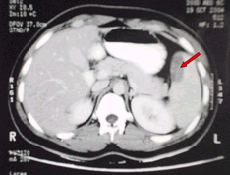

Slide 10
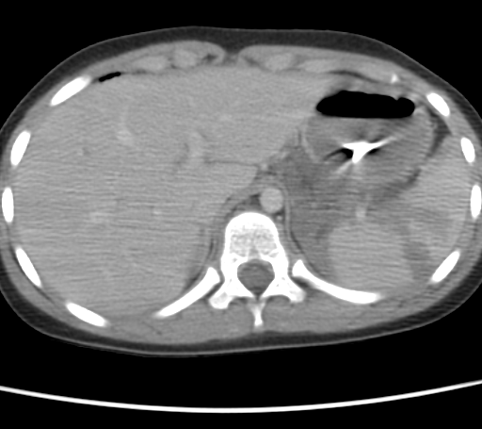

Slide 11
Splenic injury- non-surgical management (70%)
Hemodynamically stable patients:
FAST, CT for diagnosis
No other intra-abdominal injury requiring operation
Admission to ICU for continuous monitoring
Serial haemoglobin, & repeated abdominal assessment
If hypotension develops - taken for surgery

Slide 12
Splenic injury- Surgical management
Hemodynamically unstable
FAST: splenic injury, free fluid (hemoperitoneum)
Surgery- splenectomy
Polyvalent pneumococcal vaccine (pneumovax)

Slide 13
Idiopathic thrombocytopenic purpura (ITP)
ITP in children: 2-4 years age, usually post viral, most recover without treatment.
ITP in adults: IgG antibody against platelets.
Low platelets (<50,000)- epistaxis, GI bleeding, ecchymosis. Mild splenomegaly.
Initial therapy if bleeding- prednisolone, platelet concentrate, and immunoglobulin.
Persistent < 30,000 platelet after 4-6 weeks of medical therapy- splenectomy indicated

Slide 14
Hereditary Spherocytosis
Autosomal dominant disorder.
RBC- spherical, fragile, trapped in spleen & destroyed.
Excessive haemolysis- jaundice, anaemia, splenomegaly, pigment gallstone formation in 30-60%.
Disease of spontaneous remission & relapse.
Haemolytic crisis needs blood transfusion
Mild cases managed without splenectomy.
Mild/severe : Splenectomy after age 6 years (risk of OPSI)
Simultaneous Cholecystectomy if gallstone present

Slide 15
Acquired haemolytic anaemia
Aetiology: Haemolysis due to exposure to drugs, or immune reaction as in SLE, chronic lymphatic leukaemia or mycoplasma pneumoniae infection.
Initial treatment: Steroid therapy.
Splenectomy: No response to steroid. Disease relapse on cessation of steroids

Slide 16
Hypersplenism
Splenomegaly and pancytopenia with a normal bone marrow & no autoimmune disorder.
Splenomegaly of malaria, portal hypertension, rheumatoid arthritis, myeloproliferative disorder.
Sequestration & destruction of blood cells predominantly WBC & platelets.
Anaemia, leucopenia & thrombocytopenia.
Splenectomy indicated sometime after benefit & risk assessment.

Slide 17
Segmental portal hypertension-(Left sided PH)
Aetiology: Thrombosis of splenic vein due to acute/ chronic pancreatitis, carcinoma pancreas.
Gastric varices, hypersplenism, upper GI bleed.
Endoscopic control of varices unsuccessful
Splenectomy+ ligation of vessel on greater curvature of stomach very effective.

Slide 18
Proliferative disorders
Myelofibrosis: Proliferation of mesenchymal tissue in bone marrow, spleen, liver, lymph nodes. Huge splenomegaly & infarct causes discomfort. Splenectomy relieves symptoms.
Tumours: Large haemangioma, Non-Hodgkin’s lymphoma confined to spleen- splenectomy

Slide 19
Uncommon indications of splenectomy
Cysts: Congenital, degenerative, hydatid disease.
Splenic infarct
Splenic abscess
Splenic artery aneurysm.
Part of other surgery: Distal pancreatectomy, radical gastrectomy for carcinoma

Slide 20
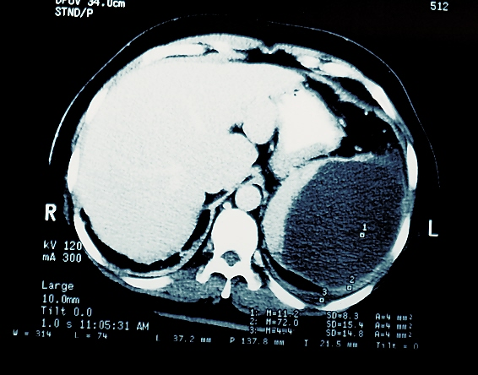

Slide 21
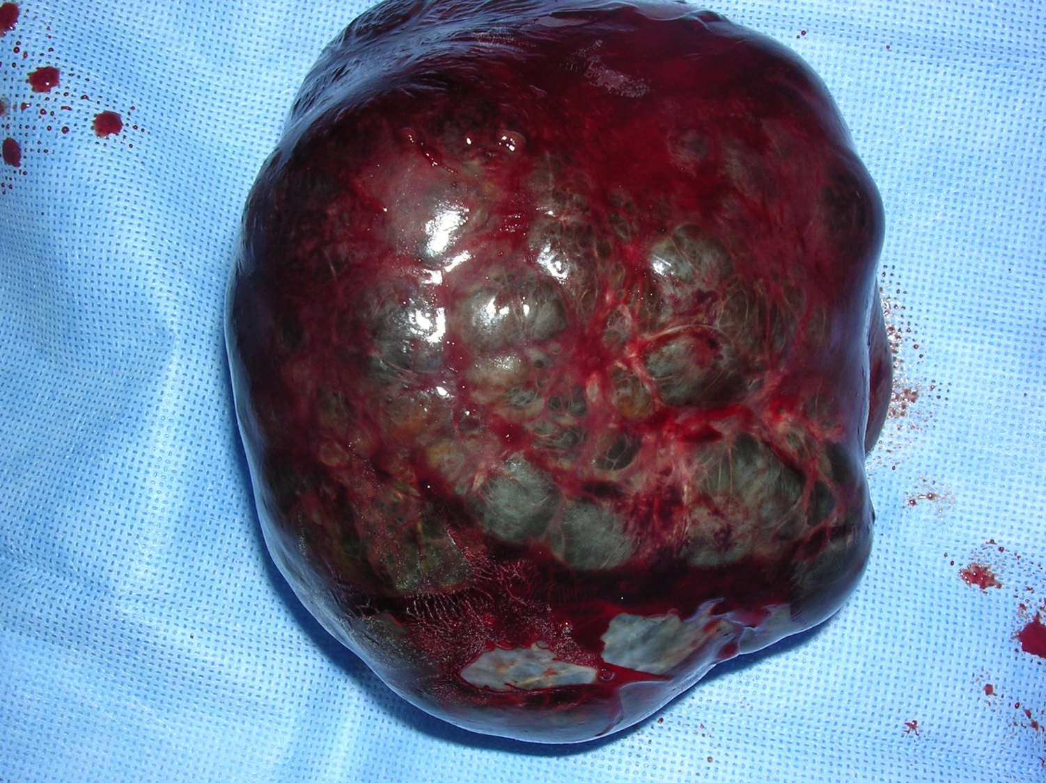

Slide 22
Complications of splenectomy
Early:
Haemorrhage
Injury to stomach, splenic flexure, pancreas
Delayed:
Fistula from stomach, pancreas
Subdiaphragmatic collection
Left basal atelectasis and pleural effusin
Thrombocytosis- thrombotic complications
OPSI- meneingococcus, H influenzae, meneigococcus

Slide 23
Effects of splenectomy
RBC: Howell Jolly bodies, erythroblasts
WBC: Leucocytosis
Platelet: Thrombocytosis, increased adhesiveness.
Immunological defects: ↓ serum IgM level, ↓ level of phagocyte promoting peptide, ↓ response to particulate antigens

Slide 24
Immunization
Pneumococcal vaccine
Not previous immunized persons:
Haemophilus influenza type b
Meningococcal type c
Life long antibiotic prophylaxis- oral phenoxymethyl penicillin or erythromycin
Elective splenectomy 2-3 weeks before surgery
Emergency splenectomy- postoperatively

Slide 25
Thank you!

