Slide 1
DR.HAMAD ALQAHTANI
Associate Professor
Consultant Hepatobiliary Surgeon

Slide 2
THE GALLBLADDER AND BILE DUCTS

Slide 3
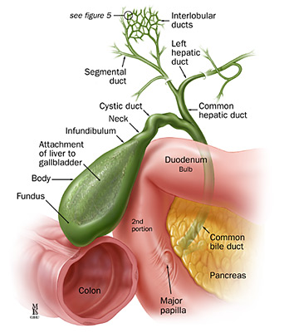
Surgical anatomy of gallbladder and bile ducts

Slide 4
Gallstones
Pathogenesis
Gallstone formation results from an imbalance of the constituents of bile
( bile salts , calcium salts of bilirubin and phospholipid ).
Types
1. Cholesterol stones: It form when the bile becomes supersaturated with cholesterol . Supersaturation is most likely occur as the bile is concentrated in the gallbladder , and favored by stasis or decreased gallbladder contractility. Cholesterol crystals forms (nucleation) around particles of mucus , bacteria , calcium bilirubinate or mucosal cells. Pure cholesterol stones are yellowish-green with a regular shape and rough surface . They are usually solitary whereas mixed stones are darker and multiple.
Predisposing conditions included : Obesity , high calorie intake or high cholesterol diets , drastic weigh loss , diseases or resection of distal ileum , drugs ( cholestyramine ), Hormones (estrogen ) intake like oral contraceptive pills and post- menopausal hormonal replacement , Pregnancy, familial

Slide 5
2. Black pigment stones
They are usually composed of calcium salts of bilirubin , phosphate and bicarbonate . It occur with chronic hemolysis ( spherocytosis , hemoglobinopathy and malaria ) and liver cirrhosis.
3. Browne pigment stones
They are usually composed of calcium salts of bilirubinate , stearates , palmitate and cholesterol. Bile stasis and infection are predisposing factors. Such patients have increased amounts of unconjugated bilirubin in the bile due to the effect of β-glucuronidase produced by E- coli , an organism that invade the biliary ducts system with bile stasis.

Slide 6
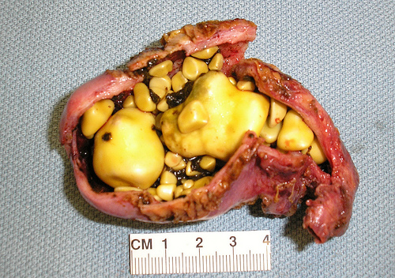
Cholesterol gallstones

Slide 7
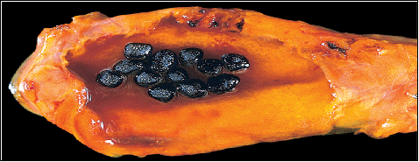
Black pigmented gallstone

Slide 8
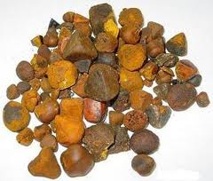
Brown pigmented gallstone

Slide 9
Gallstones diseases
1. Asymptomatic gallstones : usually no need of treatment
2. Symptomatic gallstones and related complications need treatment

Slide 10
Symptomatic gallstones and related complications
1. Biliary colic and chronic cholecystitis
Biliary colic is due to transient obstruction of gallbladder from an impacted stones in the neck of gallbladder.
Symptoms: Sever gripping pain , often developing after meal , which is maximum in the epigastrium and right upper quadrant with radiation to the back. The pain may wax and wane in intensity over several hours , and vomiting and retching are common. Resolution occurs when the stone fall back into the gallbladder lumen or passes to the common bile duct. In some cases the obstruction does not resolve and the patient develops acute cholecystitis.
Signs : Mild right upper quadrant tenderness , unless the patient develop acute cholecystitis then their will be marked tenderness and rebound.
Investigations
Blood tests ( complete blood count , liver function tests and serum amylase) will be normal
Imaging : Ultrasound abdomen will show the gallstones with acoustic shadowing.
Treatment : cholecystectomy

Slide 11
2. Chronic cholecystitis
Chronic cholecystitis is the most common cause of symptomatic gallbladder.
Pathology : It is characterized by fibrosis , contraction of gallbladder and chronic inflammatory changes with marked thickening of the wall. Predisposing factors included repeated bouts of biliary colic and acute cholecystitis or chronic typhoid infection of gallbladder.
Symptoms : recurrent right upper quadrant abdominal pain , flatulence , fatty food intolerance.
Signs : no significant signs
Differential diagnosis
1. Duodenal ulcer
2. Hiatal hernia
3. Myocardial ischemia
4. Chronic pancreatitis
5. gastrointestinal neoplasia
Treatment : Cholecystectomy

Slide 12
3. Acute cholecystitis
÷It is due to obstruction of gallbladder from an impacted stones in the neck of gallbladder or cystic duct resulting in a chemical inflammatory reactions that may superimposed by bacterial infection ( mainly E. Coli , Klebsiela aerogenoses), usually it start as biliary colic. The thickened gallbladder wall becomes intensely inflamed , edematous and occasionally gangrenous. The fundus of distended , inflamed gallbladder may perforate, giving rise to localized abscess formation and occasionally to biliary peritonitis.
Symptoms : Sever persistent abdominal pain , mainly in the right upper quadrant radiating to the right subscapular region, associated with tachycardia , pyrexia, nausea, and vomiting . The pain in acute cholecystitis is usually constant and continue for 24 hours or more differentiating this from biliary colic where the pain is short-lasting.

Slide 13
Signs : Abdominal tenderness and rigidity may be generalized but are most marked over the gallbladder. Boas,s sign ( hyperesthesia over the region around the tip of the right scapula ) and Murphy's sign ( a catching of the breath at the height of inspiration while the gallbladder area is palpated ) are usually present. A right hypochondrial mass may be felt . This is due to omentum ' wrapped ' around the inflamed gallbladder. The development of a tender mass , associated with rigors and marked pyrexia , signal empyema formation. The gallbladder may become gangrenous and perforate , giving rise to biliary peritonitis. Jaundice can develop during the attack. Usually due to associated stone in the common bile duct but gallbladder may be compressed by enlarged gallbladder or due to severe edema in porta hepatis.
Differential diagnosis
1. Perforated peptic ulcer
2. High retrocaecal appendicitis
3. Acute pancreatitis
4. Myocardial infarction
5. Basal pneumonia

Slide 14
Investigations
Blood tests : will show high white blood count (leukocytosis), sometime high liver function test due to the edema in the porta haptis compressing the extra-hepatic biliary tract.
Imaging: Ultrasound abdomen will show distended gallbladder with thick wall , peri-cholecystic fluids and positive ultrasound prop Murphy's sign.
Treatment
1. Admission to the hospital
2. Nothing given by mouth
3. Intravenous fluids infusion
4. Intravenous antibiotics
5. Analgesia
6. Surgery : Cholecystectomy if the patient presented within 3 days from the onset of the symptoms, otherwise should be managed conservatively and interval cholecystectomy after 2 – 3 months

Slide 15
4. Choledocholithiasis
Choledocholithiasis is the presence of stones in the bile ducts. The vast majority of stones in the common bile duct originate from the gallbladder ( secondary duct stone ) while the primary duct stones are rare.
Symptoms
1. It can be asymptomatic
2. Jaundice
3. Pale stool
4. Dark urine
5. Itching
Signs
1. Jaundice ( yellowish sclera and sometimes skin)
2. Scratch marks in the skin

Slide 16
Investigations
Blood tests will show high liver function tests (ALT , AST , ALP , T. bilirubin , D. bilirubin - especially alkaline phosphatase and bilirubin level and the level of direct bilirubin is higher than the indirect bilirubin)
Imaging
Ultrasound abdomen will show dilated extra-hepatic biliary system , possibly will show gallstone and the stone in the common bile duct
Treatment
Endoscopic retrograde cholangiopancreatography (ERCP) with stone extraction from the bile duct followed by laparoscopic cholecystectomy .

Slide 17
5. Cholangitis
Infection of obstructed biliary tract causes cholangitis
Symptoms : Right upper quadrant abdominal pain , pyrexia and jaundice ( Charcot's triad)
Signs : Pyrexia , tachycardia , possibly hypotension , jaundice and mild right upper quadrant tenderness.
Investigations
Blood tests : will show high LFT like obstructive jaundice with leukocytosis
Imaging : Ultrasound abdomen will show dilated extra-hepatic biliary system , possibly will show gallstone and the stone in the common bile duct.
Treatment
1. Admission to the hospital
2. Nothing given by mouth
3. Intravenous fluids infusion
4. Intravenous broad spectrum antibiotics
5. Analgesia
6. Endoscopic retrograde cholangiopancreatography (ERCP) with stone extraction from the bile duct followed by laparoscopic cholecystectomy if the gallbladder containing stones.

Slide 18
TUMORS OF BILIARY TRACT

Slide 19
1. Carcinoma of the gallbladder
Carcinoma of gallbladder is rare and mostly associated with the presence of gallstones. About 90% of lesions are adenocarcinoma. It spread by direct invasion of adjacent structures , hematogenous , and lymphatic metastasis.
Symptoms: pain in the right upper quadrant which is not distinguishable from those pf gallstone symptoms. Jaundice , which indicate invasion of biliary tract and locally advanced tumor.
Signs : jaundice if the biliary tract is invaded and obstructed . mass may be palpable in the right upper quadrant due to the tumor or due to mucocele obstructed gallbladder.
Treatment
1. Surgical resection is the best option for cure in resectable cases.
2. Palliative percutaneous or endoscopic biliary stenting to relieve the obstructive jaundice.

Slide 20
2. Carcinoma of the bile ducts
Cholangiocarcinoma is a relatively uncommon cancer that affect the elderly. It can develop anywhere in the biliary tract , but sclerotic tumor in the biliary confluence is called " Klatiskin tumor". It may develop in patients with primary sclerosing cholangitis or choledochal cyst .
Symptoms
1. Vague dyspeptic pain in the right upper quadrant of the abdomen
2. Progressive jaundice
3. Anorexia
4. Weigh loss
5. Pruritus
6. Acute cholecystitis , mucocele and empyema gallbladder my develop due to the obstruction of gallbladder.
Treatment
1. Surgical resection is the best option for cure in resectable cases.
2. Palliative percutaneous or endoscopic biliary stenting to relieve the obstructive jaundice.

