Slide 1
Adrenal Gland Disorders
DR.Mohammad Al-Akeely
Associate Professor
&
Consultant General Surgery

Slide 2
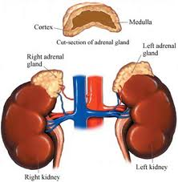

Slide 3
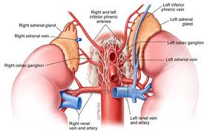

Slide 4
ADRENAL CORTEX
Salt
Sugar
Sex

Slide 5
SALT
Mineralocorticoids (fluid &elect. balance)
  Aldosterone ;(renin from kidneys controls adrenal cortex production of aldosterone)
    Na retention
    Water retention
    K excretion

Slide 6
Question:
If your Na level is low, will aldosterone secretion
or
If your serum K+ level is high, will aldosterone secretion
or

Slide 7
SUGAR
GLUCOCORTICOIDS (regulate metabolism & are critical in stress response)
  CORTISOL responsible for control and & metabolism of:
  a/ CHO (carbohydrates]
      glucose formed
      glucose released

Slide 8
CORTISOL
b/ FATS; control of fat metabolism
    stimulates fatty acid mobilization from adipose tissue
c/ PROTEINS; control of protein metabolism
  stimulates protein synthesis in liver
  protein breakdown in tissues

Slide 9
SUGAR
Other functions of Cortisol:
  inflammatory and allergic response
  immune system therefore prone to infection

Slide 10
SEX
ANDROGENS:
  Hormones which male characteristics
    release of testosterone
Seen more in women than men

Slide 11
RELEASE OF GLUCOCORTICOIDS IS CONTROLLED BY ______

Slide 12
LET’S LOOK AT ACTH
(adrenocorticotropic Hormone)
Produced in anterior pituitary gland

Slide 13
ACTH
Circulating levels of
cortisol
  levels; stimulate of ACTH
  levels; inhibits release of ACTH
  think tank: What type of feedback mechanism is this??

Slide 14
AFFECTED BY:
Individual biorhythms
  ACTH LEVELS ARE HIGHEST 2 HOURS BEFORE AND JUST AFTER AWAKENING.
  usually 5am – 7am
  these gradually decrease rest of day
Stress- cortisol production and secretion

Slide 15
ADRENAL MEDULLA
Fight or flight
What is released by the adrenal medulla?

Slide 16
CATECHOLAMINE RELEASE
Epinephrine
&
Norepinephrine

Slide 17
HYPER AND HYPOFUNCTION ADRENAL CORTEX HORMONES
Too much
Too little

Slide 18
I. CUSHING’S DISEASE
(TOO MUCH CORTISOL!)
secretion of cortisol from adrenal cortex
4 times more frequent in females
Usually occurs at 35-50
years of age

Slide 19
ETIOLOGY
Cushing’s
              adrenal Primary-tumor of the-
-Secondary-tumor on the anterior pituitary gland
-Ectopic ACTH ,secreting tumor (lung, pancreas)
-Iatrogenic-excessive cortisone intake

Slide 20
SIGNS & SYMPTOMS
Cushing’s
protein catabolism
  muscle wasting
  loss of collagen support
    thin, fragile skin, bruises easily
  poor wound healing

Slide 21
SIGNS & SYMPTOMS
Cushing’s
in CHO metabolism
  hyperglycemia
  Can get diabetes-refractory to insulin
  Polyuria

Slide 22
SIGNS & SYMPTOMS
Cushing’s
in fat metabolism
  truncal obesity
  buffalo hump
  “moon face”
  weight but strength

Slide 23
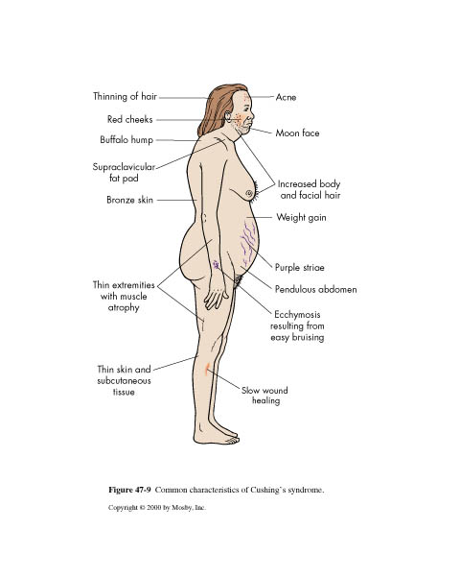

Slide 24
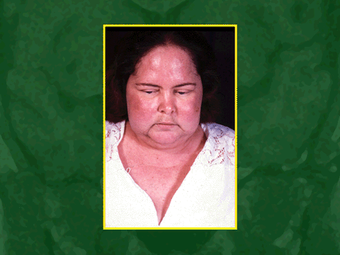
Before

Slide 25
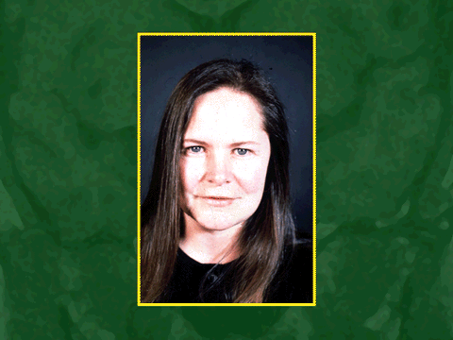
After

Slide 26
SIGNS & SYMPTOMS
immune response
  More prone to infection
  resistance to stress
  Death usually occurs from infection

Slide 27
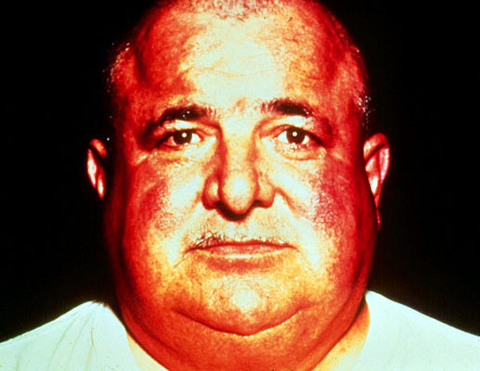
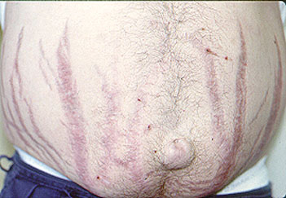
What sign would you identify in such patient?

Slide 28
SIGNS AND SYMPTOMS
Cushing’s
Androgen secretion
  excessive hair growth
  acne
  change in voice
  receding hairline

Slide 29
SIGNS & SYMPTOMS
mineralocorticoid activity
  water and sodium retention
  B.p.

Slide 30
SIGNS & SYMPTOMS
MENTAL CHANGES
Mood swings
Euphoria
Depression
Anxiety
Mild to severe depression
Psychosis
Poor concentraion and memory
Sleep disorders

Slide 31
SIGNS & SYMPTOMS
Hematology
WBCs
lymphocytes
eosinophils

Slide 32
DIAGNOSIS of Cushing’s
Serum cortisol levels
What will serum cortisol levels be? Draw AT 8AM AND 8PM
    What would you expect?
URINARY LEVELS OF STEROID METABOLITES.
    17-OHCS (hydroxycorticoid steroid)
    17-KS (ketosteroid)

Slide 33
TREATMENT of Cushing’s
Surgery
  transsphenoidal removal of pituitary tumor
  adrenalectomy-
  can be unilateral or bilateral
    if bilateral,
    need hormone replacement for life
    ectopic-try to remove source of ACTH secretion

Slide 34
Cushing’s TREATMENT
Radiation to tumors
Palliative drugs
  MITOTANE
  destroys tissue
  in adrenal cortex

Slide 35
II. HYPERALDOSTERONISM
“Conn’s Syndrome”
Too much aldosterone secretion
Question: What does aldosterone do????
_____________________________
usually caused by adrenal tumor

Slide 36
SIGNS & SYMPTOMS
Hyperaldosteronism
Na and water retention
  HTN
K+ (hypokalemia)
What is the normal serum K+ level???
Usually no edema

Slide 37
DIAGNOSIS-Hyperaldosteronism
urinary K
plasma aldosterone levels with low plasma renin levels
CT scan
EKG changes

Slide 38
INTERVENTIONS
Hyperaldosteronism
BP -aldactone=Aldosterone antagonist so what will it do to Na, H2O, and K???
Correct hypokalemia/hypernatremia
  K+ supplements; low Na diet
Partial or total adrenalectomy

Slide 39
ADRENALECTOMY
PRE-OP
Stabilize hormonally
Correct fluid and electrolytes
Cortisol PM before surgery, AM of surgery and during OR.

Slide 40
ADRENALECTOMY
POST-OP
IV cortisol for 24 hours
IM cortisol 2nd day
PO cortisol 3rd day
Poor wound healing
If unilateral- steroids weaned
  other adrenal takes over 6-12 months

Slide 41
ADDISON’S DISEASE hypofunction of adrenal cortex
What hormones will you have too little of
???

Slide 42
Aldosterone

Slide 43
What hormones will you have too little of???
glucocorticoids or _______
mineralocorticoids or __________
androgens or __________

Slide 44
Trivia Question: Which famous President had Addison’s Disease???

Slide 45


Slide 46
ETIOLOGY of Addison’s
Idiopathic atrophy :
  autoimmune condition Antibodies attack against own adrenal cortex
  90% of tissue destroyed
  TB/fungal infections (histoplasmosis)
  Iatrogenic causes
  adrenalectomy, chemo, anticoagulant tx

Slide 47
SIGNS & SYMPTOMS
Addison’s Disease
fatigue, weight loss, anorexia
  Why? think of cortisol
Changes in skin pigment
  small black freckles
  cortisol -- ACTH-- MSH
Muscular weakness
  cortisol helps muscles maintain contraction
  and avoid fatigue

Slide 48
SIGNS & SYMPTOMS Addison’s
Fluid & electrolyte imbalances
  WHY???
b.p.
  WHY???
Hyponatremia-why?
Hyperkalemia-why?
Hypoglycemia-why?

Slide 49
SIGNS & SYMPTOMS Addison’s
androgens
  hair loss, sexual functions
mental disturbances
  anxiety, irritability, etc.
salt craving-why?

Slide 50
DIAGNOSIS-Addison’s
serum cortisol
urinary 17-OHCS and 17 KS
K,
Na
serum glucose

Slide 51
INTERVENTIONS
Addison’s Disease
Life long hormone replacement
  primary-need oral cortisone 20-25mgs in AM and 10-12mg in PM
  change dose PRN for stress
  also need mineralocorticoid-(FLORINEF)

Slide 52
INTERVENTIONS
Salt food liberally
Do not fast or omit meals
Eat between meals and snack
Eat diet high in carbs and proteins
Wear medic-alert bracelet
kit of 100mg hydrocortisone IM

Slide 53
INTERVENTIONS
Addison’s Disease
Keep parenteral glucocorticoids at home for injection during illness
Avoid infections/stress

Slide 54
COMPLICATIONS
Addison’s Disease
Adrenal crisis
Electrolyte imbalance
Hypoglycemia

Slide 55
ADDISON’S CRISIS
Sudden decrease or absence of adrenal cortex hormones which are:
__________________
__________________
__________________

Slide 56
Sudden decrease or absence of adrenal cortex hormones which are:
__Mineralocorticoids____
_____glucorticoids______
_______androgens_____

Slide 57
CAUSES
Pt. with Addison’s who doesn’t respond to tx or has stress without dose
Pt. with Addison’s but undiagnosed who is exposed to stress
Pt. on steroids that are discontinued without tapering
Pt. with Addison’s not controlled

Slide 58
SIGNS & SYMPTOMS
Addisonian Crisis
Dehydration- Na, K, BP
N/V,diarrhea, wt. loss
Weakness
Confusion,headache
Hypovolemic shock, coma
Pallor, Inc. HR,RR, hypoglycemia
Renal shut-down-DEATH

Slide 59
TREATMENT
Addisonian Crisis
Rapid infusion of IV fluids
Check VS and urine output frequently
Monitor EKG
Give solu-cortef IV Q6 hours until S & S disappear

Slide 60
TREATMENT
Try to anxiety
May have to give vasopressors
  Dopamine or Epinepherine
Avoid additional stress

Slide 61
PHEOCHROMOCYTOMA
rare, benign tumor of the adrenal medulla
oh no...what are we going to see a hypersecretion of????

Slide 62
SYMPTOMS & SIGHNS
Hallmark is hypertension-200/150 or greater
“Spells” -paroxymal attacks
  bladder distension,emotional distress, exposure to cold.
NE and Epinepherine released sporadically

Slide 63
SIGNS & SYMPTOMS
Deep breathing
Pounding heart
Headache
Moist cool hands & feet
Visual disturbances

Slide 64
DIAGNOSIS
24 hour urine-VMA (metabolite of Epinepherine)
Plasma catecholamines
CT to locate tumor

Slide 65
INTERVENTIONS-PRE-OP
Adrenergic blocking agents
  Minipress to bp
Beta blocking agents
  Inderal to control heart rate
Sedatives

Slide 66
DURING SURGERY
GIVE REGITINE AND NIPRIDE TO PREVENT HYPERTENSIVE CRISIS

Slide 67
POST-OP
B.p. may be initially, BUT CAN BOTTOM OUT
Volume expanders
Vasopressors
Hourly I and O
Observe for hemorrhage

Slide 68
Thank you….

