Slide 1
Liver cirrhosis
By
Dr. Mohamed Abd Almoneim attia

Slide 2
Functions of the liver:
1- Bile metabolism.
2- Protein metabolism:
*formation of albumin (3.5-5.5 g/dl).
*formation of clotting factors (2, 7, 9, 10).
*incorporation of ammonia with CO2 to form urea.
3-fat metabolism.
4- carbohydrate metabolism: gluconeogenesis, glycogen
storage and glucose release.
5-detoxification of (hormones, drugs, and toxic substances).

Slide 3
HEPATITIS Clinical Terms
Hepatitis: inflammation of liver; presence of inflammatory cells in organ tissue
Acute Viral Hepatitis: symptoms last less than 6 months
Acute Hepatic Failure: Massive hepatic necrosis with impaired consciousness within 8 wks of onset of illness.
Chronic Hepatitis: Inflammation of liver for at least 6 months
Cirrhosis: Replacement of liver tissue→ fibrosis, scar tissue
Fulminant Hepatitis: severe impairment of hepatic functions or severe necrosis of hepatocytes in the absence of preexisting liver disease

Slide 4
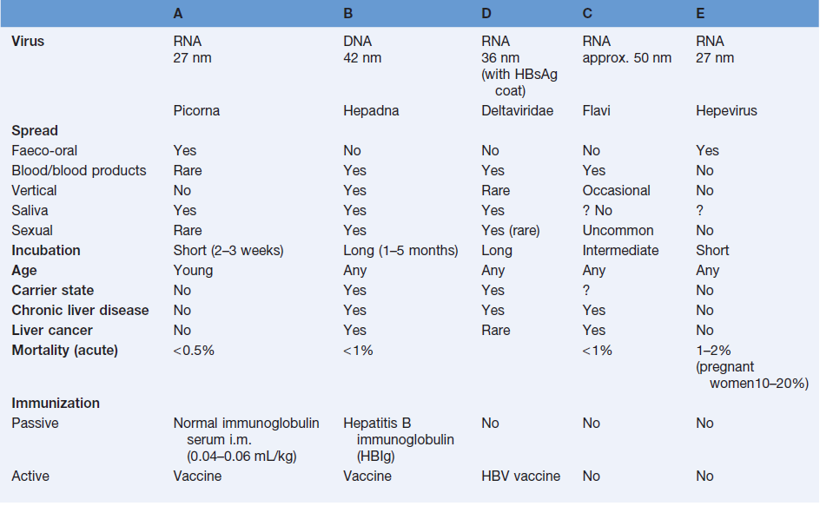
Type of Viral Hepatitis

Slide 5
Classic presentation: Acute Viral Hepatitis
Phase 1 - Viral replication; Patients are asymptomatic during this phase.
Phase 2 –. Prodromal phase:
Patients experience anorexia, nausea, vomiting, alterations in taste, arthralgias, malaise, fatigue, urticaria, and pruritus. Some develop an aversion to cigarette smoke.
When seen by a health care provider during this phase, patients are often diagnosed as having gastroenteritis or a viral syndrome.

Slide 6
Phase 3 - Icteric phase : Jaundice, Patients may note dark urine, followed by pale-colored stools.
In addition to the predominant gastrointestinal symptoms and malaise, patients become icteric and may develop right upper quadrant pain with hepatomegaly.
Severe cases may result in Fulminant Hepatitis:
Hepatic Encephalopathy: B/L asterixis, palmar erythema
Hepatorenal syndrome
Bleeding diathesis
Phase 4 - Convalescent phase; symptoms and icterus resolve. Liver enzymes return to normal.

Slide 7
Investigations
Liver function
  Serum transaminase : ALT(alanine transferase) ↑
    AST(aspartase transferase) ↑
  Albumin
  Bilirubin
  Prothrombin time
  Detection of the markers of hepatitis virus
Ultra-sound examination
FibroScan-Non-invasive test of liver fibrosis
Liver biopsy

Slide 8
Hepatitis A virus

Slide 9
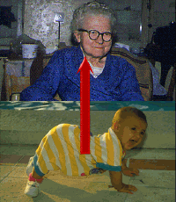
Hepatitis A
Common cause of acute hepatitis
Single-stranded, positive-sense, linear RNA enterovirus (Picornaviridae)
Transmission: faecal-oral
Incubation: 2-6weeks
High-risk countries:
Eastern Europe, Africa, Asia, South America
The proportion of symptomatic forms
and complications increase with age

Slide 10
Diagnosis: AST, ALT elevated,
Anti HAV IgM, IgG
Prevention: hygienic measures
passive immunization :HAV immunoglbulines
active immunization: HAV vaccine
Treatment: nospecific, dietary food and long rest
CHRONIC LIVER DISEASE DOES NOT OCCUR!

Slide 11
Hepatitis B virus

Slide 12
Hepatitis B
DNA virus
Transmission route is variable
  HBV is found in blood and all body fluids
  “Western” societies: percutaneous, hetero/homosexual contact is most common
  “Non-western” societies: perinatal transmission is most common
Incubation: 1-6 months
During HBV infection, the host immune response causes both hepatocellular damage and viral clearance

Slide 13
Epidemiology
*About 350 million people are chronically infected with HBV worldwide.
*Despite the hepatitis B vaccine programs, new infections with HBV remain common.
*Individuals with chronic hepatitis B are at increased risk for developing:
a)cirrhosis,
b)hepatic decompensation,
c)hepatocellular carcinoma (HCC).

Slide 14
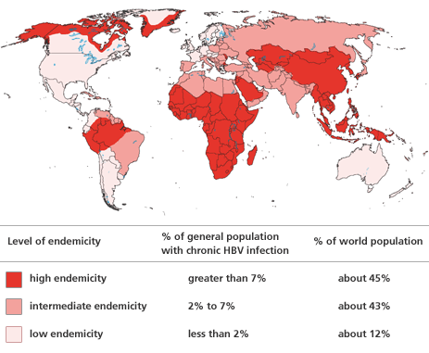

Slide 15
Clinical Presentation
Acute Hepatitis B ; Based on significant aminotransferase activity due to necro inflammatory injury
Symptoms are often non-specific symptoms such as myalgia, malaise , nausea, fatigue , pruritus, abdominal pain , jaundice
Fulminant Hepatitis--Acute HBV results in Liver Failure
Chronic Hepatitis B - greater than 6 months; Fibrosis and Necroinflammatory processes; can last for decades

Slide 16
Hepatitis B Treatment
Who to treat?
  HBsAg positive > 6 months
  HBV DNA >2000IU/ml
  ALT elevated
Goal of treatment
  Stop viral replication, HBV DNA becomes neg
  Convert HBe Ag pos to neg, Anti-HB e becomes pos
  Improvement in histology, prevention of progression to cirrhosis
  With successful treatment, loss of Surface Ag may occur in 1-2% per year

Slide 17
Prophylaxis
HBV Vaccine
Indicated for everyone and especially those in high risk groups
  IM injection at 0,1,6 months in infants and adults
  Response greater than 90% after 3rd dose
HBV Pregnant Mothers
Give 1st dose of Hip B vaccine and Hip B Immunoglobulin(HBIG) o.5 ml within 12 hours of birth.
  2nd dose at 1 month, 3rd at 6 months
  Recheck at 12 months for active infection
  95% lifetime immunity
  Not Done---leads to 90% chronic HBV
  Transmitted through birth canal during birth or through umbilical cord.
Others i.e. those receiving a needle stick
Should receive 0.04 to 0.7 ml/kg of HBIG and 1st dose vaccine within 48 and no later than a week

Slide 18
Hepatitis C virus

Slide 19
HCV, is a spherical, enveloped, single-stranded RNA virus belonging to the Flaviviridae family and Flavivirus genus.
The natural targets of HCV are hepatocytes and, possibly, B lymphocytes.
Viral clearance is associated with the development and persistence of strong virus-specific responses by cytotoxic T lymphocytes and helper T cells.
In most infected people, viremia persists and is accompanied by variable degrees of hepatic inflammation and fibrosis

Slide 20
Epidemiology
Hepatitis C is a worldwide problem.
The WHO estimates that 170 million individuals worldwide are infected with HCV.
Egypt had the highest number of reported infections, largely attributed to the use of contaminated parenteral antischistosomal therapy. This led to a mean prevalence of HCV antibodies in persons in Egypt of 22%.

Slide 21
Transmission
Transfusion of contaminated blood.
Persons who inject illegal drugs with non-sterile needles.
Transmission of HCV to health care workers may occur via needle-stick injuries or other occupational exposures (3%).
Tattooing, sharing razors, and acupuncture.

Slide 22
RNA-dependent RNA polymerase, an enzyme critical in HCV replication, lacks proofreading capabilities and generates a large number of mutant viruses known as quasispecies.
HCV quasispecies pose a major challenge to immune-mediated control of HCV and may explain the variable clinical course and the difficulties in vaccine development.

Slide 23
HCV can produce at least 10 trillion new viral particles each day.
HCV genome is made of:
Structural components include the core and 2 envelope proteins, E1 and E2.
The nonstructural components include NS2, NS3, NS4A, NS4B, NS5A, NS5B, and p7.

Slide 24
Genotypes
HCV is divided into 6 genotypes.
The major HCV genotype worldwide is genotype 1, which accounts for 40-80% of all isolates.
Genotype 1 also may be associated with more severe liver disease and a higher risk of HCC.
Genotypes 1a and 1b are prevalent in the United States, whereas, genotype 4 is the main type in Egypt.

Slide 25
Clinical Presentation
Asymptomatic
Nonspecific symptoms
Complications from advanced or decompensated liver disease
Extrahepatic manifestations of HCV

Slide 26
Extrahepatic Manifestations of Hepatitis C
Membranoproliferative GN
Essential Mixed Cryroglobulinemia
Porphyria Cutanea Tarda
Leukocytoclastic Vasculitis
Mooren Corneal Ulcer
Focal Lymphocytic Sialadenitits
Lichen Planus
Rheumatoid Arthritis
Non-Hodgkin's Lymphoma
Diabetes Mellitus
+ANA 21%; +ASMA 21%; +ALKM 5%

Slide 27
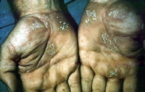

Slide 28
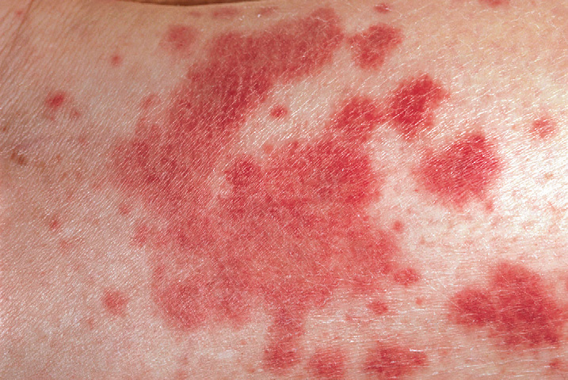

Slide 29
Diagnosis
Hepatitis C Antibody Test
97% specific but cannot distinguish acute from chronic infection
PCR assays for HCV RNA
Qualitative
Quantitative

Slide 30
HCV Genotyping
Genotyping is helpful for predicting the likelihood of response and duration of treatment.
Patients with genotypes 1 and 4 are generally treated for 12 months, whereas 6 months of treatment is sufficient for other genotypes.

Slide 31
Delta Hepatitis
Defective RNA virus, requires presence of HBV Surface Ag.
  More common in southern, eastern Europe, Middle East, and South America
Transmission is similar to HBV
Clinical manifistations
  Co-infection with HBV
    Fulminant hepatitis more common (34%)
    Progression to chronic infection is uncommon
  Super-infection of HBV
    Acute exacerbation of ongoing hepatitis
    Chronic liver disease occurs in 90%
    Diagnosis: HDV Ag, HDV RNA, HDV IgG and IgM
    Prevention - Avoidance of Hip B and/or Hip B vaccine
Treatment
  Interferon a-2b 3-9 mu sq tiw, Rx > 12 months
  21-50% lose HDV RNA and have improved histology
  Relapse occurs in almost all patients stopping treatment

Slide 32
Hepatitis E
Hepatitis E virus (HEV) RNA virus of the genus Hepevirus
Enterically transmitted infection; fecal-oral route, typically self-limited
Most outbreaks occur in developing countries.
Symptoms of acute hepatitis
Incubation period of hepatitis E virus is 2-9 weeks
1-4% overall mortality; 20-30% mortality if pregnant

Slide 33
Hepatitis E: diagnosis
Serum, liver, and stool samples can be tested for HEV RNA
Anti-HEV antibodies:
IgM (acute)
IgG (chronic)
AST & ALT are elevated several days before the onset of symptoms; return to normal within 1-2 months after the peak severity of disease.
Treatment: supportive

Slide 34
Liver cell failure:
1- acute :
Develop within less than 8 weeks in patients without preexisting liver disease and is fatal
2- chronic:
Complicate all forms of liver diseases e.g cirrhosis.
Clinical picture:
F :
Failure of health (protein metabolism)
Fever (low grade)
Foetor hepaticus
H
Haematological
Hepatic encephalopathy
Hepatorenal syndrome.
Ascites

Slide 35
Liver cirrhosis:
Definition:
1- Pathological: diffuse liver diseases characterized by (degeneration, regenerating nodules, fibrosis and loss
of architecture)
2- Clinical: liver with sharp edge and firm in consistency (shrunken).
Types :
Clinical picture:
1-latent well compensated with no liver functions impairment.
2-active and decompensated : may be :
*loss of functions of liver cells (parenchymatous decompensation= liver cell failure).
*vascular decompensation:= portal hypertension.

Slide 36
Pathophysiology
►Slow, insidious, progressive, chronic
►Fibrous bands replace normal liver structure
► Cell degeneration occurs
► Liver attempts to regenerate cells but cells are abnormal and disorganized
► Causes abnormal blood and lymph flow
► Results in more fibrous tissue formation

Slide 37
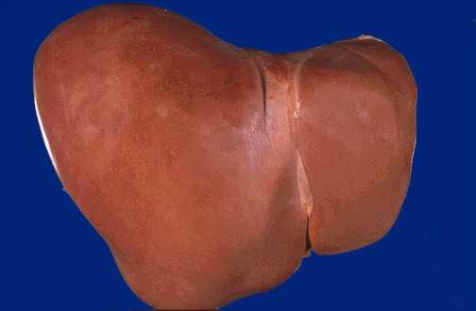
Normal Liver

Slide 38
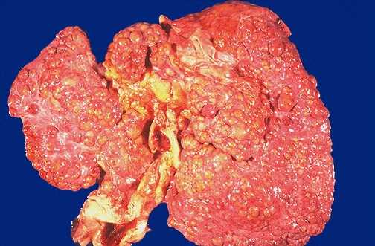
Cirrhosis

Slide 39
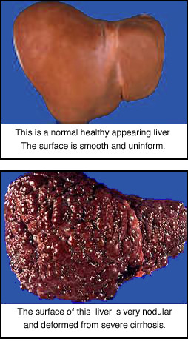
Cirrhosis

Slide 40
Cirrhosis Facts:
Progressive, leads to liver failure
Insidious, prolonged course
9th leading cause of death in U.S.
Twice as common in men
Highest incidence between ages
40 and 60.

Slide 41
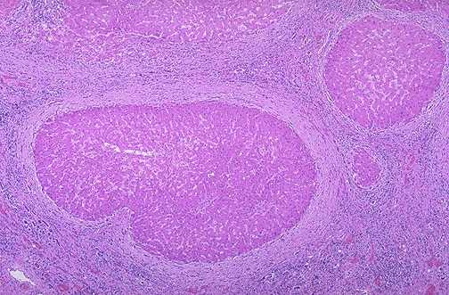
Cirrhosis
Fibrosis
Regenerating Nodule

Slide 42
Classification of Cirrhosis
◘ WHO divided cirrhosis into 3 categories based on morphological characteristics of the hepatic nodules
  Micronodular
  Macronodular
  Mixed
Notes:
42

Slide 43
Causes of Cirrhosis
Chronic viral hepatitis(HCV, HBV±HDV)
Metabolic: hemochromatosis, Wilson dis, alfa-1-antitrypsin, NASH
Prolonged cholestasis (PBC, PSC)
Autoimmune hepatitis
Hepatic venous outflow obstruction (VOD, BCS, Constrictive pericarditis)
Drugs and toxins
Alcohol

Slide 44
Cirrhosis - 4 Types
Alcoholic (Laennec’s)
  Long term ETOH abuse
Post necrotic - Massive hepatic cell necrosis
  Post viral hepatitis
  Toxic exposure
  Autoimmune process
Biliary
  Chronic biliary obstruction
  Bile stasis
  Inflammation
Cardiac
  Severe RHF
  Corpulmonale
  Constrictive pericarditis
  Tricuspid insufficiency

Slide 45
Clinical Presentation
Stigmata of chronic liver disease.
Abnormal LFTs and CBC.
Radiographic abnormalities.
Complication of cirrhosis.
Cirrhotic appearance of the liver at laparotomy or laparoscopy.

Slide 46
Clinical Features
*Fatigue, anorexia, malaise.
*Weight loss & muscle wasting.
*Jaundice & dark urine.
*Parotid enlargement & diarrhea.
*Anemia, leucopenia, thrombocytopenia.
*Bleeding gum, epistaxis, ecchymosis.
*Spider angioma, palmar erythema, white nails, dilated veins.

Slide 47
Clinical Features Cont.
*Gynecomastia, change in body hair patterns.
*Amenorrhea, loss of libido, testicular atrophy, impotence.
*Swelling of LL and abdomen.
*Dyspnea & hypoxia.
*Increased susceptibility to infections.

Slide 48
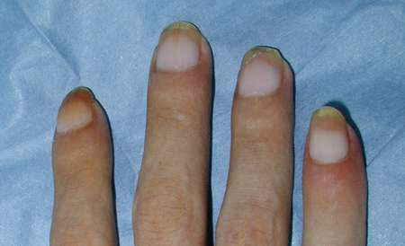
“White Nails”
Notes:
Seen in cirrhosis

Slide 49
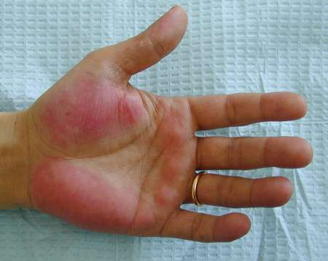
Palmar Erythema

Slide 50
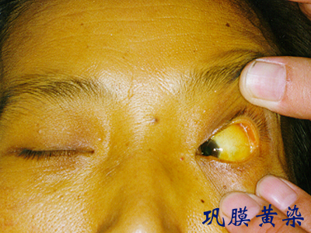
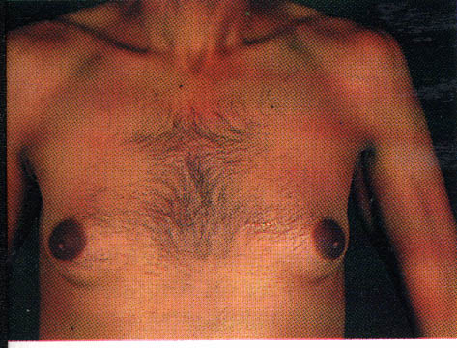
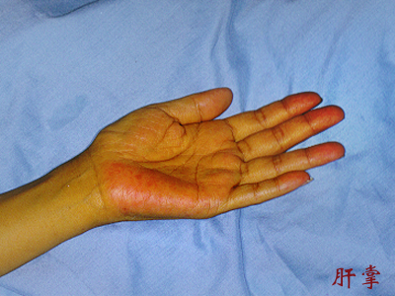
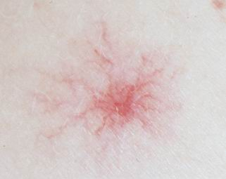
Clinical Features of Cirrhosis

Slide 51
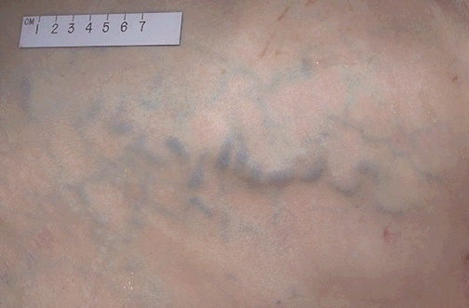
Prominent abdominal veins.

Slide 52
Complications
Portal hypertension
  Ascites
  Varices
Coagulation defects
Hepatic encephalopathy
Hepatocellular carcinoma
Hepatorenal syndrome

Slide 53
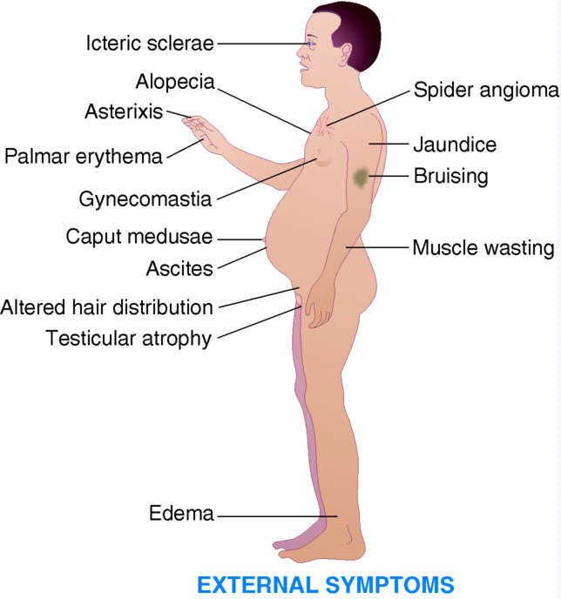
Clinical Manifestations of Cirrhosis

Slide 54
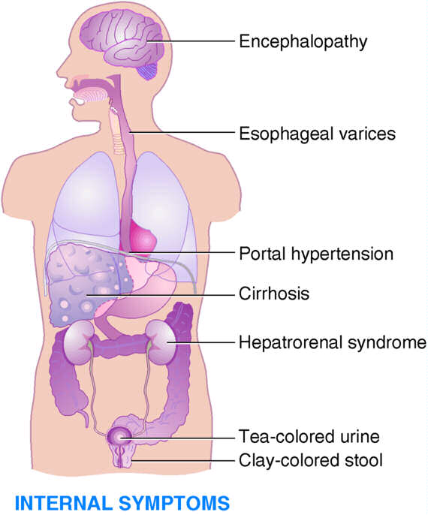
Clinical Manifestations of Cirrhosis

Slide 55
Complications of Cirrhosis
Portal Hypertension
Esophageal Varices
Hepatic Encephalopathy
Ascites
Peripheral Edema
Hepatorenal Syndrome

Slide 56
Diagnosis of cirrhosis
Physical examination
*Stigmata of chronic liver disease
*Features of portal hypertension
*Hepatic encephalopathy
Laboratory evaluation
*Tests for hepatocellular necrosis
*Tests for cholestasis
*Tests for synthetic function
*Special tests for the cause
*Screening test for HCC; AFP

Slide 57
Diagnosis of cirrhosis
Imaging modalities
*Abdominal ultrasound.
*Computed tomography (CT).
*Magnetic resonance imaging (MRI).
*Fibroscan
Esophagogastroduodenoscopy (EGD).
Liver Biopsy.

Slide 58
Prognosis
*Depends on the development of cirrhotic complication
*Assessed by Child-Pugh score
*Model for End-stage Liver Disease (MELD)
Based on serum bilirubin, creatinine, and INR
Determine optimal timing for liver transplantation

Slide 59
Child-Pugh score
score | 1 | 2 | 3
Albumin. | >3.5 | 3.5-2.8 | <2.8
Bilrubin | <2 | 2-3 | >3
Ascites | Absent | Mild-Moderate | Severe/ Refractory
HE | Absent | Mild (I-II) | Severe (III-IV)
PT prolongation | <4 sec. (<1.7) | 4-6 sec. (1.7-2.3) | >6 sec. (>2.3)
Class A: 5-6 Class B: 7-9 Class C: 10-15

Slide 60
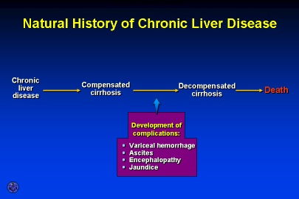

Slide 61
Management
Specific treatment
*Antiviral in HBV-cirrhosis
*Corticosteroids in AIH
*Phlebotomy in hemochromatosis
Treatment of complications
Screening for HCC
Liver transplantation

Slide 62
Portal hypertension:
Definition: elevation of hydrostatic pressure within portal vein or its tributaries (normally =5 mmHg so, if portal hypertension = 7 mmHg or 30 CM water)
Increase in hepatic sinusoidal pressure to ≥ 6mm Hg.
N.B : Portal pressure must be at least 10mm Hg for gastroesophegeal varices to develop and at least 12mm Hg for varicees to bleed.
Anatomy:
Union of superior mesenteric vein and splenic vein behind head of pancreas.
Causes: (Blood pressure = flow × resistance ) so may be :
1-incresead resistence to flow (blood flow obstruction):
*prehepatic (splenic vein)
*hepatic (cirrhosis)
*post hepatic (heart and IVC)
2-increased portal blood flow:
*splenic (arteriovenous fistula)
*huge spleen.

Slide 63
Clinical picture:
1- congestion:
*gastric: leading to dyspepsia
* intestinal : leading to constipation and diarrhea
*spleen: enlarged spleen (left hypochondreal pain)
*abdominal enlargement due to ascites and hepatosplenomegally
2-rupture esophageal varices:
*dilated elongated tortuous veins in the upper stomach , lower esophageus manifested by haematemesis and melena.

Slide 64
*may be:
- silent
-repeated insidious hemorrhage leading to iron deficiency anaemia.
-sudden rupture either :
(From within due to sudden increase in portal venous pressure by cough, exercise, or straining) OR erosion from esophegitis due to ( NSAID-hard food or peptic ulcer).
Here patient manifested by bright red blood not stopped spontaneously because of negative intrathoracic pressure which keep veins patent
It can be diagnosed by endoscopy and barium swallow.

Slide 65
Portal Hypertension & Esophageal Varices
Compression & destruction
Portal veins
Hepatic veins
sinusoids
Obstruction of normal flow through portal system → portal hypertension
Collateral circulation develops primarily in
  Lower esophagus
  Anterior abdominal wall
  Rectum
  Parietal peritoneum
Collateral circulation develops to ↓
  Portal pressure
  Plasma volume
  Lymphatic flow

Slide 66
Varices

Slide 67
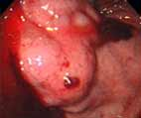
Esophageal Varices

Slide 68
Complications:
Esophageal & Gastric Varices:
Esophageal:
  Complex of twisting veins at lower end of esophagus
  enlarged & swollen
Gastric-
  upper portion of stomach
  may occur alone or in combination with esophageal
Tolerate high pressure poorly, bleeding easily with distention
Rupture in response to irritation
Most life threatening complication!!
The varices can rupture in 1/3 cases and can lead to death in 50% cases.
Clinical Feature :
*Melena (black colour stools)
*Hematemis
*Hypovolumic shock

Slide 69
Esophageal Varices
Medical Management
Prevent
initial
hemorrhage
Manage
acute
hemorrhage
Prevent
recurrent
hemorrhage

Slide 70
Treatment
A- Stop drugs.
B- treatment of upper GIT bleeding:
Definition: bleeding occur from upper portion of GIT usually (esophagus, stomach, duodenum ) due to:
( rupture esophageal varices, peptic ulcer (gastroduodenal ), systemic cause as NSAID).
Clinical picture:
*Overt bleeding in the form of hematemesis and melena.
*occult blood in the stool which can lead to iron deficiency anaemia.

Slide 71
Treatment:
A)- Stop acute bleeding:
*Urgent hospitalization, complete bed rest with head lower down with warmth.
*Monitor the vitals signs and Pass I/V line.
* Fresh blood transfusion to supply deficient clotting factors and avoid stored blood which contain ammonia
(may be packed RBCs to maximize O2 delivery)
(don’t give plasma expander which produce dilution of blood coagulation constituents so, increasing bleeding tendency).
*FFP( Fresh Frozen Plasma) can be given in case of thrombocytopenia.
*After restoring blood volume , take blood sample for (clotting and bleeding time and for level of createnine for acute renal failure).
*Vitamin K (IM) to crrect hypoprothrominaemia) , recombinant activated factor factor 8 to augment initiation of coagulation and intensify thrombin effect at site of injury without affecting clotting cascade elsewhere.

Slide 72
*Suction of blood from the stomach then gastric lavage with cold saline.
*Sedative (if needed give oxazepam not diazepam), never morphine.
*Ranitidine I.V.: aim is decrease stomach PH to reduce gastric irritation and so, decrease frequency of stress induced mucosal lesions ( surgery , truma, burn , haeorrhage…_)
*Emergency endoscopy: its aim to detect blood origin , exclude bleeding peptic ulcer from other causes.
* Drug treatment:
Only used to control acute bleeding from rupture esophageal varices due to portal hypertension e.g :

Slide 73
1- Vasopressin: (via V1 receptors):
Mechanism of action:
*V.C of splanchnic blood vessels so, decreasing blood inflow and decrease intravariceal blood flow.
*contraction of esophageal musculature so, collapsing of varices.
*contraction of intestine so, get rid of blood in the bowel.
*V.C of other blood vessels (systemic so, increasing blood pressure , coronary so, producing angina pain, etc….)
* Spasmogenic to other SMF, as uterus leading to its contraction (abortion in pregnant female).
Side effects:
-Abdominal colic, facial pallor, and bowel evacuation (active drug).
-PPT myocardial ischemia.
- abortion in pregnant female.
-antidiuretic action.

Slide 74
2-Glypressin (given bolus):
Vasopressin is released from it over several hours in amounts beneficial to decrease portal venous pressure without systemic side effects.
3-Terlipressin:
Same as vasopressin with slow release with long t1/2 but higher tissue penetration than vasopressin.
4- Somatostatin:
Has short t1/2 so its analogues (octereotide,,….) are used .
It decreases hepatic blood flow, portal pressure in patient with cirrhosis with no alteration of systemic blood pressure.
It causes of v.c of collateral vessels feeding varices.

Slide 75
*Non drug therapy for ROV:
*Sclerotherapy by injecting varices with sclerosant (ethanolamine oleate, histoacryl blue ,Ethanolamine tetradecyl sulfate.
*Banding - can be performed by putting rings at basis of varices Endoscopic Band Ligation (EBL) .
*Ballon tamponade.
Prophylaxis (prevention of rebleeding fro esophageal
varices):
Once the initial episode of bleeding is controlled, the risk of rebleeding is 50-80% without further therapy.
(1) Long term injection sclerotherapy
usually 4-6 treatment one required to prevent rebleeding, but every year endoscopy should be done to see the condition of varices.
*Endoscopy for every cirrhotic patient at diagnosis and periodically
1-BB (propranolol, timolol…):
It decrease portal pressure by
*B1 blockade in the heart will decrease COP with decrease hepatic flow.
*Block V.D effect of splanchnic blood vessels B2 leading to unopposed alpha1 action leading to splanchnic V.C.
It dilates the protal veins so decrease the portal vein pressure. In case of asthmatic patient glyceryl dinitrite can be used.

Slide 76
2-vasodilators (isosorbid dinitrate and mononitrate).
It decrease intrahepatic and collaterall vascular resistence and in large dose it decreases blood pressure with activation of baroreceptors leading to reflex V.C of splanchnic blood vessels.
3- H2 blockers (ranitidine to prevent gastroduodenal erosion)or PPIs.
4-Diuretics (spironolcatne with low Na in diet to decrease blood volume).
5-New treatment to decrease portal pressure by manipulating intrahepatic circulation:
*Carvedilol.
*Losartan.
*Ritanserin.
*Verapamil.
*Metoclopramide.
*Pentoxiphylline………………………………etc

Slide 77
Manage acute hemorrhage
Pharmacological Mgt.
Vasopressin/NTP
Octreotide
65-75% of cirrhotic
patients develop
esophageal varices.
Ruptured varices have
a 30-60% mortality rate
Endoscopic injection sclerotherapy
Supportive Rx
FFP, RBC’s
Vit. K
H2 blockers
Neomycin
Balloon tamponade
Sengstaken-Blakemore
Minnesota

Slide 78
Prevent recurrent hemorrhage
Shunts
↓ portal pressure
divert flow away from collateral channels
send portal venous blood directly to IVC bypassing liver
Complications
Hepatic encephalopathy
Heart Failure
Bacteremia
Shunt Clotting
Notes:
Inferior Vena Cava

Slide 79
Shunting Procedures:
Used more after 2nd major bleeding episode
TIPS
  shunt is placed between systemic and portal venous systems
    redirect’s portal blood flow
    reduces portal venous pressure
    decompresses varices
    contraindicated in patient’s with hepatic encephalopathy

Slide 80
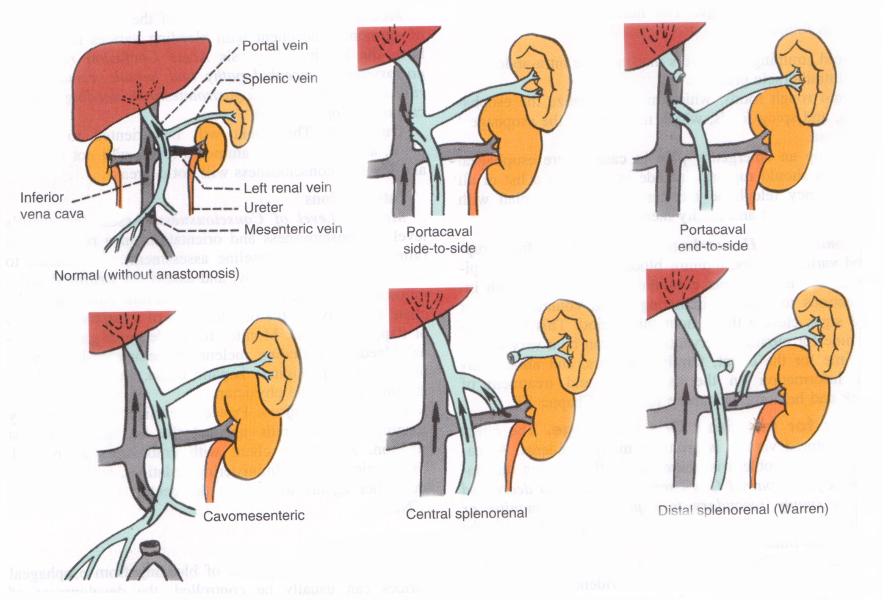
ShuntsTransjugular intrahepatic portosystemic shunt
T.I.P.S.

Slide 81
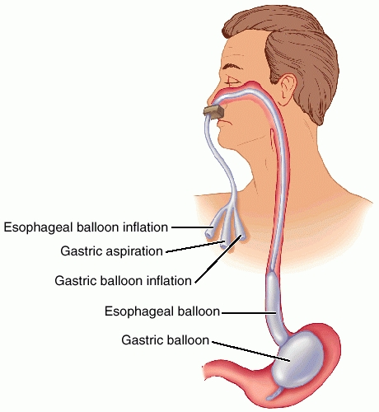
Sengstaken-Blakemore Tube
Three Lumens:
Esophageal balloon inflation
Gastric balloon inflation
Gastric aspiration

Slide 82
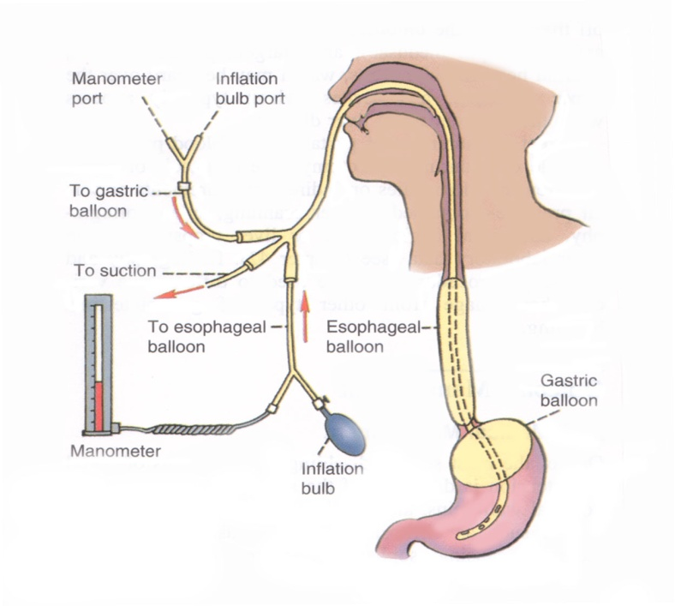

Slide 83
Ascites:
Definition: Fluid accumulation within peritoneal cavity
Causes: most important cause is liver cirrhosis
Mechanism of cirrhotic ascites :
A- Classic Starling theory:
Hypoalbuminaemia decrease plasma osmotic pressure (ascetic threshold= 3) and due to portal hypertension (act as localizing factor which localizes fluid in the peritoneal cavity rather than peripheral tissues)

Slide 84
B-generalized fluid retention:
*hyperaldosteronism due to decreased renal blood flow which stimulate RAS also, due to decreased degradation of aldosterone by the liver.
*Altered Renal blood flow (decreased renal blood flow will decreased cortical perfusion which lead to increased proximal tubular Na reabsorption which Na retention.
*Others:
- increased sympathetic activity (renal v.c)
-decreased renal production of PG, kinin.
-increased ADH
Complications:

Slide 85
1- Spontaneous bacterial peritonitis with:
Clinical manifestations:
  clinical onset of Fever, chill
  generlaized Abdominal pain
  Abdominal tenderness
  Altered mental status
Can be treated by amioglycosides and ampicillin or third.
generation cephalosporin or quinolones.
2-Complication due to treatment e.g hepatorenal syndrome if vigorous dieresis.
Treatment :
1- Bed rest to decrease metabolites handled by the liver and to increased renal perfusion.
2-diet : Na and water restriction.
3-diuretics:
*best is I.V albumin.
*Spironolactone (maximum rate of ascetic fluid mobilization is 1-2 L / day and if very rapid (dehydration, hepatorenal syndrome and electrolyte imbalance and hepatic encephalopathy)

Slide 86
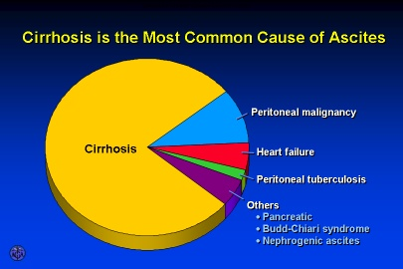

Slide 87
Ascites
Assessment of ascites
  Grading
    Grade 1 — mild; Detectable only by US
    Grade 2 — moderate; Moderate symmetrical distension of the abdomen
    Grade 3 — large or gross asites with marked abdominal distension
  Older system -subjective
    1+ minimal, barely detectable
    2+ moderate
    3+ massive, not tense
    4+massive and tense
Imaging studies for confirmation of ascites
  Ultrasound is probably the most cost-effective modality

Slide 88
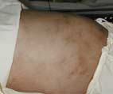
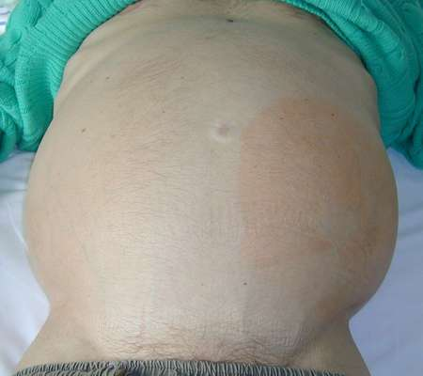
Ascites

Slide 89
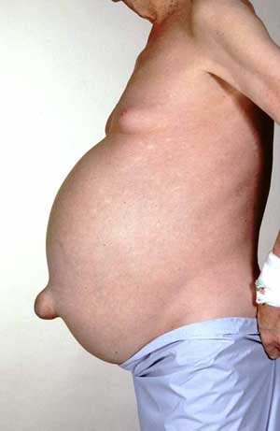

Slide 90
Medical Management of Ascites:
Diuretic therapy:
Paracentesis
  needle puncture of abdominal cavity to remove ascitic fluid- temporary
  have patient void before procedure
Peritoneovenous Shunt
  surgical procedure
  provides continuous reinfusion of ascitic fluid into venous system
Not 1st line therapy due to high number of complications
Does not improve survival rates

Slide 91
Paracentesis:
Which is removal of ascitis fluid (4- 6L) from the abdominal cavity with a needle or catheter.
Indicated in tense ascites.
Fluid is rich in albumin → for every 1 L removed give 6-8g albumin.

Slide 92
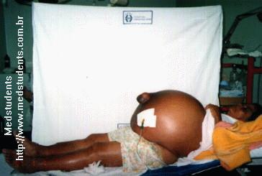
Paracentesis

Slide 93
Diuretics:
Diuresis should be gradual because hypokalemia or intravascular volume depletion caused by aggressive therapy→ compromised renal function, and hepatic encephalopathy.

Slide 94
Complications:
1-Hepatorenal syndrome:
N.B
Normally 25% of RBF go to medulla of the kidney ,75% go to the cortex
Medulla of the kidney contain juxtamedullary nephron which has avid Na retaining power so, decrease urinary Na excretion.
Definition: Functional oliguric renal failure which occur as a serious complication in patient with cirrhotic ascites.
Causes:
Any factor which decrease blood volume as :
1-G.IT bleeding due to rupture esophageal varices.
2-diuretics, paracentesis.
3-diarrhea.
4-others (urinary tract infection and nephrotoxic drugs as NSAId =prostaglandin have V.D effect)
May be reversed by liver transplantation
not in the kidney but prerenal due to decreased RBF.
acute renal failure coupled with advanced hepatic disease (due to cirrhosis or less often metastatic tumor or severe alcoholic hepatitis)
characterized by:
  Oliguria
  benign urine sediment
  very low rate of sodium excretion
  progressive rise in the plasma creatinine concentration
Pathogenesis:
Decreased blood volume due to shift of fluid from intravascular spaces into peritoneal cavity which decreases blood volume which in turn decreases RBf which decreases GFR also, stimulate epinephrine and RAS leading to V.C of afferent arterioles with corticomedullary shift of blood i.e more blood go to medulla which contain avid Na retaining power.
The decreased GFR is due to (decreased RBF and corticomedullary shift)

Slide 95
Complications
2-Other Pulmonary syndromes
  Hepatic hydrothorax
  Portopulmonary HTN
3-Hepatic Encephalopathy
4-Hepatocellular carcinoma

Slide 96
Hepatic Hydrothorax
Pleural effusion in a patient with cirrhosis and no evidence of underlying cardiopulmonary disease
Movement of ascitic fluid into the pleural space through defects in the diaphragm, and is usually right-sided
Diagnosis -pleural fluid analysis
  reveals a transudative fluid
  serum to fluid albumin gradient greater than 1.1

Slide 97
Hepatic hydrothorax
Treatment options:
  diuretic therapy
  periodic thoracentesis
  TIPS

Slide 98
Portopulmonary HTN
Refers to the presence of pulmonary hypertension in the coexistent portal hypertension
Prevalence in cirrhotic patients is approximately 2 percent
Diagnosis:
  Suggested by echocardiography
  Confirmed by right heart catheterization

Slide 99
Hepatocellular Carcinoma
Patients with cirrhosis have a markedly increased risk of developing hepatocellular carcinoma
Incidence in well compensated cirrhosis is approximately 3 percent per year

Slide 100
Hepatic encephalopathy:
Definition: complex neuropsychatric syndrome complicating acute or chronic liver disease .
Pathogenesis: many factors with lack of detoxification of toxic substaces absorbed from intestine due to :
A- severe hepatocellular damage
B- vascular shunt (in portal hypertension).

Slide 101
P.P.F:
1- Ammonia theory:
Increase blood ammonia level (unionized) which when reach the brain combine with alpha ketoglutaric acid to be converted to glutamine which decrease oxygen consumption in Krebs cycle to produce diffuse cerebral inhibition.
Source of ammonia:
*GIT: (dietary protein- GI hemorrhage ) by bacterial deamination of amino acids in the intestine .
*hepatic (decrease urea synthesis).
*renal (in hepatorenal syndrome )
2-Synergism theory :
Include ammonia and long chain fatty acids (elevated in cirrhosis)
These long chain fatty acids displace neuroactive chemicals e.g tryptophan from serum albumin.

Slide 102
Neurotoxins in Liver Disease
Ammonia
  Normal NH₃ metabolism
    By-product of protein catabolism by gut flora
    Absorbed by gut and enters portal vein
    Metabolized in the liver to urea and glutamine (Krebs cycle)
  NH₃ in liver disease
    Not cleared by the liver
    Delivered to the brain by systemic circulation
    Associated with hepatic encephalopathy
      Not necessarily the cause!

Slide 103
3-False neurotransmitters theory :
With increase aromatic amino acids level e.g phenyl alanine which compete with tyrosine so, there is less conversion to NE and dopamine but increase level of octopamine (weak chemical transimitter) leading to manifestations of extrapyramidal syndrome which is improved with L, dopa and branched chain amino acids.
Also, increased level of tryptophan which is strong inhibitory chemical transimitter.
4-GBAB theory:
GABA level is increased in the brain which produce diffuse cerebral inhibition (act as endogenous benzodiazepines)
5-Inflammation and infection theory:
Infection act to synergizes ammonia effect in the brain.

Slide 104
Neurotoxins in Liver Disease
False neurotransmitters – amino acids
  Patients with cirrhosis have a decreased ratio of branched-chain amino acids (BCAA) to aromatic acids (AAA), from 3.5:1 to 1:1.
    BCAA include valine, leucine, and isoleucine
    AAA include phenylalanine, tyrosine, and tryptophan
  The decrease in BCAA is caused predominantly by their extensive use by skeletal muscle

Slide 105
Neurotoxins in Liver Disease
False neurotransmitters (cont.)
  It has been postulated that the increase in AAA in the CNS may interfere with physiologic neurotransmission by competitively inhibiting “normal” neurotransmitters (i.e., DA, NE) and favoring formation of weak, “false” neurotransmitters (i.e., octopamine)

Slide 106
Neurotoxins in Liver Disease
  This attractive hypothesis raises the possibility that correction of the AAA:BCAA ratio may lead to amelioration of hepatic encephalopathy

Slide 107
Pathophysiology – Other factors
GABA/benzodiazepine receptor complex
Branched-chain amino acids
Serotonin
Zinc
Manganese

Slide 108
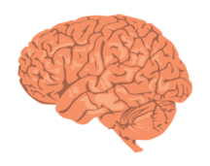
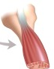
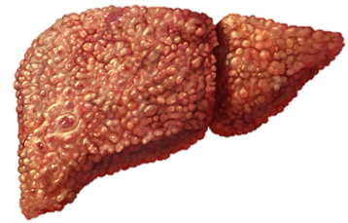
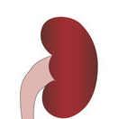
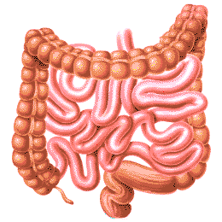
Pathophysiology
NH₃
Glutamine
NH₃
NH₃
Urea
Glutamine
Glutamine
NH₃ NH₄+
Urea
Feces
Urine

Slide 109
P.P.F:
A: azotemia
B: bleeding.
C: constipation (increased ammonia formation due to increased gut transit time).
D: diet(protein) and drugs (diuretics,, CNS inhibitors as benzodiazepines, alcohol;, narcotics…etc)
E: electrolyte imbalance ( hypo or hyperkalaemia)
F: febrile illness (tissue catabolism = infection).

Slide 110
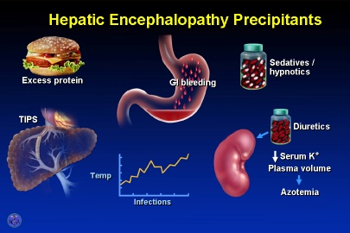

Slide 111
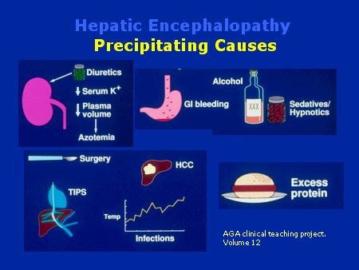

Slide 112
Clinical picture:
1- Hepatic precoma:
*Psychiatric ( lack of concentration, disturbed moode, altered personality…)
*Neurological :( tremor, rigidity)
*imperfect performance.
*Disturbed conscious state (insomnia and hypersomnia).
*Flapping tremors.
*Dysartheria.
2- Hepatic coma.
Investigations:
1- Liver function tests (bilirubin , albumin, SGOT, SGPT, ammonia….etc).
2-For rupture esophageal varices.
3-For hepatic encephalopathy (EEG, CT brain).

Slide 113
Treatment of ammonia theory= hyperammoniaemia
1-Decrease ammoniogenic substances:
*prevention of GIT bleeding.
*dietary protein restriction to decrease ammonia formation.
* give vegetable proteins (high in branched chain and low in aromatic amin oacids )so, this help to resore balance between both.
*use lactulose cleansing enema and daily bowel wash out using 1% dextrose cleansing enema.
2- Inhibit production and absorption of ammonia:
*Antibiotics:
-neomycin but its side effects limits its use so, use
-rifamixin , metronidazole or vancomycin.
*pre and probitics.
*lactulose.
*lactitol.

Slide 114
Neomycin:
Is a non absorbable aminoglycoside which destroy some of intestinal bacteria which generate ammonia so, decrease ammonia blood level.
Its side effects : ototoxicity, and nephrotoxicity.
Used in acute exacerbation of hepatic encephalopathy as it has rapid onset of action.
Can be used in the form of retention enema or orally.

Slide 115
Rifaximin
Semisynthetic antibiotic based on rifamycin
Poor bioavailability - confined to the gut
Mechanism thought be through intestinal flora alteration
Similar efficacy to nonabsorbable disaccharides
Due to cost, reserved for patients who cannot tolerate or do not respond to disaccharides
Neomycin is a less costly alternative, but association with ototoxicity and nephrotoxicity limit use

Slide 116
*Lactulose:
- is non absorbable disaccharide (galactose- fructose) non absorbed in the small intestine.
-metabolized by colonic intestinal bacteria into low molecular weight acids (acetic acid, lactic acid and formic acid) which:
1-decreases PH of colonic environment to inhibit ammonia producing bacteria and favor ammonia transport from blood to colonic lumen where it is converted to ammonium ion which is poorly absorbed but excreted in the stool due to its osmotic laxative effect.
2- osmotic laxative by acceleration colonic transit time and increase excretion of ammonia ion.

Slide 117
-uses:
Less used in acute attack due to slow onset of action (1-2 days) but used to :
*prevention of portosystemic encephalopathy.
*patient with advanced hepatic cirrhosis to improve patient tolerance.
*laxative.
- may be used orally or in the form of retention enema (In patient with impending coma or in patient with coma stage of hepatic encephalopathy)
- side effects :
At therapeutic doses : abdominal distension, flatulence, nausea, vomiting, diarrhea all these side effects can be controlled with decreasing doses so, this drug can be used for a long time with less side effects.

Slide 118
*lactitol
As lactulose but quick onset with less diarrhea and less flatulence and more palatable
*Prebiotics. Synbiotics, and probiotics :
-They are new ttt for hepatic encephalopathy which replace antibiotics and lactulose.
- Antibiotics are not preferred in for ttt of HE since ammonia producing resistant bacteria may survive and replace ammonia producing ammonia susceptible bacteria.
-in the intestine they are not absorbed or digested but get fermented by colonic bacteria to (lactic , acetic and butyric acids) and gas specially hydrogen (H2) this gas causes massive intestinal hurry with expulsion of ammoniogenic bacteria.
- other mechanisms (decrease inflammation and oxidative stress on hepatocytes.

Slide 119
* stimulation of ammonia metabolism:
-by administration of substances to permit its to certain substances :
1-LOLA (L, ornithine , L aspartate): stimulate of glutamine so, increase ammonia removal by hepatocytes with decrease ammonia blood level. (ornithine is substrate for urea, aspartate is substrate for glutamine).
2- Zinc supplementation:
Zinc is important in urea cycle since 2 enzymes need zinc as cofactor.
Also in HE there is increased zinc loss so, zinc supplementation is needed.
3-sodium benzoate :
It decreases ammonia by reacting with glycine to form hippurate which is renally excreted .

Slide 120
*For GABA theory: give flumazenil I.V which give response within minute but 2/3 of patients deteriorates after 3-4 hours.
*For false neurotransimitter theory:
-infusion of BCAA
-oral BCAA supplement.
-L dopa.
-Bromocriptine.
*other lines of ttt :
1- ttt of metabolic complications (hypoglycemia by 10% glucose – hypokalaemia by I.V KCL and hyponatraemia by water restriction).
2- ttt of precipitating factors………
3- folic acid, vitamin C and B6,…….
4-surgical (colectomy , liver transplant…….

Slide 121
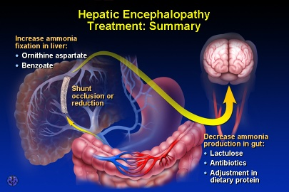

Slide 122
Four Stages of Hepatic Encephalopathy
Stage Symptom
I Mild confusion, agitation, irritability, sleep disturbance, decreased attention
II Lethargy, disorientation, inappropriate behavior, drowsiness
III Somnolence but arousable, incomprehensible speech, confusion, aggression when awake
IV Coma

Slide 123
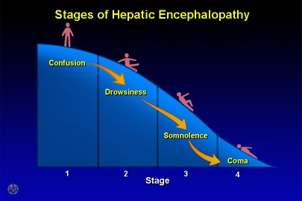

Slide 124
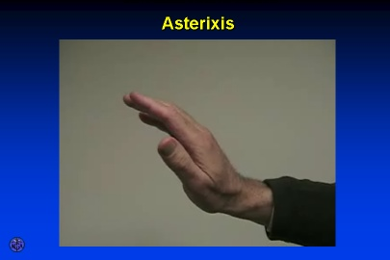

Slide 125

Hepatic Encephalopathy
Stages
0-1st
Insomnia
Personality changes
Disturbances of awareness
Forgetfulness, irritability, & confusion
Trouble writing

Slide 126
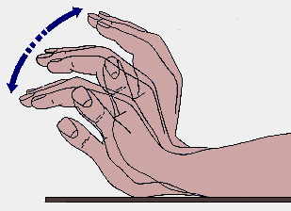
Hepatic Encephalopathy
Stages
2nd & 3rd
Lethargy, drowsiness
Inappropriate speech
  Slurred speech
Disorientation
Asterixis
  flapping tremors
Hiccups
Hyperactive reflexes
Violent behavior
Slow, deep respirations
Fetor hepaticus
  musty sweet smell to breath

Slide 127
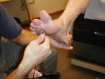
Hepatic Encephalopathy
Stages
4th
+ Babinski
Possible seizures
Swelling of brain tissue

Slide 128
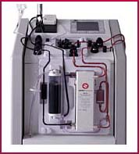
Liver Dialysis
Bridge to transplant
Dialyze 6 hours at a time

Slide 129
Donors:
Live donor liver transplants are an excellent option.
Liver regenerates to appropriate size for their individual bodies.
Survival rates increase / shorter wait time
The donor - a blood relative, spouse, or friend, will have extensive medical and psychological evaluations to ensure the lowest possible risk.

Slide 130
Liver Transplantation
Blood type and body size are critical factors in determining who is an appropriate donor.
Potential donors evaluated for:
  liver disease, alcohol or drug abuse, cancer, or infection.
  hepatitis, AIDS, and other infections.
  matched according to blood type and body size.
  Age, race, and sex are not considered.
Cadaver donor have to wait

Slide 131
Liver Transplantation
Liver transplantation is the definitive treatment for patients with decompensated cirrhosis
Depends upon the severity of disease, quality of life and the absence of contraindications

Slide 132
Thank you

