Slide 1
Shock

Slide 2
Shock
A broad term that describes a physiologic state where oxygen delivery to the tissues is inadequate to meet metabolic requirements, causing global hypoperfusion
Stages of Shock:
Compensated
Maintains end organ perfusion
BP is maintained usually by ↑ HR
Uncompensated
Decreases micro-vascular perfusion
Sign/symptoms of end organ dysfunction
Hypotensive
Irreversible
Progressive end-organ dysfunction
Cellular acidosis results in cell death

Slide 3
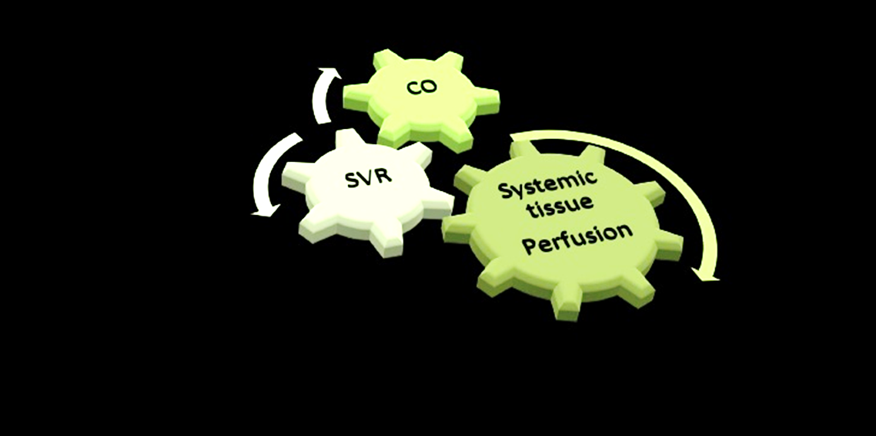
MAP = CO x SVR
HR x Stroke volume
Preload Afterload Contractility

Slide 4
1- Cardiogenic Shock: Causes
↓MAP = ↓ CO (HR x Stroke Volume) x ↑SVR
Decreased Contractility (Myocardial Infarction, myocarditis, cardiomypothy)
Mechanical Dysfunction – (Severe Aortic Stenosis, rupture of ventricular aneurysms etc)
Arrhythmia – (ventricular tachycardia, atrial fibrillation etc.)
Cardiotoxicity (B blocker and Calcium Channel Blocker Overdose)

Slide 5
2- Obstructive Shock: Causes
↓MAP = ↓ CO (HR x Stroke Volume) x ↑SVR
Heart is working but there is a block to the outflow
Massive pulmonary embolism
Cardiac tamponade
Tension pneumothorax
Obstruction of venous return to heart
Vena cava syndrome - eg. neoplasms

Slide 6
3- Hypovolemic Shock: Causes
↓MAP = ↓ CO (HR x Stroke Volume) x ↑SVR
Decreased Intravascular volume (Preload) leads to Decreased Stroke Volume
Hemorrhagic - trauma, GI bleed, ectopic pregnancy
Hypovolemic - burns, GI losses, dehydration, Diabetic Ketoacidosis

Slide 7
4- Distributive Shock: Causes
↓MAP = ↑CO (HR x SV) x ↓ SVR
Loss of Vessel tone
Septic and Toxic Shock Syndrome
Anaphylactic
Decreased sympathetic nervous system function
Neurogenic - C spine or upper thoracic cord injuries

Slide 8
Manifestations of Shock
Blood pressure dropped
Reflex tachycardia
Feeble pulse
Pale and cold skin (warm in septic shock)
Decreased urine
Increased lactic acid and acidosis
Stagnant hypoxia and cyanosis
Ischemia to brain leads to fainting and brain damage
Notes:
Notes:
To determine if we are dealing with shock, there are a few tools at our disposal. The most important are the signs and symptoms.
i.e look for cardinal findings. Laboratory and hemodynamic measures can also help us, however these are often not available. Which
underscores the importance of being able to identify shock early with our clinical history and physical.
Slides 32-35 describe the signs and symptoms associated with pre-shock and shock

Slide 9
Empiric Criteria for Shock
4 out of 6 criteria have to be met
Ill appearance or altered mental status
Heart rate >100
Respiratory rate > 22 (or PaCO2 < 32 mmHg)
Urine output < 0.5 ml/kg/hr
Arterial hypotension > 20 minutes duration
Lactate > 4
The shock index
is easily calculated (heart rate divided by systolic blood pressure) and can provide clues to the severity of the patient's condition.
A normal index ranges from 0.5-0.7; repeated values >1.0 indicate decreased left ventricular function and are associated with higher mortality.
Notes:
Notes: to standardize the diagnosis of shock, 4 of these 6 criteria have to be met to define shock

Slide 10
Laboratory values should be examined, but do not wait for results to begin your treatment.

Slide 12
Treatment of Neurogenic Shock
Resting a recumbent or head down position.
Narcotic analgesic (morphine) to relieve pain and allay anxiety.
Sympathomimetics to elevate the blood pressure.
Treatment of cardiogenic Shock
Dopamine or dobutamine (see ANS)
Intravenous fluids to correct hypovolemia.
Vasodilators e.g. sodium nitroprusside, or vasoconstrictors e,g, noradrenaline as necessitated by the condition of the patient.

Slide 13
Treatment of Hypovolaemic Shock
In case of blood loss, blood transfusion is prefered. When compatible blood is not available, a transfusion of human plasma or plasma substitute may be given instead.
In case of plasma loss, plasma transfusion is necessary.
In case of severe vomiting, saline is used.
In case of severe diarrhea, saline and sodium lactate.
alpha adrenergic blocking agent phenoxybenzamine was advocated in the treatment of shock only after full replacement of I.V. fluid volume with blood or other appropriate fluids.
Dopamine (see ANS).
Cortisone.

Slide 14
Treatment of Septic Shock
This may occur as a result of severe infections, especially with Gram-negative organisms.
The objective is to improve tissue perfusion and treat the underlying infection.
Antibiotics
Corticosteroids in high doses.
Dopamine or Dobutamine for cardiovascular support.
Initial fluid should be balanced salt solution.
Maintain ventilation.

Slide 15
Treatment of Anaphylactic Shock
This could result from an antigen-antibody reaction by hypersensitive individuals.
Treatment
Place the patient in recumbent position.
Adrenaline is a drug of choice.
Glucocorticoids (hydrocortisone 100-250 mg I.V.).
Antihistaminics (H1 antagonists).
Aminophylline I.V. very slowly if bronchospasm is severe.
Plasma transfusion in severe cases.

Slide 16
Resuscitation of a shock state
is thought to be successful when the following occurs:
normalization of hemodynamic state (BP, HR, and urine output)
lactate decreases by half in the first couple of hours
normal volume status restored
maximal tissue oxygenation
resolution of acidosis and return to normal metabolic parameters

Slide 17
Case 1
24 year old male
Previously healthy
Lives in a malaria endemic area (PNG)
Brought in by friends after a fight - he was kicked in the abdomen
He is agitated, and won’t lie flat on the stretcher
HR 92,
BP 126/72,
SaO2 95%,
RR 26
Notes:
Instructions: Ask the learner if the patient in Case 1 is in Shock? If say yes - challenge with “but the blood pressure is normal”.
Answer: The patient is in shock because:
-his respiratory rate is increased (tachypnea is a compensatory mechanism for early metabolic acidosis)
-he is also agitated which means he has altered mental status due to end organ lack of perfusion and dysfuction

Slide 18
Case 2
23 year old woman
Has been fatigued and short of breath for a few days
She fainted and family brought her in hospital
They tell you she has a heart problem
HR 132, BP 76/36, SaO2 88%, RR 30, Temp 36.3
Appearance - obtunded
Cardiovascular exam - S1, S2, irregular, holosytolic murmer, JVP is 5 cm ASA, no edema
Chest - bilateral crackles, accessory muscle use
Abdomen - unremarkable
Rest of exam is normal

Slide 19
Case 3
36 year old woman
Hitted by a car
She is brought into the hospital 2 hrs after accident
Short of breath
Has been complaining of chest pain
HR 126, SBP 82, SaO2 70%, RR 36, Temp 35
Obtunded, Accessory muscle use
Trachea is deviated to Left
Heart - distant heart sounds
Chest - decreased air entry on the right, broken ribs, subcutaneous emphysema
Abdominal exam - normal
Apart from bruises and scrapes no other signs of trauma

Slide 20
Fluid replacement therapy

Slide 21
BLOOD TRANSFUSION
Blood is obtained from human volunteers by aseptic technique and is stored between +2 to +6 C° to limit bacterial growth.
It is kept in sterile bottles containing citrate-phosphate-dextrose-adenine. Citrate acts as anticoagulant and dextrose is required for RBCs metabolism.
As a general rule, banked blood should be infused within 21 days of withdrawal from the donor. Blood is considered fresh when it is infused within 4 days of withdrawal.

Slide 22
Types of Blood
Whole blood
Packed RBCs.
Indications
Haemorrhage to restore blood volume
Severe chronic anemia to improve O2 carrying capacity Haemolytic anemia to combat shock.
Fresh blood transfusion used to restore certain blood elements
To increase RBCs in anemia.
To increase leucocytes in leucopenia.
To increase platelets in thrombocytopenia.
To increase prothrombin in hypoprothrombinaemia.
To increase plasma proteins in hypo proteinaemia.

Slide 23
Advantages of Blood: It contains all elements of blood (RBCs, plasma, platelets, leucocytes, antibodies).
Complication of Blood Transfusion
Pyrogenic reactions: occurs due to pyrogens, may occur with haemolytic reactions or due to pyrogens present in the anticoagulant solution or bottle.
Treatment:
Slow rate of infusion
Warming the patient
Antihistaminic
Sedatives

Slide 24
Allergic reactions in patients with history of allergy due to presence of antigen in the donor' s blood. It may be in form of rigors, fever, urticaria, oedema, rarely asthma, laryngeal oedema and anaphylactic reactions.
Treatment: stop transfusion, adrenaline, antihistamine, corticosteroids.
Heart failure due to transfusion of large amount of blood (circulatory overload).
Haemolytic reactions: due to blood groups incompatibility.
Hyperkalaemia due to transfusion of haemolysed RBCs.
Transmission of certain diseases e.g. infective hepatitis, malaria, syphilis, AIDS.

Slide 25
Precautions during Blood Transfusion
The donor should be free from blood transmitted disease.
Blood grouping and cross matching should done to avoid incompatibility.
Blood should not be used if there is haemolysis or if plasma is turbid (if blood is stored for 3 weeks).
The first 100 ml of blood should be infused slowly to allow early detection of any reactions.
Transfusion should not be too rapid or over transfusion which may lead to heart failure or pulmonary edema.
Medications should never be added to the blood in transfusion.

Slide 26
PACKED RBCs
60-80% of plasma is removed immediately after collection. Preferred in anemic patients.
Advantages:
High oxygen carrying capacity with minimal volume expansion
Lower risk of hepatitis because the organisms present in plasma.
Less in citrate, antigenic debris and plasma protein.

Slide 27
PLASMA
Types:
1-Fresh frozen plasma
Prepared from fresh whole blood and frozen at - 18 C° or lower.
It maintains all known clotting factors including prothrombin for minimum of one year.
Used in specific or multiple clotting factors replacement.
2-Liquid plasma (non-frozen plasma)
It is prepared from the blood after its expiration date.
It can be stored for 2 years at 2 - 10 C°.
Not contain prothrombin (because it is destroyed in few hours in room temperature).
Used mainly as a volume expander in shock

Slide 28
3-Albumin and human plasma protein fraction
It is a sterile solution of proteins derived from normal human plasma.
Stored at 2-10 C° for up to 5 years.
Used as volume expanders, in burns and in hypoproteinaemia states.
4- Dried plasma
It can be stored for 5 years
It does not contain prothrombin

Slide 29
PLASMA SUBSTITUTES (Expanders)
Hypovolaemic shock can occur either due to loss of blood or plasma and also occurs due to excessive loss of fluid and electrolytes.
Shock of dehydration occurs due to loss of fluid and electrolytes as in cholera, addisonian disease, diabetic ketoacidosis and burn.
In these conditions the deficit may be corrected by simple replacement of fluid and electrolytes (crystalloids).

Slide 30
Types:
Colloidal preparations:
Human protein e.g. albumin.
Animal protein e.g. gelatin
Polymerized carbohydrates: Dextran, pectin.
Crystolloids preparations:
Saline (normal 0.9% or half normal 0.45%)
Glucose 5%.
Na lactate or lactate ringer solution

Slide 31
Indications:
Treatment of haemmorhage in the absence of blood
Treatment of hypoproteinaemia (albumin).
To increase the volume of plasma in case of plasma loss.
Crystalloid are used in:
Dehydration due to vomiting or diarrhea
As vehicle for drugs given by infusion.
Advantages: as plasma

Slide 32
Disadvantages:
No O2 carrying capacity.
No prothrombin.
Human protein is expensive
Animal protein is antigenic and causes renal damage.
Polymerized carbohydrate
Dextran: acts as antigenic and interferes with blood groups.
Crystalloids: their use as plasma substitute is limited because they are isotonic, so they remain in blood for long time.

