Slide 1
Heart failure
By
Dr.Mohamed Abd Almonein Attia

Slide 2
According to state of the COP:
High COP failure:
Occurs when the heart fails to pump enough blood to meet the metabolic demands of the tissue although there is increased all cardiac properties but it exceeds physiological limits e.g. In hyperthyroidism the metabolic demands are greater than normal, or in severe anemia where tissues require a greater volume of blood to supply normal metabolic need.
The heart increases its work to match the high tissue need, but finally fails.
The aim of therapy in this condition is to treat the cause.
Low output failure (congestive):
Occurs when the heart is unable to pump all the blood filling the ventricles. Inability of the heart to pump sufficient blood to meet the body’s need.
The aim of therapy in this condition is to strengthen the cardiac ms (e.g. by a +ve inotropic drug)
There is pathology in the heart.

Slide 3
Classification of heart failure:
1-According to clinical presentation:
Acute heart failure:
Heart failure of sudden onset (hours or days).
The aim of therapy is to ↓ both afterload and preload (e.g. by mixed VDs).
Chronic heart failure:
Heart failure develops slowly (months).
Occurs de novo or follows AHF.

Slide 4
Chronic | Acute
Weeks or Months | Sudden (Hours–a few days) | Time factor
a) Chronic hypertension (b) Chronic valvular diseases (d) Chronic lung diseases (e) Chronic severe anaemia (f) Chronic thyrotoxicosis | a) Acute coronary artery occlusion with infarction or arrhythmia (b) Pulmonary embolism (c) Severe malignant hypertension (d) Acute toxic myocarditis | Causal diseases
-Chronic edema and chronic venous congestion | Acute pulmonary edema may occur. -May be acute ischaemic effects in brain and kidneys - No chronic edema or chronic venous congestion. | Effects

Slide 5
Causes of Heart Failure
coronary artery disease (CAD)
myocardial infarction (MI), with scar tissue that interferes with the heart muscle's normal work (Systolic Dysfunction)
Sustained high blood pressure (Diastolic Dysfunction)
heart valve disease
primary disease of the heart muscle itself, called cardiomyopathy.
congenital heart defects.
infection of the heart valves and/or heart muscle itself — endocarditis and/or myocarditis
Diabetes
Obesity
Advancing age
Chronic alcoholism
High cholesterol

Slide 6
2-According to anatomy:
Left-sided heart failure:
The problem is in the left side (usually due to systemic hypertension or aortic valve disease).
The cardinal manifestations are those of pulmonary congestion e.g. tachypnea, dyspnea (difficulty in breathing), orthopnea (dyspnea on lying back), paroxysmal nocturnal dyspnea, and cough with expectorations.
Signs: left ventricular hypertrophy, bilateral basal lung crepitations, and gallop (3rd heart sound).

Slide 7
Right-sided heart failure:
The problem is in the right side (usually due to pulmonary hypertension or lung disease).
The cardinal manifestations are those of systemic congestion e.g. congested neck veins, congested liver, bilateral leg edema, right ventricular hypertrophy, etc.
Total heart failure (congestive heart failure “CHF”):
Combination between the two.

Slide 8
Right Ventricular failure | Left Ventricular failure
-Peripheral edema -Weakness, fatigue | -Shortness of breath -Dyspnea on exertion -Orthopnea -Paroxysmal nocturnal Dyspnea -Weakness, fatigue | Symptoms (Subjective)
-Right ventricular hypertrophy (RVH) -Weight gain (fluid retention) -Neck vein distension - Tachycardia -Hepatomegaly -Hepatojugular reflux (applying pressure to the liver may cause further distension of the neck veins if hepatic venous congestion is present) | -Left ventricular hypertrophy (LVH) -Rales, (crepitation & ronchi), S₃ gallop rhythm -Reflex tachycardia | Signs (Objective)

Slide 9
STAGE |  | DISABILITY
CLASS 1 MILD |  | No symptoms Can perform ordinary activities without any limitations
CLASS 2 MILD |  | Mild symptoms - occasional swelling Somewhat limited in ability to exercise or do other strenuous activities
CLASS 3 MODERATE |  | Noticeable limitations in ability to exercise or participate in mildly strenuous activities Comfortable only at rest
CLASS 4 SEVERE |  | Unable to do any physical activity without discomfort Some HF symptoms at rest

Slide 10
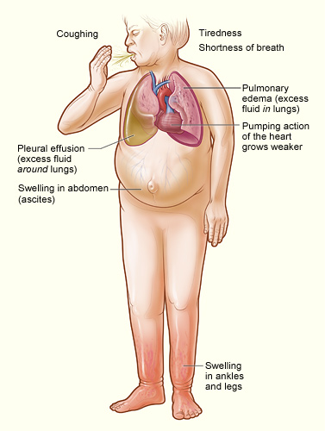
Heart Failure

Slide 11
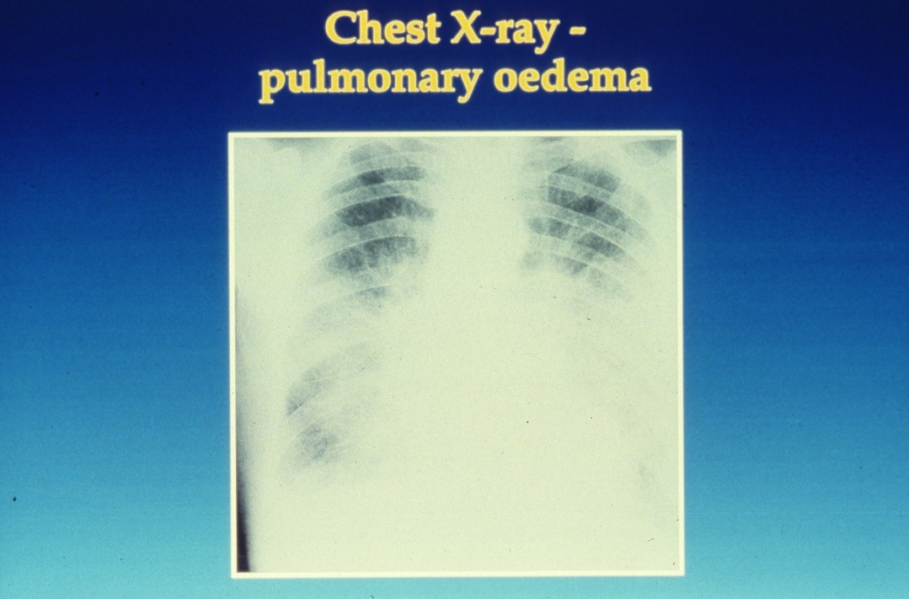

Slide 12
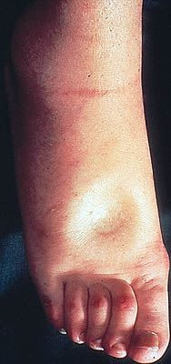
Pitting Edema

Slide 13
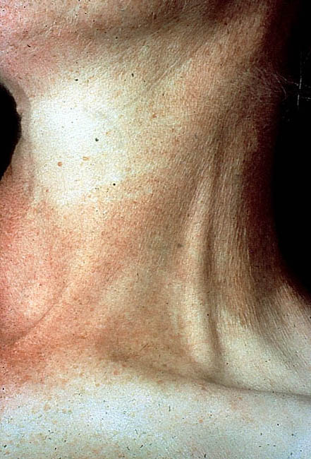
Distended Jugular Vein

Slide 14
What Are The Symptoms of Heart Failure?
Think FACES...
Fatigue
Activities limited
Chest congestion
Edema or ankle swelling
Shortness of breath

Slide 15
Patho-Physiology of heart failure

Slide 16
How Do I Know if I Have Heart Failure ? by
Investigations:
Electrocardiography (ECG): shows left or right ventricular hypertrophy or ischemia.
X-ray: reveals left ventricular and left atrial enlargement, signs of lung congestion.
ECHO: show dilated heart, impaired contractility, other pathology in the heart and measurement of ventricular function e.g. ejection fraction.
Ejection fraction: it is percent of ventricular volume expelled during systole. It is more than 60% normally. In CHF it is less than 40%.

Slide 17
Treatment of heart failure
Non-drug therapy = life style modification:
Rest.
Dietary sodium and fat restriction.
Weight reduction.
Stop smoking, coffee, and alcohol.
Encourage mild exercise.
Control of risk factors:
Surgical correction of valvular diseases.
Treatment of hyperthyroidism, hypertension, etc.
Avoid drugs that ↑ BP: e.g. sympathomimetics, cortisone, sodium containing drugs, carbenoxolone, etc.

Slide 18
Bed rest:
Decrease the metabolic demands of the failing heart,subsequently increase renal perfusion resulting in diuresis.
Sodium restricted diet: In order to decrease blood volume (It can be reduced to 2-4 gm of NaCl by eliminating cooking salt).

Slide 19
Usual treatment today has two aims
Aims of heart failure management
To improve symptoms
Diuretics:
Digoxin
ACE inhibitors (V.D)
To improve survival
ACE inhibitors and ARBs
β Blockers:
Spironolactone
Davies et al. BMJ 2000;320:428-431

Slide 20
Diuretics:
Indications in HF:
1-Furosemide and bumetanide are the most effective and commonly used alsoin severe cases of HF
2-Thiazide are used in mild to moderate HF
3-K⁺-retaining diuretics are used in HF associated with hyperaldosteronism. Also, spirnolactone minimize potassium loss, prevent sodium and water retention, endothelial dysfunction and myocardial fibrosis.
Mechanism in HF:
They ↓ ECF volume and prevent and fluid retention.
They ↓ pulmonary congestion and improve tissue oxygenation.
They ↓ preload and afterload.

Slide 21
Vasodilators:
Mechanism in HF:
Arteriolodilators → ↓ BP (afterload) → ↓ myocardial strain and myocardial O₂ demand.
Venodilators → ↓ VR (preload) → ↓ heart work and myocardial O₂ demand.
ACEIs: See before

Slide 22
Vasodilators :
Isosorbide dinitrate and hydralazine also used specially in patients who cannot tolerate ACE inhibitors.
Amlodipine and prazosin are other vasodilators can be used in CCF.
METHYLXANTHINES
They act by increase concentration of cAMP ,increase intracellular calcium and blockade of adenosine receptors e.g. aminophylline.

Slide 23
Beta blockers in CCF

Slide 24
Rational for use of β-blockers in heart failure:
The use of beta blockers in the treatment of CHF is potentially hazardous and patients must be selected carefully
β-blockers are generally not recommended in heart failure because they produce –ve inotropic effect and cardiac decompensation.
In spite of this, β-blockers may have some benefits in heart failure because most patients with HF have ↑ sympathetic activity.
Beneficial effects of β-blockers in HF:
Have been demonstrated to reduce morbidity and mortality in mild/moderate and severe heart failure by 30%
Should be used only when a patient has been stabilized and not during an acute presentation
Specialist use only
Start at low dose and monitor for bradycardia
β-blockers ↓ tachycardia and myocardial O₂ demand.
β-blockers ↓ blood pressure and reduce ventricular strain associated with HF.
β-blockers ↓ cardiac remodeling through inhibition of the mitogenic activity of catecholamines and renin-ang-II system.
Carvedilo Also, BISOPROLOL and METOPROLOL
l is a new beta-blocker with additional VD and antioxidant properties.
Beta blockers are used in selected patients (mild/moderate failure, low dose)

Slide 25
Beta-blockers are specially indicated in the following cases:
1-HF associated with ↑ sympathetic overactivity.
2-HF associated with pheochromocytoma.
3-HF associated with thyrotoxicosis.

Slide 26
Positive inotropic drugs:
Digitalis
Dopamine and dobutamine (used for short term only).
Phosphodiesterase (PDE) inhibitors: amrinone and milrinone.

Slide 27
Cardiac glycosides (digitalis)

Slide 28
Cardiac Glycosides
Oldest and most effective group of cardiac drugs.
Comes from the plant “fox glove”.
Digoxin or Lanoxin is the only commonly used digitalis glycoside. Can be given orally or IV

Slide 29
Pharmacokinetics

Slide 30
Mechanism of action:
1. Positive inotropic action:
Digitalis ↑ cardiac contractility by increasing free intracellular Ca²⁺ through inhibition of membrane-bound Na⁺/K⁺ ATPase enzyme. This result in inhibition of Na⁺/K⁺ pump with subsequent accumulation of intracellular Na⁺ and Ca²⁺ via:
↑ Ca²⁺ release from the sarcoplasmic reticulum.
Displacement of intracellular Ca²⁺ from its binding sites.
↑ Ca²⁺ entry into the cardiac ms cells.
↓ exchange of extracellular Na⁺ for the intracellular Ca²⁺.

Slide 31
Autonomic effects:
It restores the vagal tone and abolishes the sympathetic over activity.
a. Vagal actions:
Direct stimulation of central vagal nucleus.
Reflex vagal stimulation due to increased sensitivity of baroreceptors.
b. Sympathetic action:
In therapeutic doses, digitalis reduces sympathetic discharge to the heart but toxic doses may increase cardiac sympathetic activity.

Slide 32
Pharmacological effects:
CVS:
↑↑ Cardiac contractility and COP leading to better tissue perfusion.
HR: Bradycardia due to:
Vagal effect: …..see before
Extravagal effects:
Direct inhibition of the A-V conducting system.
↓ sympathetic discharge to the heart due to relieve of hypoxia and improved hemodynamics.

Slide 33
Conduction velocity:
Atrial conduction: small dose ↑ it (vagal stim) but large dose ↓ it (direct effect).
A-V conduction: ↓↓ by direct and vagal effects.
Purkinje fibers: ↓ by direct effect only.
Excitability: small dose ↑ excitability while large dose ↓ it.
In cases of CHF, digitalis may ↓ excitability 2ry to relief of hypoxia.
Automaticity: ↑… Digitalis increase the ability of ventricular muscles and Purkinje fibers to generate ectopic beats leading to arrhythmia of any type (usually bigeminy, trigeminy, heart block, etc.). The causes of this arrhythmia are:
Accumulation of intracellular Na⁺ and loss of intracellular K⁺.
Digitalis ↓ A-V conduction leading to varying degree of heart block.
Digitalis ↓ action potential duration.

Slide 34
ECG changes:
*↑ PR interval (due to ↓ A-V conduction).
*Tall R wave (due to ↑ ventricular contraction)
*↓ QT interval.
*ST segment depression and T-wave inversion.
*Arrhythmia of any type.
*Normalization of arterial and venous pressures due to improved hemodynamics.

Slide 35
Kidney effects: ↑ diuresis “The best diuretic in case of CHF is digitalis” due to:
↑ COP → ↑ RBF and ↑ GFR.
↓ Na⁺ reabsorption due to inhibition of Na⁺/K⁺ ATPase enzyme in the tubular cells.
Competitive antagonism with aldosterone (steroid structure).
GIT effects:
Stimulation of CTZ → nausea and vomiting.
Anorexia and diarrhea.

Slide 36
CNS effects:
CNS stimulation → excitation and convulsions (in high dose).
Stimulation of the visual area causing yellow vision
Therapeutic indications:
The major indication is chronic CHF associated with atrial fibrillation.
Treatment of heart failure failing to respond to other drugs.
Atrial flutter: (the atria beat regularly at 200-400 bpm) due to:
↓ A-V conduction and protects the ventricles from the accelerated atria.
Improvement of ventricular function.
Atrial fibrillation: (the atria beat irregularly at 400-600 bpm)
The same mechanism as atrial flutter.
Paroxysmal atrial tachycardia:
To ↓ A-V conduction → protects the ventricles from the accelerated atria.

Slide 37
Absolute contraindications:
Heart block: because digitalis ↓ conduction by direct and vagal effects.
Hypertrophic obstructive cardiomyopathy (IHSS): because increasing cardiac contractility will ↑ the outflow tract resistance and accelerate heart failure.
Wolff-Parkinson-White (WPW) syndrome: although digitalis (also BB and verapamil) ↓ conduction in the normal pathway, they can ↑ conduction in the abnormal pathway leading to ↑ arrhythmia .
Paroxysmal ventricular tachycardia: because digitalis ↑ excitability and automaticity.

Slide 38
Contraindications:
Relative contraindications:
(= Factors modifying the response to digitalis)
Bradycardia or sick sinus syndrome…. Severe bradycardia may occur.
Hypersensitive carotid sinus…………. Severe bradycardia may occur.
With beta-blockers or with verapamil… Severe bradycardia may occur.
In hypertensive HF: digitalis will ↑ the strain of the left ventricle.

Slide 39
Cardiopulmonary diseases: pulmonary hypertension, chronic lung disease, severe hypoxia, etc.
Renal or hepatic diseases: digoxin must be avoided in renal patients while digitoxin must be avoided in hepatic patients.
Myxedema: renders the heart more sensitive to digitalis.
Concomitant drugs:
Narrow therapeutic index……………………..

Slide 40
Mechanism/effect | Drug
Bind digoxin in gut and decrease bioavailability | Antacids Cholestyramine Kaolin –pectin
Increase in gut motility leads to decrease digoxin absorption. | Metoclopramide
Decrease in gut motility leads to increase digoxin absorption | Atropine Propantheline
Kill gut flora leading to decrease digoxin metabolism in the gut. | Erythromycin Tetracyclines
Decrease in renal and non-renal clearance; can increase SDC by 70%-100% | Amiodarone
Decrease in renal and non-renal clearance; also displacement of digoxin from tissue binding; SDC increase about twofold | Quinidine
Decrease in renal and non-renal clearance; SDC may increase 70%-100%. Also increase liability for heart block | Verapamil
Decrease in renal and non-renal clearance; thus increasing SDC. | Spironolactone Propafenone
Thiazides or loop diuretics may cause hypokalemia and hypo-magnesemia and increase the risk of digitalis toxicity | Diuretics
SDC = serum digoxin concentration

Slide 41
Dosage and administration:
Initial digitalization:
Slow (cumulative) method:
It is done by giving the daily maintenance dose (one tablet 0.25 mg /day → 5 days/week) from the start.
The steady state plasma conc (Cpss) will be achieved after 5 half-lives (i.e. after one week for digoxin and after one month for digitoxin).
It is the safest method for digitalis administration.

Slide 42
Rapid (loading) method:
It is done to achieve early Cpss and in emergency conditions e.g. in acute heart failure or in rapid AF.
2 tablets (0.5 mg) twice daily for 2 days then maintain on one tab/d (2x2x2)
2 tablets (0.5 mg) t.d.s for one day then maintain on one tab/d (2x3x1)
Maintenance dose: 0.25 mg/day, 5 days/week (AF requires slightly higher dose).
The optimum therapeutic plasma level is 1-2 ng/ml
Arrhythmia occurs when level exceeds 2 ng/ml

Slide 43
Evaluation of EffectivenessAssessment of response to digitalis:
Relief of dyspnea and orthopnea.
Relief of tachycardia and tachypnea.
Relief of edema, lung congestion, and fatigue.
Improvement of physical performance(Decreased fatigue).
Increased urinary output
Decreased shortness of breath, dyspnea and crackles
Improved peripheral pulses.
Serum digoxin levels 0.5 to 2 ng/mL.

Slide 44
Precautions during digitalis therapy:
Never give digitalis i.v. before being sure that the patient has not received digitalis during the last 14 days to avoid digitalis toxicity.
Continuous monitoring of plasma K⁺ level.
Reduce digoxin dose in elderly people because renal function is ↓.
Mention other factors modifying the response to digitalis.

Slide 45
Digitalis toxicity
Predisposing factors:
Hypokalemia or hypercalcemia.
Elderly patients (↓ renal function).
Renal or hepatic impairment.
Excessive digitalis therapy.
Manifestations:
Cardiac:
Bradycardia and variable degree of heart block.
Paroxysmal atrial tachycardia
Any type of arrhythmia (e.g. ventricular premature beats, bigemeny, trigemeny, ventricular tachycardia, etc.)

Slide 46
Extracardiac:
GIT: anorexia, nausea and vomiting (due to ++ of CTZ).
CNS: headache, delirium, hallucination, and convulsions.
Vision: yellow vision , diplopia, etc. due to retrobulbar neuritis.
Others: skin rash, gynecomastia, galactorrhea.

Slide 47
Management:
Stop digitalis administration.
Correct hypokalemia:
Stop drugs that cause hypokalemia (e.g. diuretics).
Give K⁺ either i.v. or oral (2 gm/4 h).
Antiarrhythmic drugs:
Lidocaine (in ventricular arrhythmia): 1-2 mg/kg i.v. bolus then 1-2 mg /min i.v.i.
Phenytoin (in ventricular arrhythmia): 100 mg i.v.i. (anti-arrhythmic of choice).
Atropine: if there is bradycardia or heart block.
Beta-blockers: if there is tachyarrhythmia.
Specific digitalis antibodies (Fab fragments) to bind digitalis and ↑ its excretion (the most specific therapy).

Slide 48
Prevention of digitalis toxicity:
Avoid predisposing factors (mention all).
Therapeutic drug monitoring for digitalis therapy (mention therapeutic level)
Allow weekly drug holiday (2 days/week) to prevent digitalis cumulation.
if bradycardia (heart rate less than 60 bpm) or new arrhythmias occur. No drug intake
Take apical pulse for one full minute before giving the medication – listen for any irregular heart beats
Adults: apical pulse less than 60
Older child: apical pulse less than 60
Infant or younger child: apical pulse less than 100

Slide 49
Assess for peripheral edema and auscultate lungs for rales/crackles.
Check kidney function since you want to know they can excrete excess digoxin and avoid build up in body.
Laboratory Values :
Electrolyte imbalance: potassium, calcium and magnesium values need to be monitored
Hypokalemia (low potassium)
Hypomagnesemia (low magnesium)
Both can lead to irregular heart rate.

Slide 50
Other positive inotropic drugs:
Dopamine: It is used for short term in some cases of refractory heart failure. In moderate doses, it increases myocardial contractility by stimulation of cardiac β1 receptors. In larger doses it can cause VC due to α1 stimulation. Dopamine is used in shock states.
Dobutamine: It causes increase in COP due to stimulation of cardiac β1 receptors. It could be used in some cases of congestive heart failure and in acute myocardial infarction.

Slide 51
Phosphodiesterase (PDE) inhibitors:
Cardioactive bipyridines: Inamrinone, Milrinone
All PDE inhibitors are arrhythmogenic.
Milirnone is more potent and has fewer side effects.
Mechanism:
They inhibit PDE enzyme (type 3) → ↑ cAMP → ↑ Ca2+ influx in myocardial cells → ↑ myocardial contractility.
They have VD properties → reduction of PR with no effect on HR.
Uses: they are used in acute HF when other drugs fail.
Side effects:
Thrombocytopenia.
Cardiac arrhythmia.
Hepatotoxicity.

Slide 52
Treatment of acute pulmonary edema (cardiac asthma)
Acute pulmonary edema (APE) is one of the acute complications of left-sided HF.
Management:
Hospitalization.
Semi-setting or sitting position.
Oxygen: by oxygen mask or even hyperbaric oxygen. Oxygen will also reduce pulmonary capillary pressure and edema.
Morphine: (5 mg i.v.)
Analgesic effect → ↓ stress of the patient.
Venodilatation → ↓ VR → ↓ lung congestion.
It ↓ pulmonary stretch reflex → ↓ tachypnea → ↓ exhaustion of the patient.
Vasodilators: nifedipine or captopril sublingual, or hydralazine i.v.
Diuretics: (furosemide 40 mg i.v.)
It ↓ pulmonary wedge pressure → ↓ pulmonary edema.
Diuretic effect and ↓ ECF volume (preload).
It ↓ systemic BP (afterload).
Rapid digitalization (0.25 mg i.v.): provided that there are no contraindications.
Aminophylline: (250 mg slowly i.v.)
It causes bronchodilatation.
It ↑ myocardial contractility.
It ↑ RBF → diuretic effect.
Treatment of the precipitating factor: e.g. hypertension.

Slide 53
Case
Male patient aged 58 years old admitted with a chief complaint of increasing shortness of breathing. He mentioned that his blood pressure was high.
General Examination: reveals a dyspneaic, cyanotic, tachycardic patient with the following: blood pressure 220/120mm Hg, respiratory rate 28/minute . On cardiac examination S₃ gallop is heard. Chest examination reveals bilateral rhonchi. The patient was diagnosed as acute left sided heart failure.
Investigations
Laboratory values:
Potassium 3.2 m Eq/L
Sodium 132 m Eq/L
Creatinine 0.8mg /dl
PaO₂ 60mm Hg, PaCO₂ 42mm Hg
Chest X-Ray:
Shows bilateral pleural effusions and cardiomegaly.

Slide 54
Questions:
What are your objectives for treatment of this patient?
What are the main groups of drugs, which could be used for treatment of hypertension?
Which group/s do you prefer for this patient and why?
What is the diuretic of choice in this patient and what is the rational for its use?
What is the possible cardiovascular side effect of diuretic?
How can you correct hypokalaemia?
As regard ACEIs, what is the rational for their use in this patient?
What are the precautions during use of these drugs?
What are the absolute contraindications for use of ACEIs.
If this patient taking ACEIs and complains of dry cough what is the possible cause and how can you treat it?
If this patient taking ACEIs and complains of angioedema what is the possible mechanism and what is the alternative?
After two weeks of treatment you decided to add digitalis. What are the beneficial effects of digitalis in heart failure?
Which digitalis glycoside preparation should this patient receive?
How should digitalis therapy be evaluated?
What are the signs and symptoms consistent with digitalis toxicity?
How digitalis toxicity is treated?

